Slide 1
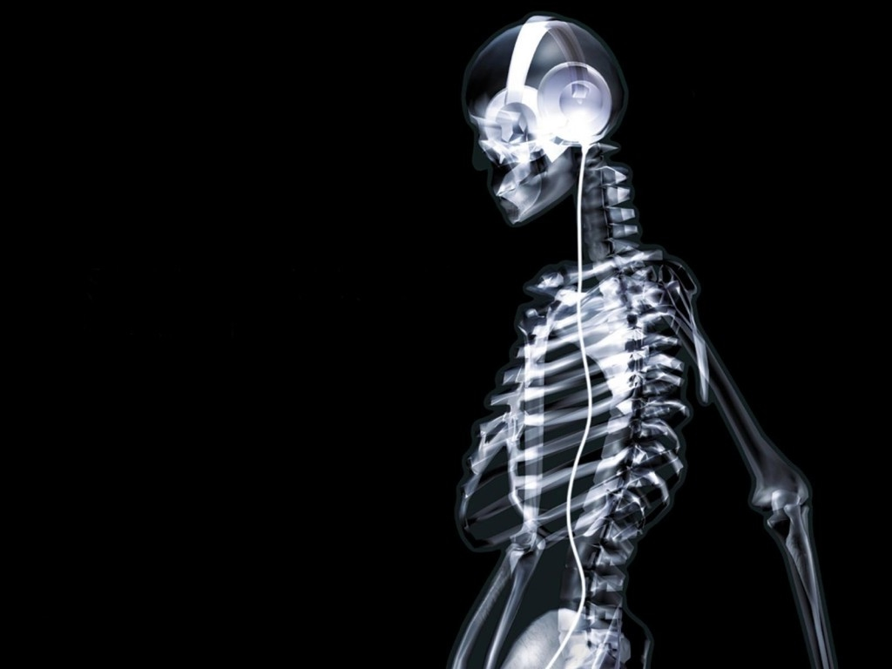
Feb. 29, 2016 / Please Do Now
Sharpen Pencil
Collect Please Do Now, chrome book, pen/pencil that works
Take out planner, write in homework / Finish Skeletal System Foldable
Complete Please Do Now

Slide 2
Review How to Solve for Speed
Grade Please Do Now as a class

Slide 3
Essential Question
How would you be able to do simple movements like; give a hug, bend at the knee to pick up something, text your friend and so forth if you did not have joints? How do joints help you do the things listed above? Explain.
Try to stand up with out bending your knees
Try to pick your pencil up with out bending your fingers
Based off of your physical observation (physically doing items listed above) answer the essential question.

Slide 4
The Skeletal System
Students will watch the clip below and add new data to engage question.
Students will pair share new data collected
The class will discuss new information collected
Students will apply this knowledge to complete skeletal system foldable on own
https://www.youtube.com/watch?v=o6uog6zt79Y

Slide 5
Skeletal System Foldable
Teacher explains/model expectations and procedures for completing the foldable.
Teacher Shows/Explains the Skeleton Inter-active and CK12 on Skeletal System Joints
CK12:
http://www.ck12.org/life-science/Skeletal-System-Joints-in-LifeScience/?referrer=concept_details&by=ck12&difficulty=all#real_world
Skeletal System Inter-Active:
http://www.childrensuniversity.manchester.ac.uk/media/services/thechildrensuniversityofmanchester/flash/skeleton.swf

Slide 6
Exit Slip
How would you be able to do simple movements like; give a hug, bend at the knee to pick up something, text your friend and so forth if you did not have joints? How do joints help you do the things listed above? Explain.

Slide 7
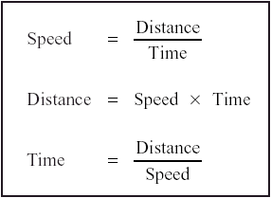
Monday, Please Do Now
Name:
Class Period:
1. Jim travels 45 miles at 15 mph.
How long does it take him? (Show your work)
Answer:

