Slide 1
Feb. 27, 2018
Collect PDN From Basket by door / 6th=Blue 7th=Green
Sharpen Pencil
Sit 1 boy / 1 girl per table unless teacher has personally assigned you a seat/spot
Complete PDN on own

Slide 2
Agenda
7th Grade
1. PDN
2. Biodiversity Power Point
3. DOL / Exit Slip
6th Grade
1. PDN
2. Plant Cell Diagram
3. DOL / Exit Slip

Slide 3
LO’S
7th Grade
We will identify what biodiversity and the three main types of biodiversity are.
6th Grade
We will create a diagram of a plant cell to compare/contrast the different organelles structure and function.

Slide 4
DOL’S
6th Grade
I will complete an exit slip to explain 2 organelles that a plant cell has that an animal cell does not.
7th Grade
I will complete an exit slip to explain what biodiversity is, the definition.

Slide 5
TEKS
7th Grade
7.10 (B) describe how biodiversity contributes to the sustainability of an ecosystem
6th Grade
6.12 (D) differentiate between structure and function in plant and animal cell organelles, including cell membrane, cell wall, nucleus, cytoplasm, mitochondrion, chloroplast, and vacuole

Slide 6
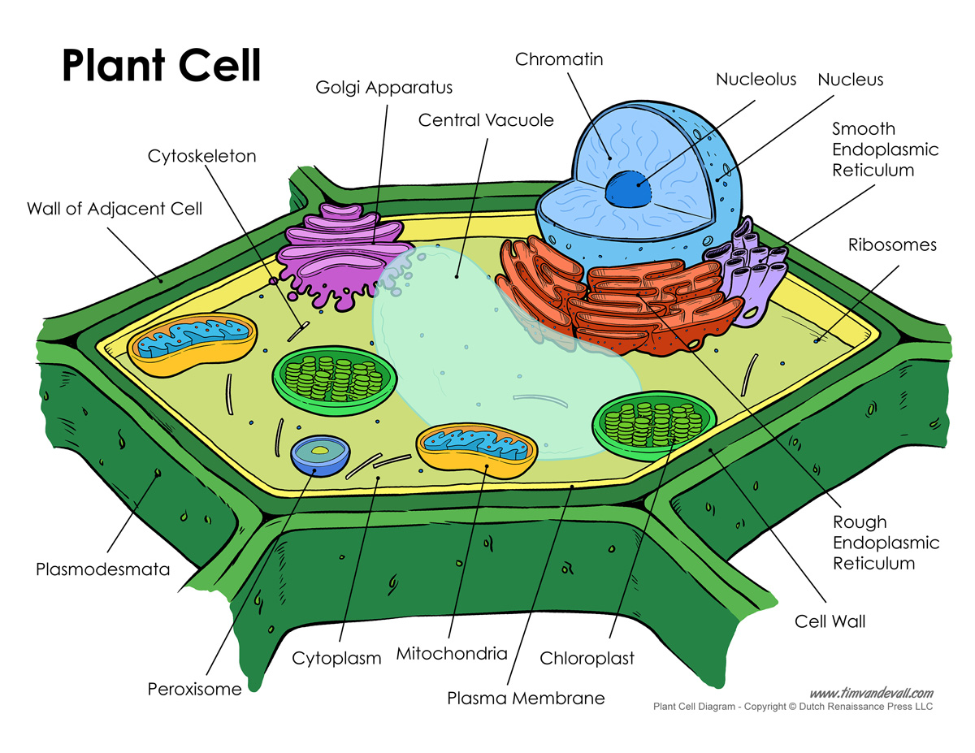
6th Grade Plant Cell Diagram
Color the organelles found in a plant cell ( remember to color code your plant cell organelles with your animal cell organelles for your key)
Cut out organelles without labels (see diagram in scavenger hunt foldable for assistance)
Glue organelles in the correct location with in the plant cell
Cut out / Glue plant cell onto same sheet as the animal cell diagram
Label all organelles within the plant cell
Make/complete a key for both plant and animal cell to explain function of each organelle

Slide 7
6th Grade Exit Slip
On yellow post it note, write first/last name and class period
Answer the question below..
What 2 organelles does a plant cell have that an animal cell does not?

Slide 8
7th Grade Brainstorm
List 3 things you think are examples of what biodiversity is.
Put your name and class period on the back of the post-it note
Waite for teacher directions to continue

Slide 9
Brainstorm continued…
Discuss with 2 other students who are sitting near you, ones you do not have to get out of your seat to discuss with what you wrote.
Add new information collected to your post it note.
Regroup and discuss findings as a class

Slide 10
Bill Nye on Biodiversity…
Teacher will stop video clip to assist with answering note outline.
Students will complete note outline over biodiversity.
https://www.schooltube.com/video/8e1097409b914b60be69/Bill%20Nye%20Biodiversity

Slide 11
7th Exit Slip
Write first/last name and class period on post-it note
Answer the question/statement below in complete sentences on post-it note.
I will explain what biodiversity is in an exit slip.

