Slide 1
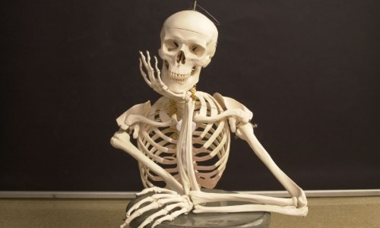
Feb. 26, 2016 / Please Do Now
Sharpen Pencil
Collect Please Do Now, Chrome Book, pen/pencil that works
Take out Planner , write in homework / Study Human Body Systems Vocabulary
Complete Please Do Now for Friday

Slide 2
Essential Question / TEK 7.12B
What would happen if all our bones turned super soft like play dough? What 2 body systems would this effect? Explain.

Slide 3
The Skeletal System Play Dough Activity
Lab Power Point is on website under 5th 6 weeks
www.coachpease.com
Click on 5th 6 weeks
Click on Skeletal System Play Dough Activity
Take out journal to record notes in

Slide 4
Virtual Lab Activity/Foldable
Teacher will pass out foldable, explain/model how to complete foldable
Students will work on virtual activity as teacher works with small groups.

Slide 5
Exit Ticket
What would happen if all our bones turned super soft like play dough? What 2 body systems would this effect? Explain.

