Slide 1
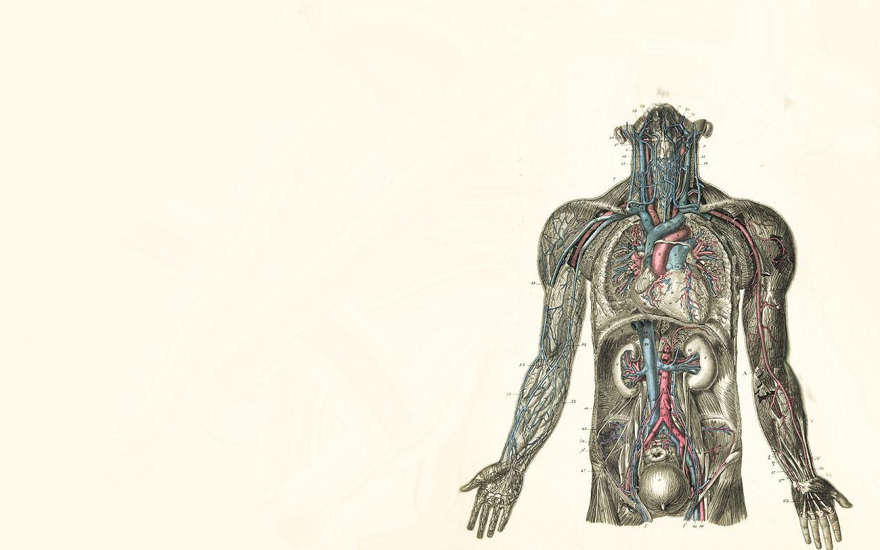
Feb. 23, 2016 / Please Do Now
Sharpen Pencil
Collect Please Do Now from counter in front of G. Pigs
Take our planner, journal and pen/pencil that works
Complete the “Tues” Please Do Now on your own

Slide 2
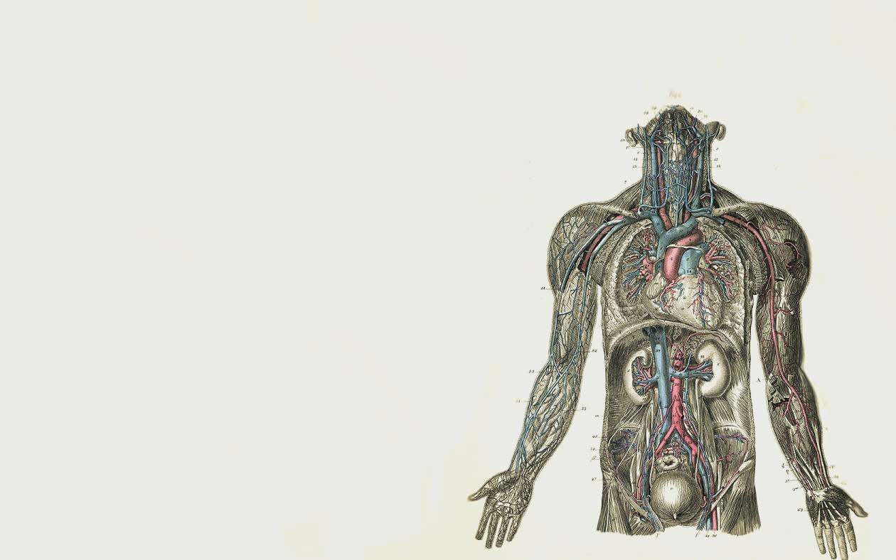
Human Body System Virtual Card Sort
Login to www.coachpease.com
Click on Games
Scroll to Human Body Systems
Click on Human Body System Quizlet Vocabulary
https://” and go through complete set 2 times
Click on “Scatter” quizlet.com/12054122/human-body-systems-quizlet-flash-cards/
Click on “Flashcards and see what the fastest time you can complete the vocabulary scatter.

Slide 3
Essential Question / Answer in your journal…
If your nose is runny, your body hurts all over, your chest hurts and you are having the chills; would you be able to tell the doctor what systems where not working correctly in your body? Could knowing this information be helpful in helping to make your self feel better? Explain Why or Why not.

Slide 4
Scavenger Hunt
Teacher will explain expectations for behavior and classwork during the scavenger hunt.
Student will be given 1 graphic will go on scavenger hunt to organizer to guide scavenger hunt and be completed for a grade.
Student find Clue Cards to assist in answering questions on graphic organizer
Students will re-group with table partners and compare answers in a pair-share
Students and Teacher will re-group and discuss answers as a class.

Slide 5
If finish early…
Login to www.coachpease.com
Click on Games
Scroll to Human Body
May play any game under Human Body

Slide 6
Exit Ticket…
If your nose is runny, your body hurts all over, your chest hurts and you are having the chills; would you be able to tell the doctor what systems where not working correctly in your body? Could knowing this information be helpful in helping to make your self feel better? Explain Why or Why not.

