Slide 1
Feb. 22, 2016 / Please Do Now
Sharpen Pencil
Collect Please Do Now from Blue Basket by Door, chrome book, journal, planner, pen/pencil that works
Write Homework into Journal
Study Human Body System Quizlet (see Links on www.coachpease.com) Vocabulary
4. Do the Please Do Now for Monday, may use journal notes to assist

Slide 2
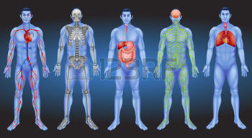
Advisory
Eat Breakfast (must be finished once announcements are done)
Complete any homework for any other class first
Collect Card sort on the 6 kingdoms
Do the card sort with a partner, NO LOUDER then a WHISPER!

Slide 3
Correct Please Do Now / Correct 4th 6 Wks Test
Students do Not grade their own Test / Please Do Now
Students may take corrected test home once Coach enters the grade to correct wrong answers with full justifications and a parent signature for a possible grade up to a 75% (better then a zero)

Slide 4
Today’s Essential Question to pair share about…
Why do you think it is important to know the different parts of your body? Could knowing this be helpful when you are sick? Explain

Slide 5
K/W/L on Human Body
1. Answer / Fill-in in small groups
2. Discuss as a class
3. Make/Complete in Journal on own

Slide 6
Human Body Scavenger Hunt
Procedures explained by teacher
Complete on own
Re-group and discuss

Slide 7
Exit Ticket
Why do you think it is important to know the different parts of your body? Could knowing this be helpful when you are sick? Explain

