Slide 1
Feb. 20, 2018
Collect PDN from basket Blue=6th / Green=7th
Sharpen Pencil
Sit 1 boy/1 girl per table, unless Coach has assigned you a certain seat
Complete PDN on own

Slide 2
Agenda
7th Grade
1. PDN
2. Round Robin Brainstorm
3. Scavenger Hunt / Foldable
4. DOL / Exit Slip
6th Grade
1. PDN
2. Round Robin Brainstorm
3. Scavenger Hunt / Foldable
4. DOL / Exit Slip

Slide 3
LO’s
7th Grade
We will identify the different biotic and abiotic factors that help to sustain life within the biomes.
6th Grade
We will identify the different organelles found within plant and animal cells.

Slide 4
DOL’s
7th Grade
I will complete an exit slip that explains 3 factors that help sustain life in a biome.
6th Grade
I will complete an exit slip to explain the what organelles are within the cell.

Slide 5
TEK’S
7th Grade
7.10 (A) observe and describe how different environments, including microhabitats in schoolyards and biomes, support different varieties of organisms
6th Grade
7.12 (D) differentiate between structure and function in plant and animal cell organelles, including cell membrane, cell wall, nucleus, cytoplasm, mitochondrion, chloroplast, and vacuole

Slide 6
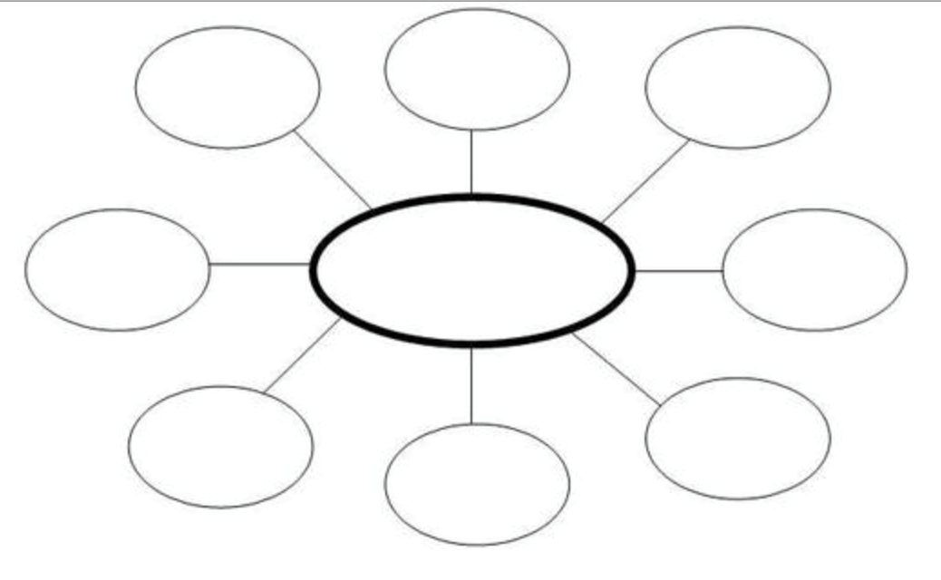
PDN: Cell Brainstorm (write 1 fact per bubble)
Cells

Slide 7
6th PRE-AP Round Robin Brainstorm
1. You will work in a teacher assigned small group.
2. Each group will get 3 minutes to read over large bubble chart on table as a group (whispers due to being at same table)
3. You will add new information to the table bubble chart that is NOT already written (remember 1 fact per bubble)
4. If there is information/facts written that are not written on own chart, add this information to your individual chart (PDN)
5. At end of 3 minutes teacher will say rotate to right, you will get 10 seconds and walk to the next table.
6. Repeat Steps 2-5 till you return to your original table

Slide 8
Round Robin Brainstorm Continued…
7. Pick 2 facts from large table bubble chart to write on small white circles teacher gives you.
8. Will regroup as a class and each group will add their facts to the class bubble chart with teacher acting as facilitator

Slide 9
Did you know that each of these cells within your body have their own set of organs that help them to function? What are these structures called?
This the question we will be researching today as we complete the scavenger hunt over the structure and function of the plant and animal cell.

Slide 10
Exit Slip for 6th Grade
What is the name of the structures within a cell that are like the organs that make up the organ systems within our own body called?

Slide 11
PDN: How an environment sustains life? Brainstorm (write 1 fact per bubble)
How does an environment sustain life?

Slide 12
7th Grade Round Robin Brainstorm (if behavior allows)
1. You will work in a teacher assigned small group.
2. Each group will get 3 minutes to read over large bubble chart on table as a group (whispers due to being at same table)
3. You will add new information to the table bubble chart that is NOT already written (remember 1 fact per bubble)
4. If there is information/facts written that are not written on own chart, add this information to your individual chart (PDN)
5. At end of 3 minutes teacher will say rotate to right, you will get 10 seconds and walk to the next table.
6. Repeat Steps 2-5 till you return to your original table

Slide 13
Round Robin Brainstorm Continued…
7. Pick 2 facts from large table bubble chart to write on small white circles teacher gives you.
8. Will regroup as a class and each group will add their facts to the class bubble chart with teacher acting as facilitator

Slide 14
If I was to walk our outside school and look around the area would it look the same as if I walked outside and looked around in an tropical rainforest? What might I see / feel that would be the same and what would be different?
This the question we will be researching today as we complete the scavenger hunt over the different biomes of the world. If behavior allows.

Slide 15
Exit Slip for 7th Grade
What are 3 factors found in every biome that help to sustain life?

