Slide 1
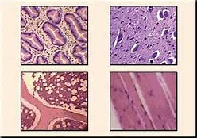
Feb. 18, 2016 / Please Do Now
Sharpen Pencil
Collect Please Do Now from blue basket on desk by door, Chrome Book
Take out to assist your Levels of Organization Foldable and Note-outline
Complete Please Do Now on your own.

Slide 2
Group Card Sort
Teacher will pass out cards to students/ 1 per student.
Students will work as a class, with teacher as facilitator to put cards in correct order in a pocket chart.
Students will check answers with answers in foldable from the day before, make corrections as needed.

Slide 3
Essential Question:
What is the process it takes to get from a single cell to the person you see looking back at you in the mirror? Explain.

Slide 4
Review Levels of Organization
in an organism
Watch the link below…
https://www.youtube.com/watch?v=ZRFykdf4kDc
Re-visit your essential question and add new information you collected from the video clip.

Slide 5
Levels Pyramid Activity
Teacher will explain/model how to make the pyramid. Students will use resources via internet to complete information.
Log into www.coachpease.com
Click on 4th 6 weeks or Links
Or Log into http://marshscience6.blogspot.com

Slide 6
Exit Slip
What is the process it takes to get from a single cell to the person you see looking back at you in the mirror? Explain.

