Slide 1
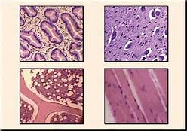
Feb. 17, 2016 / Please Do Now
Sharpen Pencil
Collect Cell Re-Take Test from blue basket on desk by door, cell organelle book on counter in front of G. Pigs.
Do NOT use a chrome book
You may use YOUR cell organelle book
Complete the Re-Take Test on your own (you will only have 15 minutes top to complete)

Slide 2
Correct Test as a Class
Students will not grade their own re-take test.
Students will see own grade and then turn into basket.

Slide 3
Essential Question:
What is the process it takes to get from a single cell to the person you see looking back at you in the mirror? Explain.

Slide 4
Review Levels of Organization
in an organism
Watch the link below…
https://www.youtube.com/watch?v=ZRFykdf4kDc
Re-visit your essential question and add new information you collected from the video clip.

Slide 5
Complete Note Outline
Log into www.coachpease.com
Click on 4th 6 weeks
Click on “Powerpoint-43-Levels of Organization”
Follow along with power point to complete note outline (We glued this into your journal yesterday)
Once note outline is complete, use the notes to complete vocabulary foldable for a grade.

Slide 6
Exit Slip
What is the process it takes to get from a single cell to the person you see looking back at you in the mirror? Explain.

