Slide 1

Feb. 13, 2017
Sharpen Pencil
Collect PDN/DOL from basket
Sit in assigned seat silently
Complete PDN/DOL on own

Slide 2
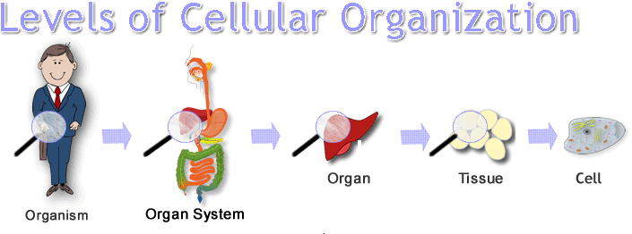
7th Grade TEK
7.12(D) differentiate between structure and function in plant and animal cell organelles, including cell membrane, cell wall, nucleus, cytoplasm, mitochondrion, chloroplast, and vacuole;
7.12(C) recognize levels of organization in plants and animals, including cells, tissues, organs, organ systems, and organisms;

Slide 3
7th Grade LO
LO: We will complete a written assessment over the structure and function of the cell’s organelles. We will compare/contrast the different levels of organization by completing a vocabulary foldable.
  7.12(D) differentiate between structure and function in plant and animal cell organelles, including cell membrane, cell wall, nucleus, cytoplasm, mitochondrion, chloroplast, and vacuole;
  7.12(C) recognize levels of organization in plants and animals, including cells, tissues, organs, organ systems, and organisms;

Slide 4
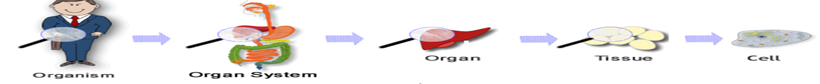
7th Grade DOL
DOL: I will complete an exit slip to explain 1 thing I did well on the test and 1 thing I did not understand.

Slide 5
7th Grade Agenda
1. PDN/DOL
2. Finish Cell Organelle Test
3. Levels of Organization in an Organism Vocabulary Foldable
4. Exit Slip

Slide 6

6th Grade TEKS
7.11(C) identify some changes in genetic traits that have occurred over several generations through natural selection and selective breeding such as the Galapagos Medium Ground Finch (Geospiza fortis) or domestic animals.

Slide 7
6th Grade LO
LO: We will compare/contrast natural selection, selective breeding and adaptations by completing a inter-active vocabulary foldable.
  TEK 7.11(C) identify some changes in genetic traits that have occurred over several generations through natural selection and selective breeding such as the Galapagos Medium Ground Finch (Geospiza fortis) or domestic animals.

Slide 8
6th Grade DOL
I will complete an exit slip to explain who Charles Darwin was and what he is famous for.

Slide 9
6th Grade Agenda
1. PDN / DOL
2. Charles Darwin Review Video
https://www.youtube.com/watch?v=yGV82kE4IEc
3. Vocabulary Foldable
4. Exit Slip

