Slide 1
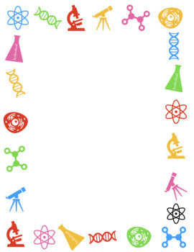
Feb. 12, 2018
Collect PDN Sharpen Pencil
Sit 1 boy / 1 girl per table, unless teacher has assigned you a seat personally.
Complete PDN on own

Slide 2
Agenda
7th Grade
1. PDN
2. 4th 6 Week District Test Review
3. Exit Slip
6th Grade
1. Dol
2. 6 Kingdoms ppt.
3. 4th 6 Week District Test Review
3. Exit Slip

Slide 3
LO’S
7th Grade
We will review photosynthesis, cycles of matter and energy flow in an ecosystem to prepare for the 4th 6 weeks test.
6th Grade
We will compare/contrast the 6 kingdoms.

Slide 4
DOL’S
7th Grade
I will explain what a food web and a food chain have in common in an exit slip.
6th Grade
I will explain 2 characteristics an organism must have to be in the kingdom Animalia.

Slide 5
TEKS
7.5 A/B/C
(A) recognize that radiant energy from the Sun is transformed into chemical energy through the process of photosynthesis;
(B) demonstrate and explain the cycling of matter within living systems such as in the decay of biomass in a compost bin
(C) diagram the flow of energy through living systems, including food chains, food webs, and energy pyramids
6.12
(D) identify the basic characteristics of organisms, including prokaryotic or eukaryotic, unicellular or multicellular, autotrophic or heterotrophic, and mode of reproduction, that further classify them in the currently recognized Kingdoms

Slide 6
6th Grade
Question to Ponder:
You go on a walk and see an organism you have never seen before. What type of properties would you use to describe the organism? How does this relate to what scientist do out in the field of study?

Slide 7
6th Grade Foldable
Teacher will pass out and explain expectations/procedures for completing note outline
Students will follow along with video clip / power point to assist in completing note outline.

