Slide 1
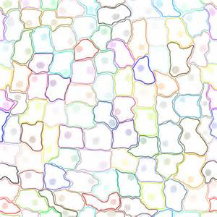
Feb. 10, 2016 Please Do Now
Sharpen Pencil
Collect Chrome Book, Cell Organelle Book, Please Do Now Quiz(Tues.)
Take out journal, planner pen/pencil that works
Write Homework into planner: Study Cell Organelles Structure and Function Vocabulary
Do the Please Do Now/DOL questions for Tuesday

Slide 2
Students will complete Pg. 19 in Cell Organelle Book
Login to www.coachpease.com
Click on links
Click on 2nd link under cells
http://www.edusmart.com/displayEles?format=simple&val=g72
Edu-Smart
Inter-Activity

Slide 3
2-D Cell Diagram
Go to www.coachpease.com
Click on 4th 6 Weeks
Click on The 2-D Cell Diagram http://sitebuilder.yola.com/restricted_view/site_design/8a4986cb37bc2ecf0137bd9fc638135d/resources/The%20Cell%202-D%20Diagram.pptxl
Read the directions to self and waite for teacher directions.

Slide 4
Exit Slip
Explain what cell organelles both plant and animal cells in common? Which ones are different?

