Slide 1
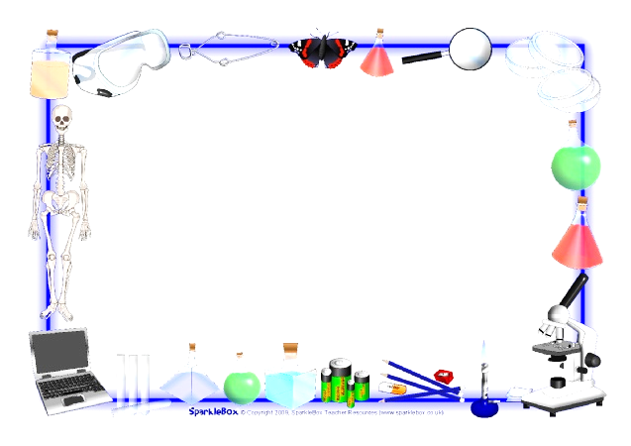
Feb 1, 2018
Collect DOL QUIZ
Sharpen Pencil
Sit in assigned seat (Boy/Girl)
Complete DOL

Slide 2
Agenda
7th Grade
1. DOL Quiz
2. Food Chain Review
3. Food Chain Anchor /Diagram chart
4. Exit Slip
6th Grade
1. DOL Quiz
2. 3 Types of Boundary Notes
3. Plate Boundary Clay Lab
4. Exit Ticket

Slide 3
LO’S
7th Grade
We will sequence the flow of energy in a food chain.
6th Grade
We will investigate how the movement of the plate boundary's create different landforms.

Slide 4
DOL’s
7th Grade
I will complete and exit slip over the food chains.
6th Grade
I will complete and exit slip over plate boundaries.

Slide 5
TEKS
7th Grade
7.5 (C)
the flow of energy through living systems, including food chains, food webs, and energy pyramids.
6th Grade
6.10(D)
describe how plate tectonics causes major geological events such as ocean basins, earthquakes, volcanic eruptions, and mountain building

Slide 6
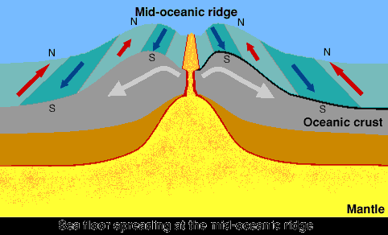
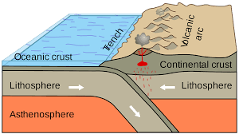
6th Grd. / Plate Boundary DOL Quiz 2
Name: ___ _______________________ Period: ___
Directions: Please match the correct boundary with the correct movement below. Please match the correct type of landform with the correct boundary type below.
1.
4.
 | Word Bank (some may be used more then once)
A | CONVERGENT BOUNDRY
B | DIVERGENT BOUNDRY
C | TRANSFORM BOUNDRY
2.
5.
# | Answer
1
2
3
4
5
3.

Slide 7
6th Grd. / Plate Boundary DOL Quiz 2
Name: ___ _______________________ Period: ___
Directions: Please match the correct boundary with the correct movement below. Please match the correct type of landform with the correct boundary type below.
1.
4.
 | Word Bank (some may be used more then once)
A | CONVERGENT BOUNDRY
B | DIVERGENT BOUNDRY
C | TRANSFORM BOUNDRY
2.
5.
# | Answer
1
2
3
4
5
3.

Slide 8
Question to Ponder: When the plates move how do different types of landforms form?
Take out Journal to record notes from video, teacher will stop and ask you to write down information needed for lab.
Study.com https://study.com/academy/lesson/plate-boundaries-convergent-divergent-and-transform-boundaries.html
Brain Pop: https://www.youtube.com/watch?v=RA2-Vc4PIOY

Slide 9
Plate Tectonic Boundary Clay Lab (if behavior allows)
Teacher will explain expectations and procedures for lab
Students will complete lab and record data on lab log sheet

Slide 10
7th Grd. Food Chain DOL Quiz2
Name: _________________________ Period: ___
1. When Rocky, the lizard ate the banana during the food chain demonstrated in class what level of consumer was he?
A: primary
B: tertiary
C: secondary
D: decomposers
2. When Rocky, the lizard ate the cricket during the food chain demonstrated in class what level of consumer was he?
A: primary
B: tertiary
C: secondary
D: decomposers
3. If a hawk was to eat Rocky, the lizard what level of consumer would the hawk be?
A: primary
B: tertiary
C: secondary
D: decomposers
4. How much energy from the banana does Rocky get when he eats it?
A: 10%
B: .10%
C: .001%
D: .0001%
5. If Rocky ate both the banana and the cricket, what type of consumer is he?
A: decomposer
B: herbivore
C: carnivore
D: omnivore
# | Answers
1
2
3
4
5

Slide 11
7th Grd. Food Chain DOL Quiz 2
Name: _________________________ Period: ___
1. When Rocky, the lizard ate the banana during the food chain demonstrated in class what level of consumer was he?
A: primary
B: tertiary
C: secondary
D: decomposers
2. When Rocky, the lizard ate the cricket during the food chain demonstrated in class what level of consumer was he?
A: primary
B: tertiary
C: secondary
D: decomposers
3. If a hawk was to eat Rocky, the lizard what level of consumer would the hawk be?
A: primary
B: tertiary
C: secondary
D: decomposers
4. How much energy from the banana does Rocky get when he eats it?
A: 10%
B: .10%
C: .001%
D: .0001%
5. If Rocky ate both the banana and the cricket, what type of consumer is he?
A: decomposer
B: herbivore
C: carnivore
D: omnivore
# | Answers
1
2
3
4
5

Slide 12
Question to Ponder: In a food chain what would our guanine pigs be considered?
Take out Foldable from Yesterday to assist with question above. Add new information to foldable as watch the video clip.
Study Jams.: http://studyjams.scholastic.com/studyjams/jams/science/ecosystems/food-chains.htm

Slide 13
Real Live Food Chain Lab Questions Name: _____________ Period: __
Write down the questions below onto ½ sheet of blank paper. This will be part of your exit slip / grade.
1. What is the first step in our food chain?
2. What is our lizard considered? What level?
3. What are the crickets considered? What level?
4. What type of 3rd level consumer could be a part of this food chain?
5. What level in the food chain would make it so that our lizard can give back to the food chain / soil?

Slide 14
Real Live Food Chain Lab Questions Name: _____________ Period: __
Write down the questions below onto ½ sheet of blank paper. This will be part of your exit slip / grade.
1. What is the first step in our food chain?
2. What is our lizard considered? What level?
3. What are the crickets considered? What level?
4. What type of 3rd level consumer could be a part of this food chain?
5. What level in the food chain would make it so that our lizard can give back to the food chain / soil?

