Slide 1
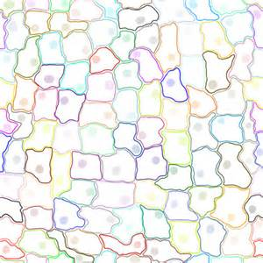
Feb. 9, 2016 Please Do Now
Sharpen Pencil
Collect Chrome Book, Cell Organelle Book
Take out journal, planner pen/pencil that works
Write Homework into planner: Study Cell Organelles Structure and Function Vocabulary
Login to chrome book / go to www.coachpease.com / click on 4th 6 weeks / click on cell organelle flashcard vocabulary / play quizlet vocabulary games on cell organelles. Time to be beat on scatter is 15 seconds.

Slide 2
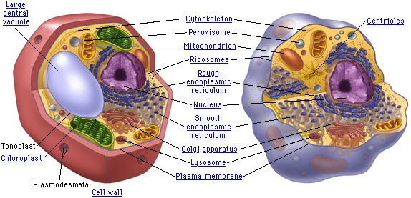
Venn-Diagram
Teacher will pass out card sort per small groups.
Students will transfer answers from card sort to pg. 18 in cell organelle structure and function book.

Slide 3
Virtual Lab Directions
Go to www.coachpease.com
Click on links
Click on Glencoe Virtual Lab
http://www.glencoe.com/sites/common_assets/science/virtual_labs/E08/E08.html
Complete Pg. 20-21 as complete the virtual lab

Slide 4
Exit Slip
Explain what 2 structures a plant cell has that an animal cell does not. Explain why a plant cell needs these structures and your cells do not.

