Slide 1
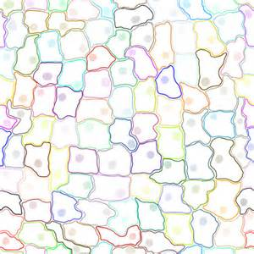
Feb. 8, 2016
Please Do Now
Sharpen Pencil
Collect Chrome Book, Cell Organelle Book
Take out journal, planner pen/pencil that works
Write Homework into planner: Study Cell Organelles Structure and Function Vocabulary
Login to chrome book, follow directions of pg. 20 in Cell Organelle Book

Slide 2
Virtual Lab Directions
Go to www.coachpease.com
Click on links
Click on Glencoe Virtual Lab
http://www.glencoe.com/sites/common_assets/science/virtual_labs/E08/E08.html
Complete Pg. 20-21 as complete the virtual lab

Slide 3
Exit Slip
Explain how the structure of a plant cell differs from that of an animal cell.

