Slide 1
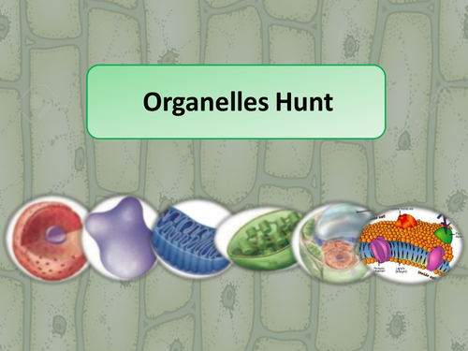
Feb. 4, 2016 / Please Do Now
Sharpen Pencil
Collect Please Do Now Quiz, chrome book, textbook (Do NOT log into chrome book)
Take out journal, planner, pen/pencil that works
Complete the Please Do Now DOL Quiz on own (NO BOOK, Chrome Book or Other Person Help)

Slide 2
Students will do a card sort over the different cell organelles.
This will be a timed competition between small groups.
http://www.online-stopwatch.com/full-screen-stopwatch/

Slide 3
Students will answer the question below….
What organelle helps a plant stand up the same way are bones help us? Explain.
Students will pair/share for 1 min ideas.
Students will volunteer answers in a class discussion.
Teacher records answers to be looked at for exit slip.

Slide 4
Student Answers:

Slide 5
Students will Turn to page 4 in Cell Book for note outline.
Students will log into Chrome book
Login to: www.coachpease.com
Go to links
Scroll to section “Cells”
Click on link for plant/animal cell edusmart
Once Loaded click on “valcuole”
Teacher will direct where to go once everyone is login.
Students will use information collected from edusmart to complete note outline on the cell theory

Slide 6
Exit Slip:
Students will re-answer the question from the please do now.
What organelle helps a plant stand up the same way are bones help us? Explain.

