Slide 1
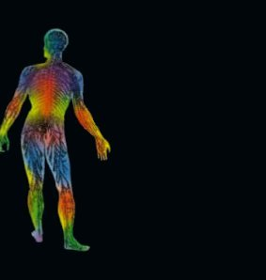
Feb. 25, 2016 / Please Do Now
1. Sharpen Pencil
2. Collect Please Do Now from counter in front of G. Pigs, chrome book, scavenger hunt worksheet from turn in basket
3. Write Homework into Planner / Study Human Body Systems Vocabulary
4. Complete the “Thurs.” Please Do Now on own
5. Do “Quizlet Vocabulary learn” over the Human Body / on website under “Games”

Slide 2
Vocabulary Quiz over Human Body
Students will take a 5 question quiz based off the homework, quiz let vocabulary.
Students will re-group and grade another students quiz.
Class will discuss any questions that arise
Quiz will be collected to be entered into the grade book

Slide 3
K/W/L Chart
Students will add 3 new things they learned from the scavenger hunt to their own personal K/W/L chart.
Students will add 1 or more new Want to knows to own K/W/L chart
Class re-groups and teacher records volunteers new information to the class size K/W/L chart

Slide 4
Essential Question / Answer in Journal
In the story of Goldilocks and the three bears they state that 1 porridge is to hot, 1 porridge is to cold and 1 one porridge is just right. How do you think this story relates to happenings in our own body? Explain.

Slide 5
Video Clip over Homeostasis
Students will take notes in journal as they watch the video to assist with answering the essential question.
Students will pair share new information in small groups
Class will discuss findings as a group aloud
On class website under “youtube” link
Go to www.coachpease.com
Click on “Youtube”
Click on https://www.youtube.com/watch?v=6fhbbFd4icY

Slide 6
Virtual Homeostasis Activity
Teacher will explain expectations for the Virtual Homeostasis lab.
Students will complete pages 2-3 in Human Body System Book as they complete the virtual lab.
Teacher will walk table to table to assist as needed.
Virtual Lab Link (on www.coachpease.com , class website, under 5th 6 weeks)
http://www.mhhe.com/biosci/bio_animations/MH11%20Homeostasis_Web/index.html

Slide 7
Exit Slip
In the story of Goldilocks and the three bears they state that 1 porridge is to hot, 1 porridge is to cold and 1 one porridge is just right. How do you think this story relates to happenings in our own body? Explain.

Slide 8
Essential Question / TEK: 7.12
In the story of Goldilocks and the three bears they state that 1 porridge is to hot, 1 porridge is to cold and 1 one porridge is just right. How do you think this story relates to happenings in our own body? Explain.

