Slide 1
Fall Semester Test Review
TEK 6.11
(11) Earth and space. The student understands the organization of our solar system and the relationships among the various bodies that comprise it. The student is expected to:
(A) describe the physical properties, locations, and movements of the Sun, planets, moons, meteors, asteroids, and comets;
(B) understand that gravity is the force that governs the motion of our solar system; and
(C) describe the history and future of space exploration, including the types of equipment and transportation needed for space travel.

Slide 2
Name: ______________________________________
Teacher: ___________________________
Class Period: ______________
Date: ______ / _________ / ______________

Slide 3
All the planets in solar system follow a ________ shaped orbit.
elliptical

Slide 4
Earth’s Orbit Around the Sun
Earth's orbit is not a perfect circle. It is elliptical, or slightly oval-shaped. This means there is one point in the orbit where Earth is closest to the Sun, and another where Earth is farthest from the Sun. The closest point occurs in early January, and the far point happens in early July (July 7, 2007). If this is the mechanism that causes seasons, it makes some sense for the Southern Hemisphere. But, as an explanation for the Northern Hemisphere, it fails miserably.

Slide 5
2. Which space program helped us to better understand the effects of how longer space flights affect humans?
Gemini Space Mission

Slide 6
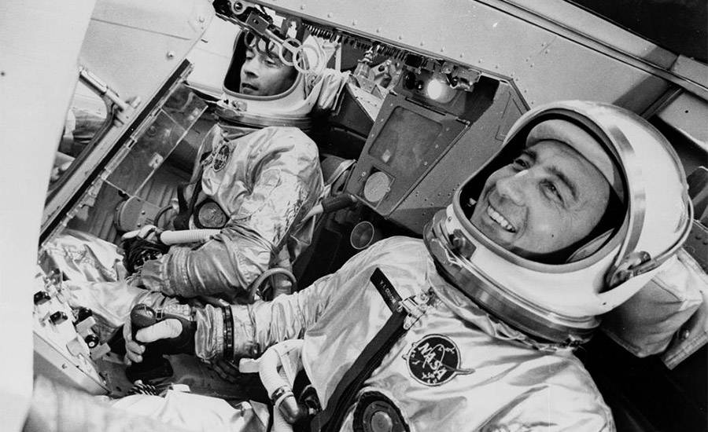
Gemini Space Mission
Gemini had four main goals: to test an astronaut's ability to fly long-duration missions(up to two weeks in space); to understand how spacecraft could rendezvous and dock in orbit around the Earth and the moon; to perfect re-entry and landing methods; and to further understand the effects of longer space flights

Slide 7
3. What is the relationship between the length of orbit and the distance of the planets from the sun?
The closer to the sun, the shorter the length of orbit…
Less Distance from Sun = Shorter # of Days/Years to Orbit the Sun Once

Slide 8
Length of Orbit / Distance from Sun
https://www.bobthealien.co.uk/solarsystem/table.htm
Great Chart over various facts for each planet.

Slide 9
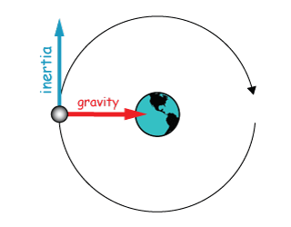
4. It was once thought that Earth was the center of the universe. Eventually it was proven that the planets orbit around the Sun. The illustration shows the path of Earth’s orbit around the sun.
Describe the path of Earth if the pull of the Sun’s gravity were to suddenly stop.
Earth would continue in a straight line from where gravity stopped in the Earth’s Orbit
It would not curve around the sun anymore.

Slide 10
The planets and moons would cease to orbit their respective parent bodies and would continue in a straight line tangential to the point (Blue line on this image)

Slide 11
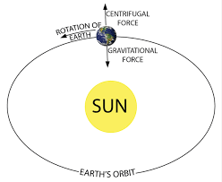
5. Why do planets stay in an orbit and not wander into space?
Gravitational Attraction from the Sun pulls them towards the sun

Slide 12
Planets Stay in Orbit Around the Sun
Newton realized that the reason the planets orbit the Sun is related to why objects fall to Earth when we drop them. The Sun's gravity pulls on the planets, just as Earth's gravity pulls down anything that is not held up by some other force and keeps you and me on the ground.

Slide 13
6. Which space program helped us to land a human on the moon?
Apollo Program

Slide 14
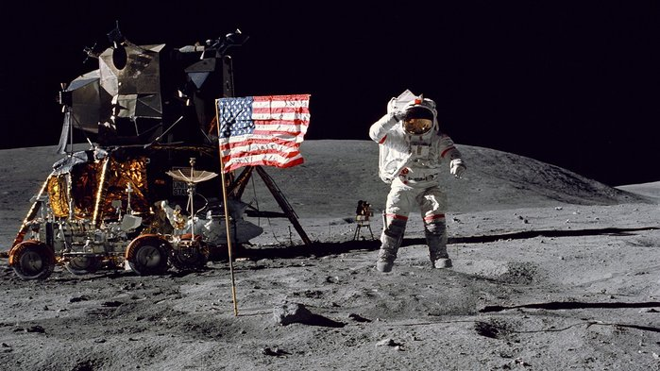
Humans Land on the Moon...
The Apollo program was designed to land humans on the Moon and bring them safely back to Earth. Six of the missions (Apollos 11, 12, 14, 15, 16, and 17) achieved this goal. Apollos 7 and 9 were Earth orbiting missions to test the Command and LunarModules, and did not return lunar data.

Slide 15
7. Where would I find the asteroid belt if I was to visit space?
In between Mars and Jupiter..
In between the Terrestrial Planets and the Gas Giants

Slide 16
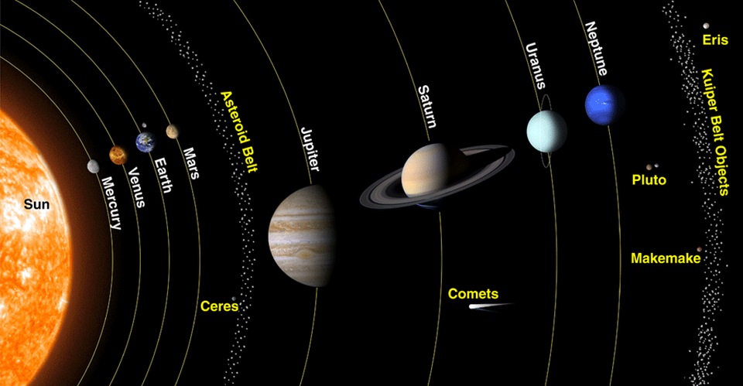

Slide 17
8. What is any object that revolves around another object in space called?
Satellite

Slide 19
9. NASA is sending a probe to Venus, a probe to Mars, and a probe to Jupiter. Which probe will experience the strongest gravitational force when approaching its planet?
Jupiter due it having the most mass / biggest

Slide 20
The more massive a planet or star is, the stronger the gravitational force it exerts. It is this force that allows a planet or star to hold other objects in their orbit.

Slide 21
10. Scientists have determined that a trip to Mars and back to Earth would take approximately 21 months. Which of the following pieces of equipment would be most important when considering the length of this trip?
Work Out Equipment

Slide 22
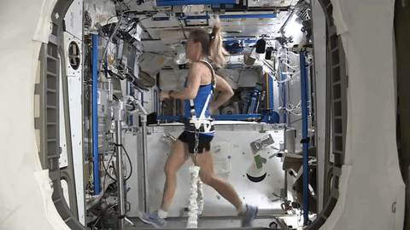
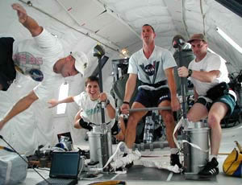
Work Out Equipment: Major Must Have in Space!!
Thanks to microgravity, astronauts experience a variety of health and physical changes while living in space — some of which they can counteract through daily exercise and other activities.

Slide 23
11. As man continues to plan space travel to other planets there will be many obstacles. Which of the following describes a challenge NASA must overcome as they plan for travel to planets such as Mars?
A Fuel sources will have to be developed that are easily stored for long periods of time.

Slide 24
One of the greatest design barriers engineers are facing is dealing with the amount of fuel that will be needed to send a spacecraft on such a round trip distance. More fuel means more weight, and more weight means the need for more fuel to transport that weight

