Slide 1
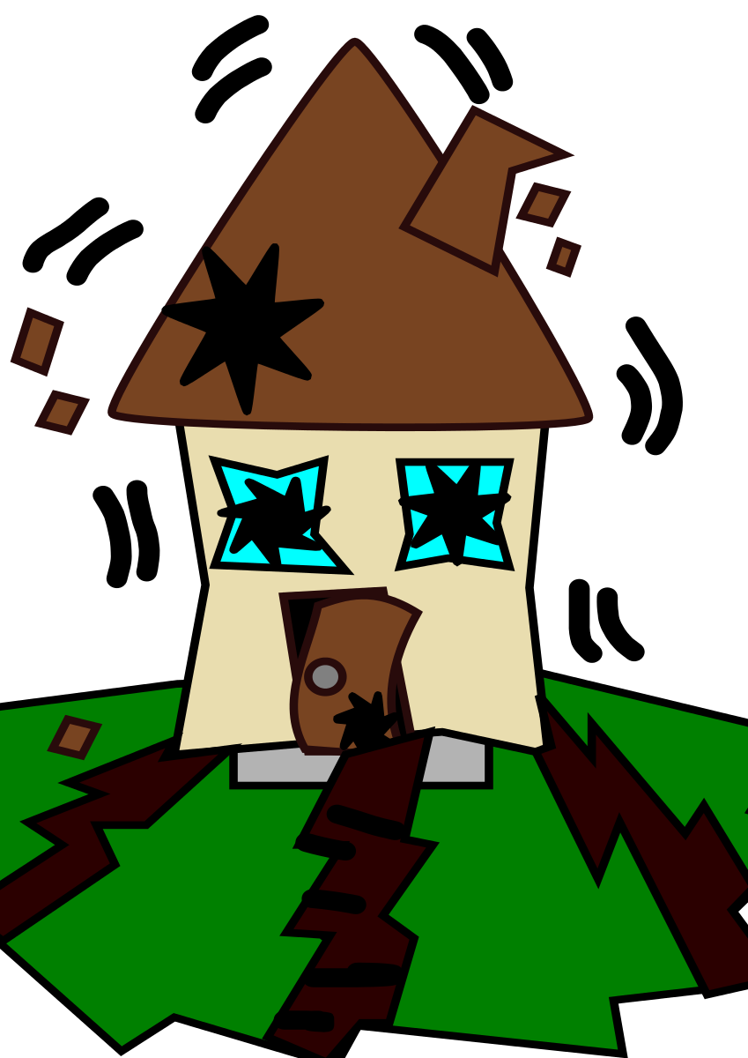
WOW!
Earthquake
Webquest

Slide 2
Name: ________________________________________ Date: _________________
Go to http://www.nationalgeographic.com/features/04/forcesofnature/interactive/index.html?section=e
Choose a force: Earthquakes
On the upper left menu, choose number 1.
Read “What is an Earthquake?”.
When do earthquakes happen?
______________________________________________________________________________________________________________________________
How many earthquakes occur every day? Each year?
______________________________________________________________________________________________________________________________
Where and what year was the deadliest quake ever? How many people were killed?
______________________________________________________________________________________________________________________________
On the upper left menu, choose number 2.
Read “Where do Earthquakes Occur?”.
Where do most earthquakes occur?
______________________________________________________________________________________________________________________________
What are the earthquakes called that are far from plate boundaries and why do they occur?
______________________________________________________________________________________________________________________________

Slide 3
What percentage of earthquakes comes from the largest earthquake belt?
______________________________________________________________________________________________________________________________
On the upper left menu, choose number 3.
Read “What Causes Earthquakes?”.
What is “plate tectonics”?
______________________________________________________________________________________________________________________________
Click “Next”
In which state is the San Andreas Fault?
_______________________________
How long is the San Andreas Fault?
______________________________
How deep is the fault?
______________________________
How many earthquakes occur along this fault each year? _____________________
On the upper left menu, choose number 4.
Read “Types of Faults”.
List the four (4) types of faults:
1. _______________________
2. _______________________
3. _______________________
4. _______________________
Click on “Normal Fault”
Why do normal faults occur?
______________________________________________________________________________________________________________________________

Slide 4
Draw a picture of a normal fault:
Click on “Next fault type”
How does a reverse fault occur?
____________________________________________________________________________________________________________________________________
Draw a picture of a reverse fault:
Click on “Next fault type”
How does a strike-slip fault occur?
____________________________________________________________________________________________________________________________________

Slide 5
Draw a picture of a strike-slip fault:
Click on “Next fault type”
Why do dip-slip faults occur?
__________________________________________________________________________________________________________________________________
On the upper left menu, choose number 5.
Read “Measurement and Recording”.
What is the “hypocenter?”
__________________________________________________________________________________________________________________________________
What is the point directly above the hypocenter?
__________________________________
Click “Next”
What is another name for a P wave? ________________________________
Click “Next”
What instrument measures seismic waves? ___________________________
What does a Richter Scale measure? ________________________________

Slide 6
On the upper left menu, choose number 6.
Read “Locate an earthquake?”.
What do you need to pinpoint the epicenter of an earthquake?
____________________________________________________________________________________________________________________________________
Click “Trigger an Earthquake”
Watch the three (3) seismograph recordings.
Click on each triangle.
Click on the point where all three (3) circles intersect.
Fill in the information about the earthquake you triggered:
On the upper left menu, choose number 7
Read “Trigger an earthquake”.
1. Select a ground type.
2. Select a magnitude.
Click on “Start the earthquake”
Play again until you think you have created the biggest earthquake.
What type of ground causes the most destruction? _____________________
Would a low magnitude or a high magnitude cause a bigger earthquake?
_____________________________
Location | Latitude | Longitude | Magnitude

Slide 7
On top right menu, click on Map.
Locate the 1906 San Francisco earthquake and click on it.
Fill in the following information:
Play the video at the bottom. Compare San Francisco before and after the earthquake. Give at least three details to support the comparison.
• _____________________________________________
• _____________________________________________
• _____________________________________________
Date | Magnitude | Deaths | Damage

Slide 8
Name: ________________________________________ Date: _________________
Go to http://www.nationalgeographic.com/features/04/forcesofnature/interactive/index.html?section=e
Choose a force: Earthquakes
On the upper left menu, choose number 1.
Read “What is an Earthquake?”.
When do earthquakes happen?
Earthquakes happen when plates, or rocks, within the Earth suddenly break or shift under stress, sending shock waves rippling.
How many earthquakes occur every day? Each year?
Thousands of earthquakes occur every day and about 500,000 quakes occur each year.
Where and what year was the deadliest quake ever? How many people were killed?
The deadliest quake ever occurred in China in 1557, when an estimated 830,000 people were killed.
On the upper left menu, choose number 2.
Read “Where do Earthquakes Occur?”.
Where do most earthquakes occur?
Most earthquakes occur along fractures in the Earth’s crust called faults. These are found along the edges of major plates.
What are the earthquakes called that are far from plate boundaries and why do they occur?
Earthquakes that occur far from plate boundaries are call intraplate quakes. They occur when stress builds up and the Earth’s crust is stretched or squeezed together until it rips.

Slide 9
What percentage of earthquakes comes from the largest earthquake belt?
80 %
On the upper left menu, choose number 3.
Read “What Causes Earthquakes?”.
What is “plate tectonics”?
Plate tectonics is the phenomenon that the Earth’s plates are constantly moving and interacting with each other - they push against each other, pull apart, or grind past one another.
Click “Next”
In which state is the San Andreas Fault?
California
How long is the San Andreas Fault?
More than 800 miles (1,290 kilometers)
How deep is the fault?
It is at least 10 miles (16 kilometers) deep.
How many earthquakes occur along this fault each year?
Thousands
On the upper left menu, choose number 4.
Read “Types of Faults”.
List the four (4) types of faults:
1. Normal Fault
2. Reverse Fault
3. Strike-Slip Fault
4. Dip-Slip Fault
Click on “Normal Fault”
Why do normal faults occur?
Normal faults occur what plate boundaries pull apart and Earth’s crust is stretched. One side of the fault slips down.

Slide 10
Draw a picture of a normal fault:
Click on “Next fault type”
How does a reverse fault occur?
A reverse fault (also known as a thrust fault) occurs where plates are colliding and one side of the fault is pushed up and over the other.
Draw a picture of a reverse fault:
Click on “Next fault type”
How does a strike-slip fault occur?
In a strike-slip fault, the plates meet evenly and slide against each other horizontally.

Slide 11
Draw a picture of a strike-slip fault:
Click on “Next fault type”
Why do dip-slip faults occur?
Dip-slip faults are strike-slip faults combined with either a normal fault or a thrust fault. One plate moves sideways, and one moves downward.
On the upper left menu, choose number 5.
Read “Measurement and Recording”.
What is the “hypocenter?”
The hypocenter is the place where the movement first occurred in the fault. It can be hundreds of miles below the Earth’s surface or just beneath it.
What is the point directly above the hypocenter?
The point directly above the hypocenter is called the epicenter.
Click “Next”
What is another name for a P wave? Primary wave
Click “Next”
What instrument measures seismic waves? Seismograph
What does a Richter Scale measure? The magnitude of the quake.

Slide 12
On the upper left menu, choose number 6.
Read “Locate an earthquake?”.
What do you need to pinpoint the epicenter of an earthquake?
You need the seismic wave measurements from three recording stations. Around each station, you draw a circle with a radius equal to its distance from the quake. The epicenter is where all three circles intersect.
Click “Trigger an Earthquake”
Watch the three (3) seismograph recordings.
Click on each triangle.
Click on the point where all three (3) circles intersect.
Fill in the information about the earthquake you triggered:
On the upper left menu, choose number 7
Read “Trigger an earthquake”.
1. Select a ground type.
2. Select a magnitude.
Click on “Start the earthquake”
Play again until you think you have created the biggest earthquake.
What type of ground causes the most destruction? landfill
Would a low magnitude or a high magnitude cause a bigger earthquake?
high
Location | Latitude | Longitude | Magnitude
San Francisco | 37.04 N | 121.88 W | 7.1

Slide 13
On top right menu, click on Map.
Locate the 1906 San Francisco earthquake and click on it.
Fill in the following information:
Play the video at the bottom. Compare San Francisco before and after the earthquake. Give at least three details to support the comparison. Answers will vary
• _____________________________________________
• _____________________________________________
• _____________________________________________
Date | Magnitude | Deaths | Damage
April 18, 1906 | 7.8 | 700 - 3000 | 28,000 buildings destroyed

