Slide 1
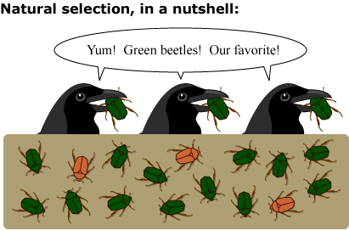
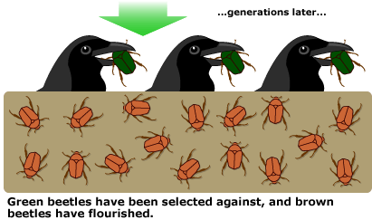
Evolution by Natural Selection

Slide 2
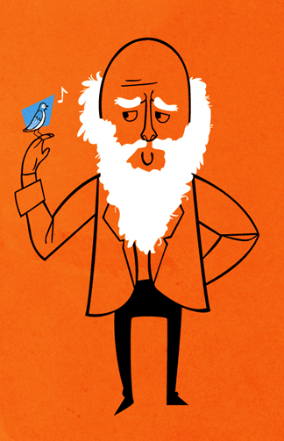
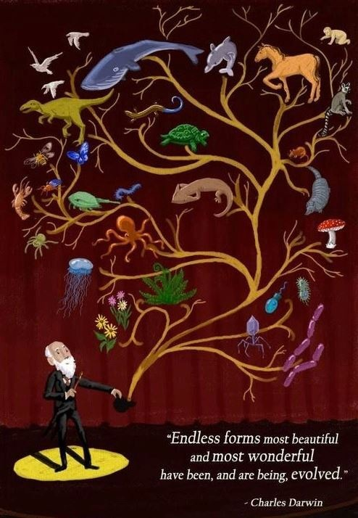

Slide 3
“There is grandeur in this view of life, with its several powers, having been originally breathed into a few forms or into one; and that, whilst this planet has gone cycling on according to the fixed law of gravity, from so simple a beginning endless forms most beautiful and most wonderful have been, and are being, evolved.”
― Charles Darwin, The Origin of Species

Slide 4
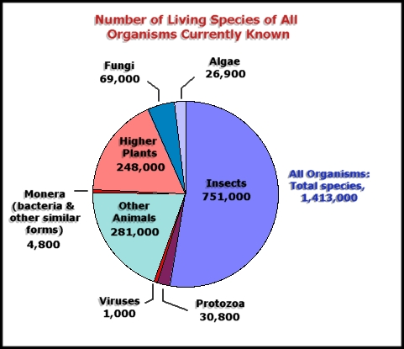

Slide 5
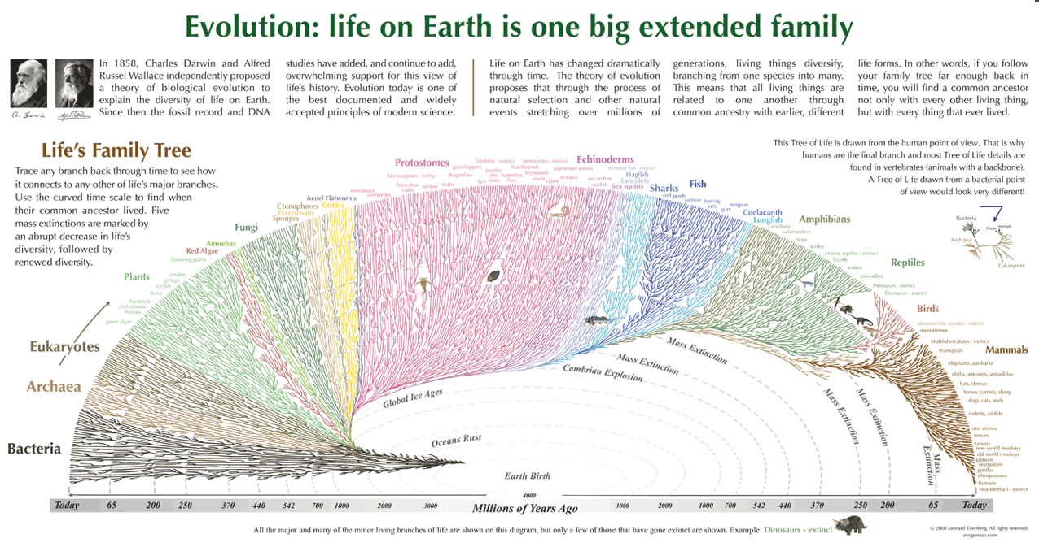
What patterns do you see?

Slide 6
What is evolution?
Simply: change in organisms over time.
It explains all of the changes that have transformed life on Earth from the earliest beginnings to the diversity of organisms in the world today.
Scientifically: Change in allele frequency in a population over time.

Slide 7
What evolution is NOT
Does not study the ORIGIN of life, only how life changes AFTER it originated.
NOT COMPLETELY RANDOM – more on this later
Organisms don’t make “progress” they don’t get “better”
Evolution does not have a goal!
Individuals DO NOT EVOLVE, only populations.
It is not invisible, we can see it happening and measure it with mathematics.
NOT “Survival of the Fittest” – this phrase implies that survival is the key to evolution, when reproduction is absolutely necessary for fitness. Darwin DID NOT coin this phrase!

Slide 8
Population
What is a population in scientific terms?
A group of potentially interbreeding members of the same species in a given area
What are some examples of populations?

Slide 9
Evolution Concepts
Natural Selection – unequal survival and reproduction of individuals in a population. NON-RANDOM because of adaptations.
Some organisms have features that allow them to survive AND reproduce better than those that don’t have those features.

Slide 10
Natural Selection Principles
Variation – differences in inherited traits in a population

Slide 11
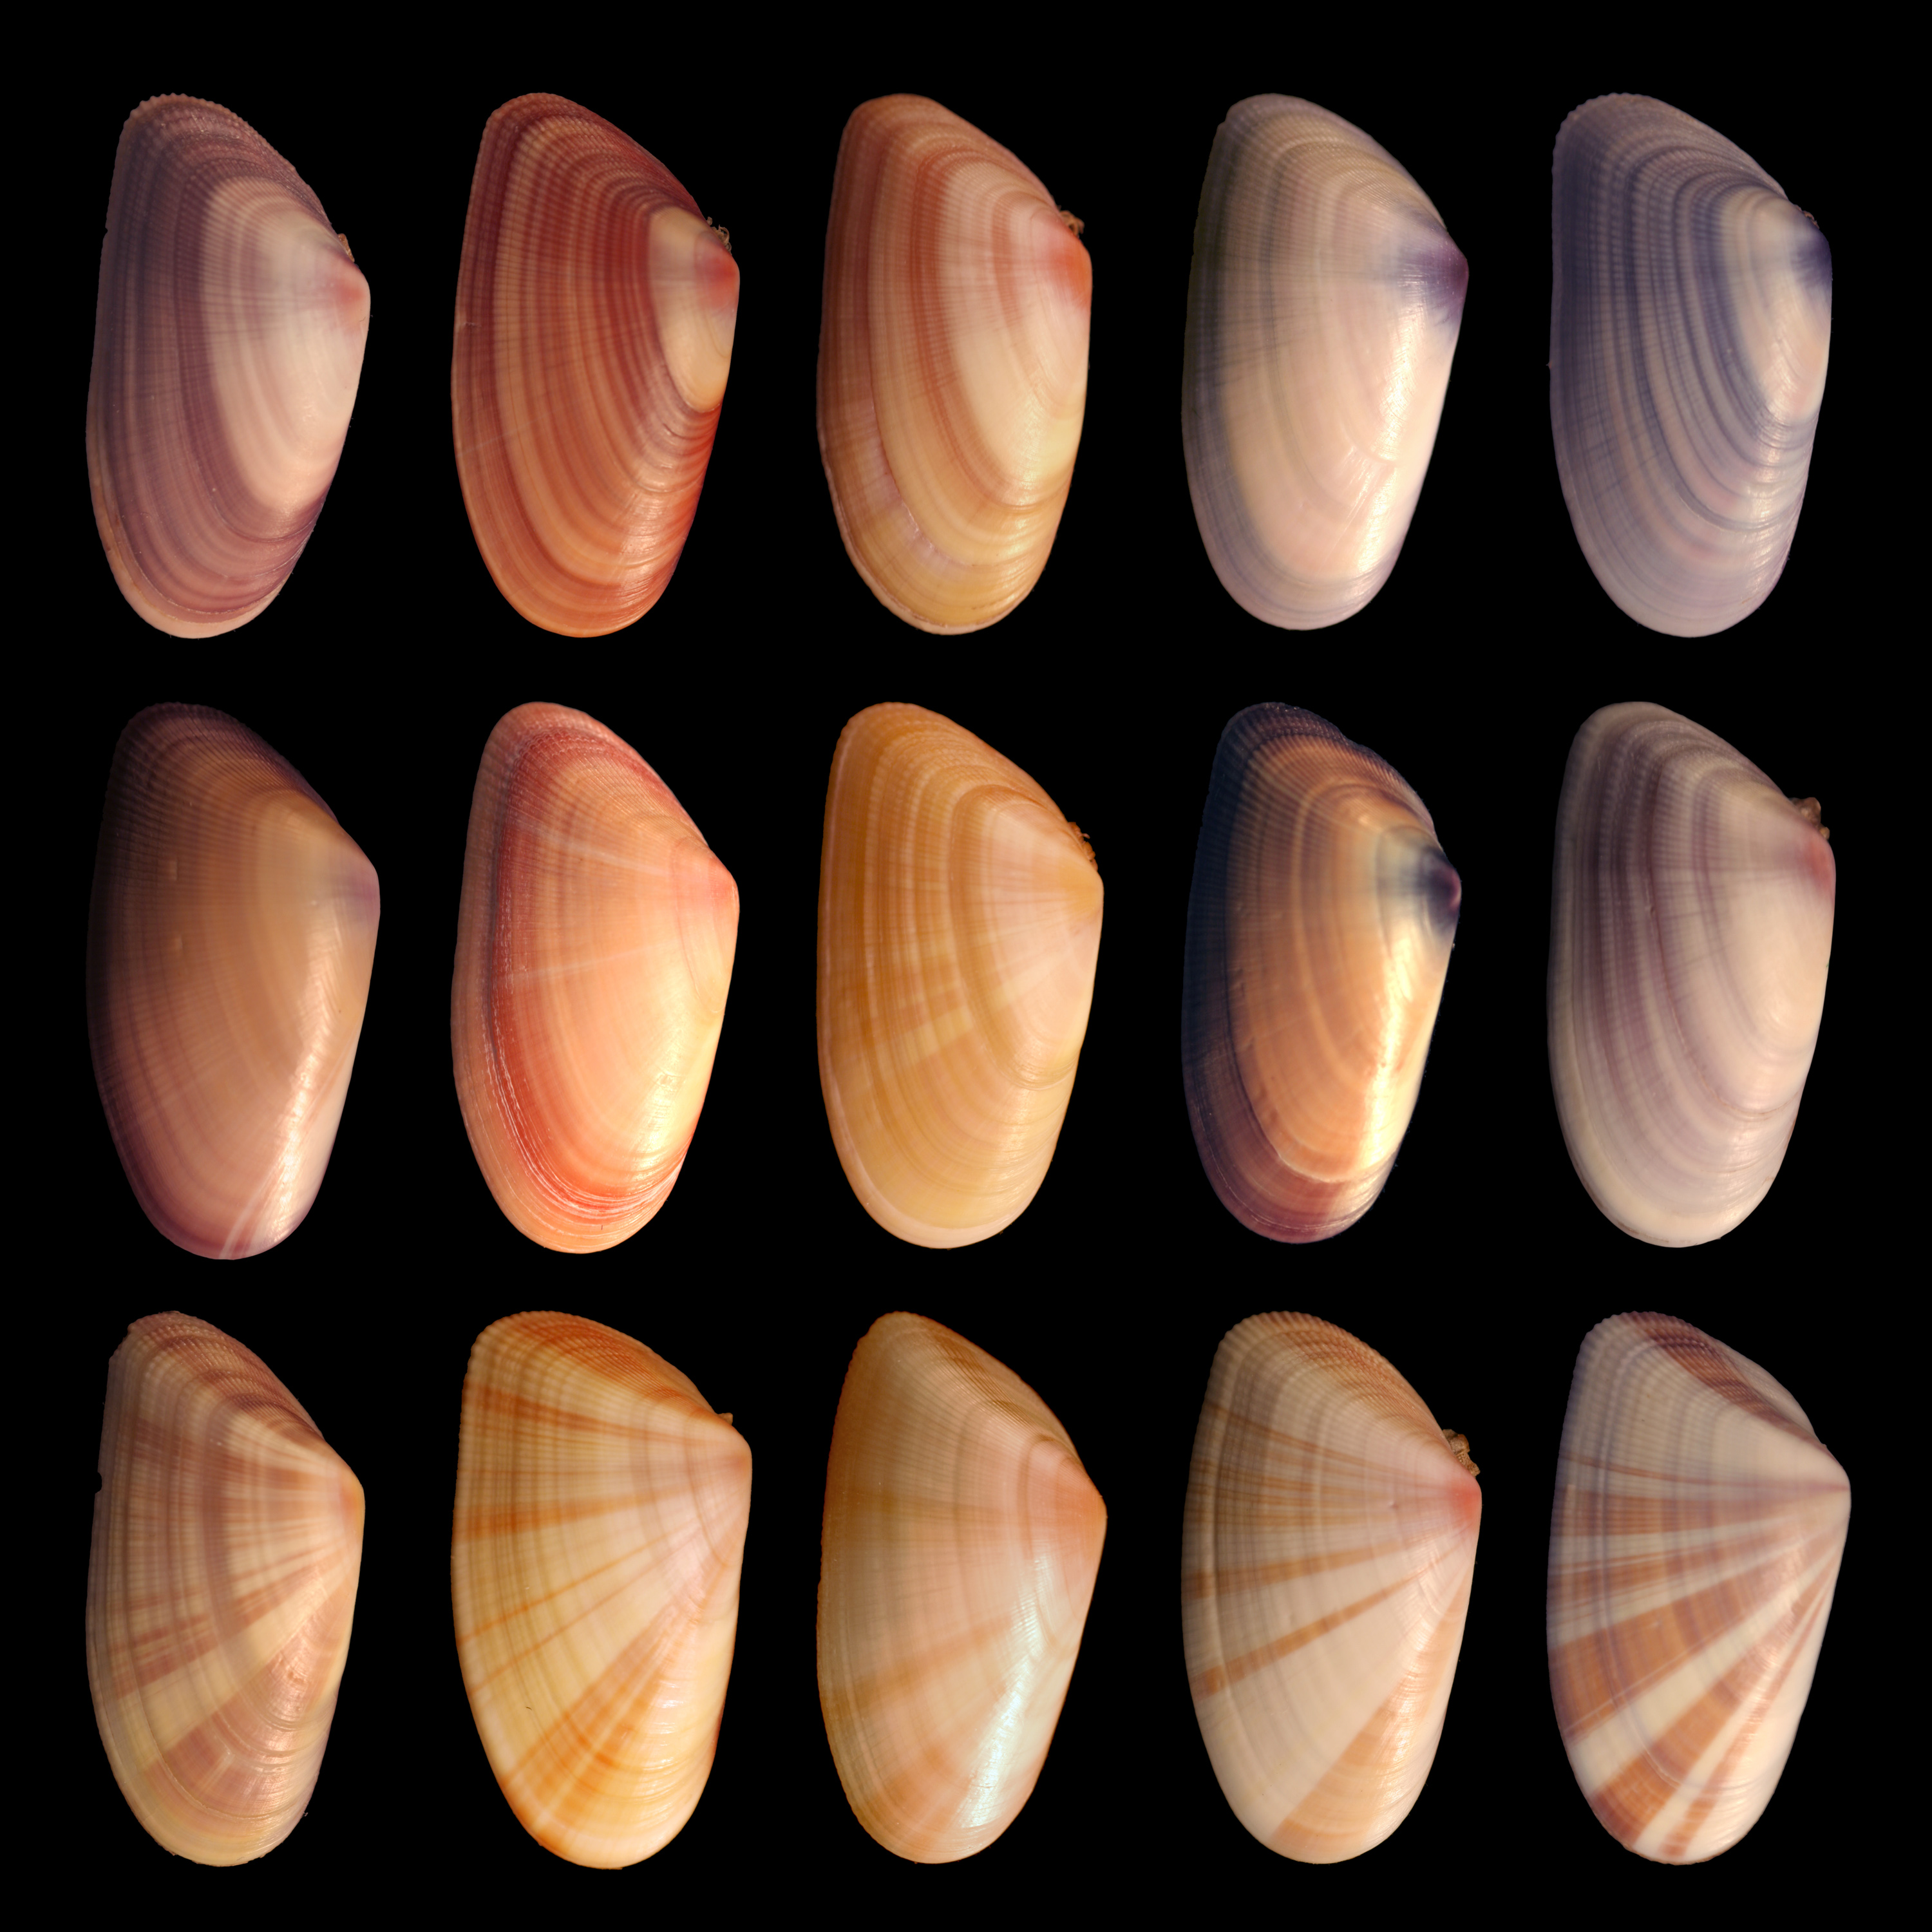
Variation
Genetic differences in populations exist. There is variation in the genotypes of individuals in populations. Certain genotypes may result in phenotypes that allow certain individuals an advantage over others.

Slide 12
Natural Selection Principles
“Overproduction” of Offspring – some species produce many offspring at a time and over a lifetime, while others produce few.
Generally, the more offspring you produce, the better chance at survival, and thus reproduction your genetic lineage will be.

Slide 13
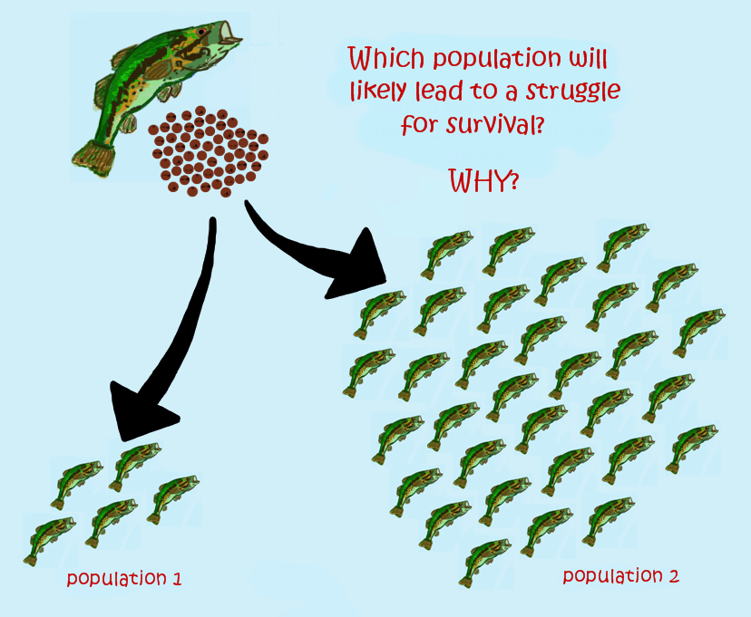
Overproduction of Offspring
The ability of a population to have many offspring raises the chance that some will survive and reproduce, but also increases the competition for resources. Think about fish and insects and how they produce far more young than will survive, some get eaten, some may not be able to have access to food. Note though that not all species "overproduce" offspring.

Slide 14
Natural Selection Principles
Adaptation – traits that increase probability of leaving offspring compared to those that don’t have the trait.

Slide 15
Adaptation
An adaptation is a beneficial inherited trait. For example: camouflage, prettier color coating that is more attractive to females. These traits are likely to be transferred to offspring because those individuals that have the adaptation are more fit (better access to mates).

Slide 16
Natural Selection Principles
Fitness – Fitness generally means reproductive success. This includes how successful an organism is at finding a mate and producing offspring (fecundity). And how well an organism’s offspring survive to reproduce, how successful their young are and so on.

Slide 17
Fitness

Slide 18
Natural Selection Principles
Selective pressure – the environment in which an organism lives changes periodically. These changes whether caused by living or non-living forces put pressure on organisms. Pressure results in some organisms being selected for (those with certain adaptations or features can survive and reproduce better than those without those adaptations and/or features).

Slide 19
Selection Pressure
Selective pressure – the bacteria that were resistant to the treatment were selected FOR, and the bacteria susceptible to the treatment were selected AGAINST. Their environment changed and put a pressure on the population.

Slide 20
Natural Selection Principles
Descent with modification – species descend through time from a common ancestor. Species branch off from each other and develop different characteristics modified from those of their ancestor.

Slide 21
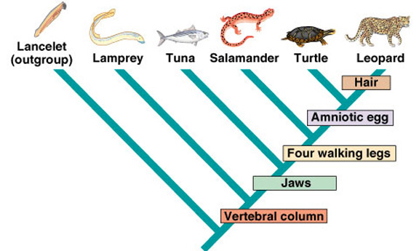
Descent with Modification
Species change over time as they respond to a changing environment. Organisms that live today are descended from a common ancestor. The only reason they are different is because species changed with adaptations/modifications as they moved through time.

Slide 22
In Conclusion…
Evolution by natural selection describes most patterns in how organisms change over time.
It is the most famous mechanism (how something happens) of evolution.
It was formed by Darwin and Wallace.
Is well supported with evidence .
Is NON – RANDOM

