Slide 1
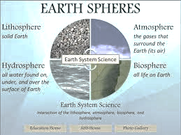
Earth Sphere’s Poster Project
By: Katherine Pease

Slide 2
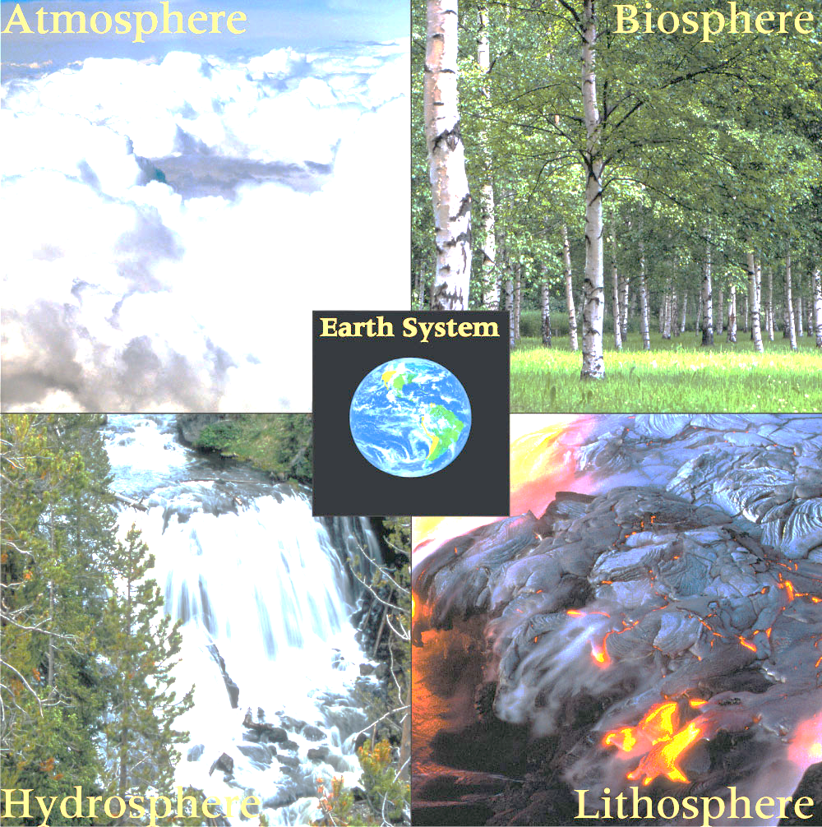
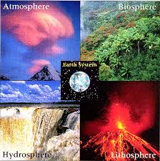
What are the 4 different Spheres that make up Earth?
Discuss ideas in small groups
Each group will share one idea that the group came up with.
Each group will write idea on a post-it note to add to a class list as the group shares answer to the question above.

Slide 3
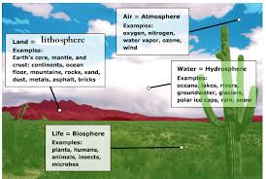
Click on link below to review the answer to the question about Earth Spheres. Students add to notes in journal to assist with project.
https://www.youtube.com/watch?v=W4ixGKA076o

Slide 4
Students will create a poster to compare/contrast the 4 different spheres’. Example of poster below
Geo-
Aneo-
%
%
spheres
Hydro-
Bio-
%
%

Slide 5
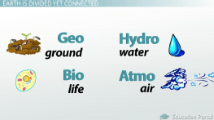
Materials
1 sheets plain white paper
1 sheet with pre-ran circles, 1 Earth picture, labels
1 paper with information over minerals and %’s
Glue
Colors
Scissors
Ruler
Journal with notes

Slide 6
Procedure
1.Fold the 2 plain white sheets of paper in half (hamburger fold)
2.Layer one white sheet over edge of 2nd sheet to form a large sheet with 4 sections.
3. Trace over the horitzontal crease (middle crease)
4. Trace over verticle crease (where 2 papers are overlapped/glued)
5. Cut out Earth model and glue in center of the 4 squares (see example)
6. Cut out the small white circles 8 in all, 2 per sphere

Slide 7
Procedure Cont.
7. Write Pre-fixes on front of 1 of the 2 circles per sphere (see example)
8. Write % sign on front of 2nd circle of 2 circles per sphere (see example)
9. Place each circle onto the squares and trace around each circle with pencil (see example for location of circles)
10. Under the pre-fix circle student will write description of the sphere the pre-fix describes
11. under the % circle students will create a circle graph (label each section with name of mineral and % found in Earth)
12. Students will glue cut out circle above the traced circle, only put glue on edge of top of the circle so that it can be lifted as a flap to aid in studying ( like in a foldable)

Slide 8
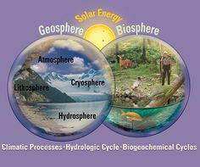
Procedure Cont.
13. Cut out the 4 long rectangles, label each rectangle with the full name of one of the 4 spheres
14. Glue label into the correct square (see example)
15. illustrate each square to show how the sphere looks on Earth / picture
16. Make sure name, class period is on back of poster before turn in for a grade.

Slide 9
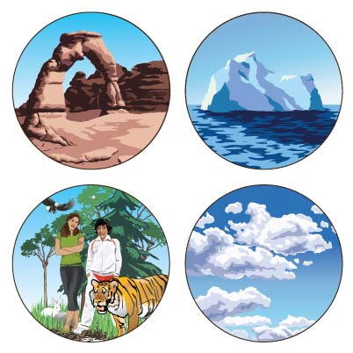
Pictures /circles to cut/paste Step 6-7

Slide 10
Cut/Trace/ Paste circles
Step 6 & 8

Slide 11
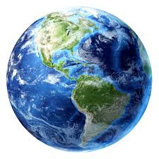
Cut/ color / paste
Step 5
-SPHERE

Slide 12
Label for back of project:
Cut / Paste
Name: ______________________________________________
Class Period: ______________ Grade: _________________%
Teacher fills in above.

