Slide 1
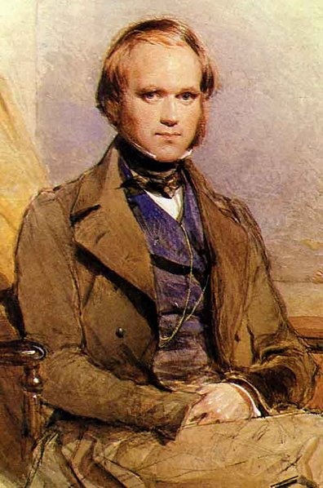
CHARLES DARWIN
EVOLUTION
by NATURAL SELECTION

Slide 2
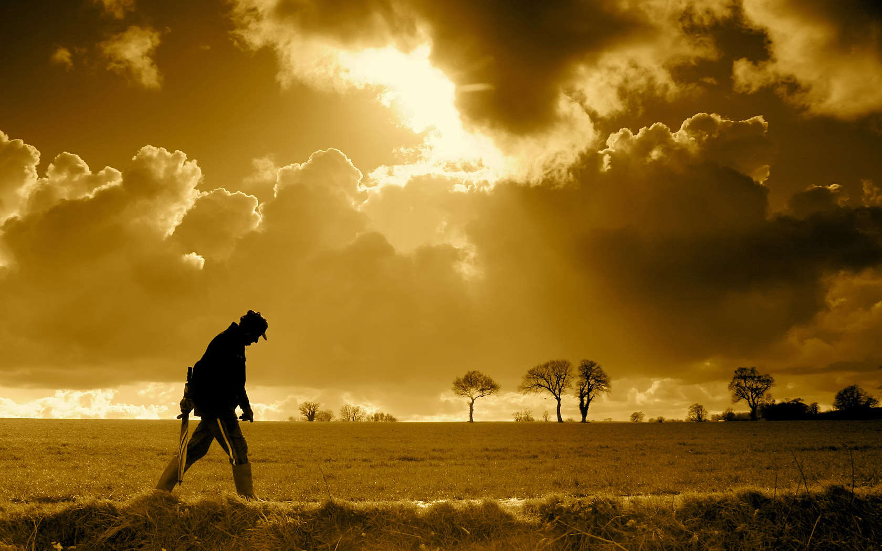
“ A NEW WAY OF THINKING ABOUT LIFE”
All about Charles Darwin
Mr. Taylor
PLAY VIDEO

Slide 3
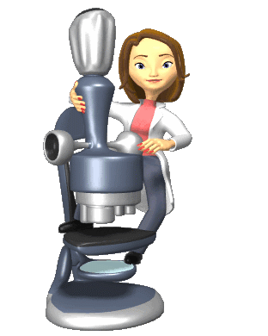
FOCUS QUESTIONS
What caused Darwin to reject his medical education at the University of Edinburgh?
Describe what a naturalist studies?
What was the primary mission of the HMS Beagle?
What is the difference between artificial and natural selection?
What 2 potent forces cause an evolutionary response?

Slide 4
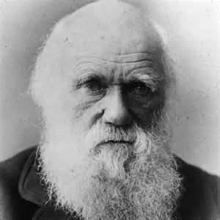
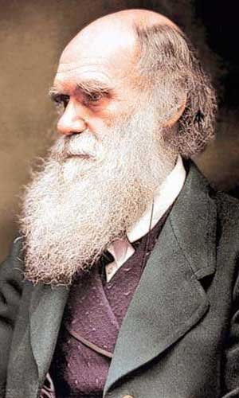
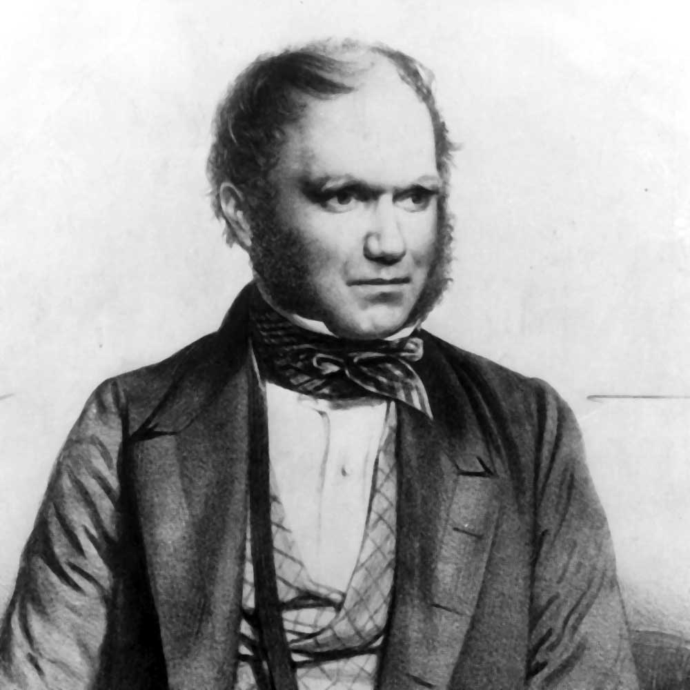
“A New Way of Thinking about LIFE”
All about Charles Darwin:
Charles Darwin was born into a wealthy family. His father was a doctor who strongly encouraged him to be a medical doctor.
However, Charles Darwin was not interested in this line of work. His interest in _________ led him to reject his medical education at the University of Edinburgh.
He pursued a career as a naturalist. A naturalist is a scientist who studies __________ and ________.
nature
animals
plants

Slide 5
“A New Way of Thinking about LIFE”
Darwin on the HMS Beagle:
4. Through family connections in 1831, Charles Darwin had an opportunity of a lifetime to open his eyes to see the world. He did this by serving on the ______________. The primary mission of the Beagle was to survey the coast of _______________.
5. While Charles Darwin boarded the Beagle, the average person believed that the world was about ______ years old and almost everyone, including Darwin, believed that animals and plants were ____________. This would be a five year journey.
HMS Beagle
South America
6,000
unchanging

Slide 6
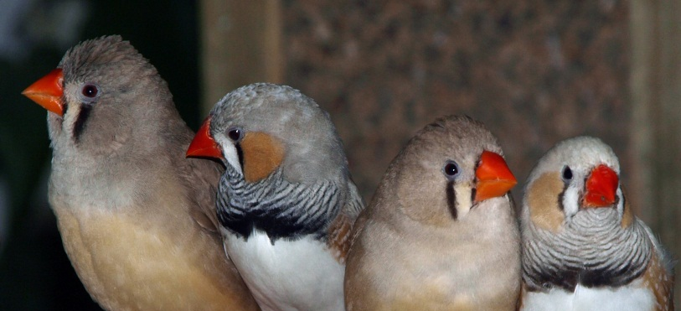
“A New Way of Thinking about LIFE”
Galapagos Islands:
6. In 1835 (4 years later), the HMS Beagle arrived in the ____________ Islands off the coast of South America. Darwin was initially disappointed by the barrenness of these volcanic islands.
7. He began to draw and collect __________________, __________, and other animals on these islands. Darwin “bagged and tagged” most of these animals and they were sent to __________ where a man named ______________ could not classify his specimens as __________ species.
8. Darwin reconsidered his observations and began to suspect, that populations from the South America (the mainland) ___________ after reaching the Galapagos.
Galapagos
mocking birds
finches
England
John Gould
separate
changed

Slide 7
SPECIES
DIVERSITY
ACTIVITY

Slide 8
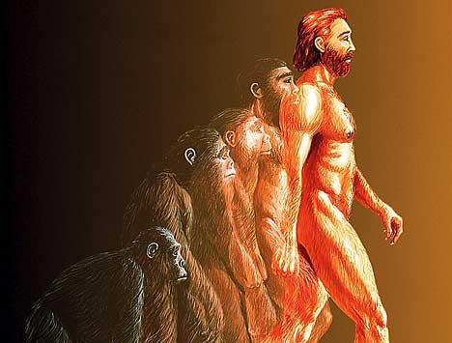
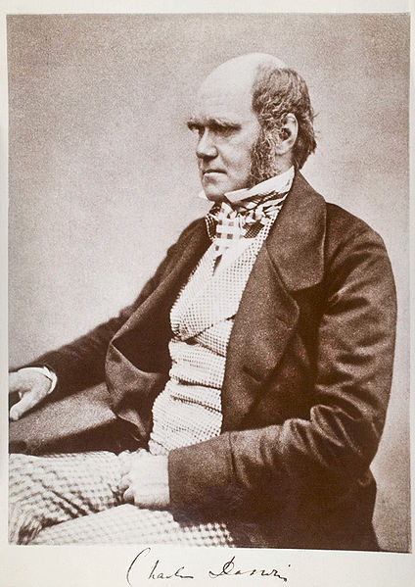
NATURAL SELECTION
“SURVIVAL OF THE FITTEST”

Slide 9
*** NATURAL SELECTION ***
NATURAL SELECTION:
Darwin understood at this time that new species could appear __________ through _______ changes in past (ancestral) species, but he did not know how this process actually worked. Therefore, he turned to a ________ breeder where it all came together. He saw how breeders could ___________ select specific traits by having the most exaggerated expressions of those traits (similar to dog breeders).
This process of selective breeding is called
____________________.
He now thought if humans could change species by artificial selection, then perhaps the same process could work in ______.
gradually
small
pigeon
artificially
artificial selection
nature

Slide 10
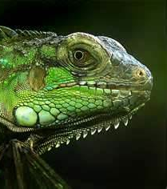
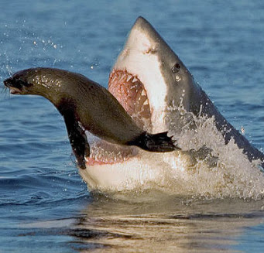
*** NATURAL SELECTION ***
Darwin reasoned that some competitors in the _________ for existence would be better equipped for ________ than others. Those less equipped would ____. Darwin recognized the brutality of nature and its power.
Therefore, the connection was made and natural selection could be summed up called “ ________________________”. Fittest does not mean the strongest, but the most ____________ to change. For example, animals that live in an environment with little food will __________ for that food. The animal that is most suitable for capturing that food will survive and leave the rest to die. The winner can reproduce and have viable offspring that will carry on that specialized equipment in generations to come.
struggle
survival
die
SURVIVAL OF THE FITTEST
adaptable
compete

Slide 11
NATURAL SELECTION
“I never knew that before!”
PLAY VIDEO

Slide 12
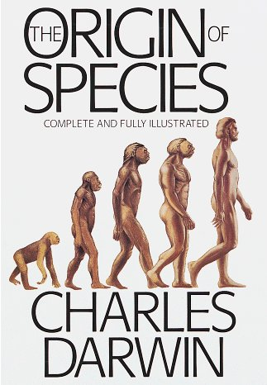
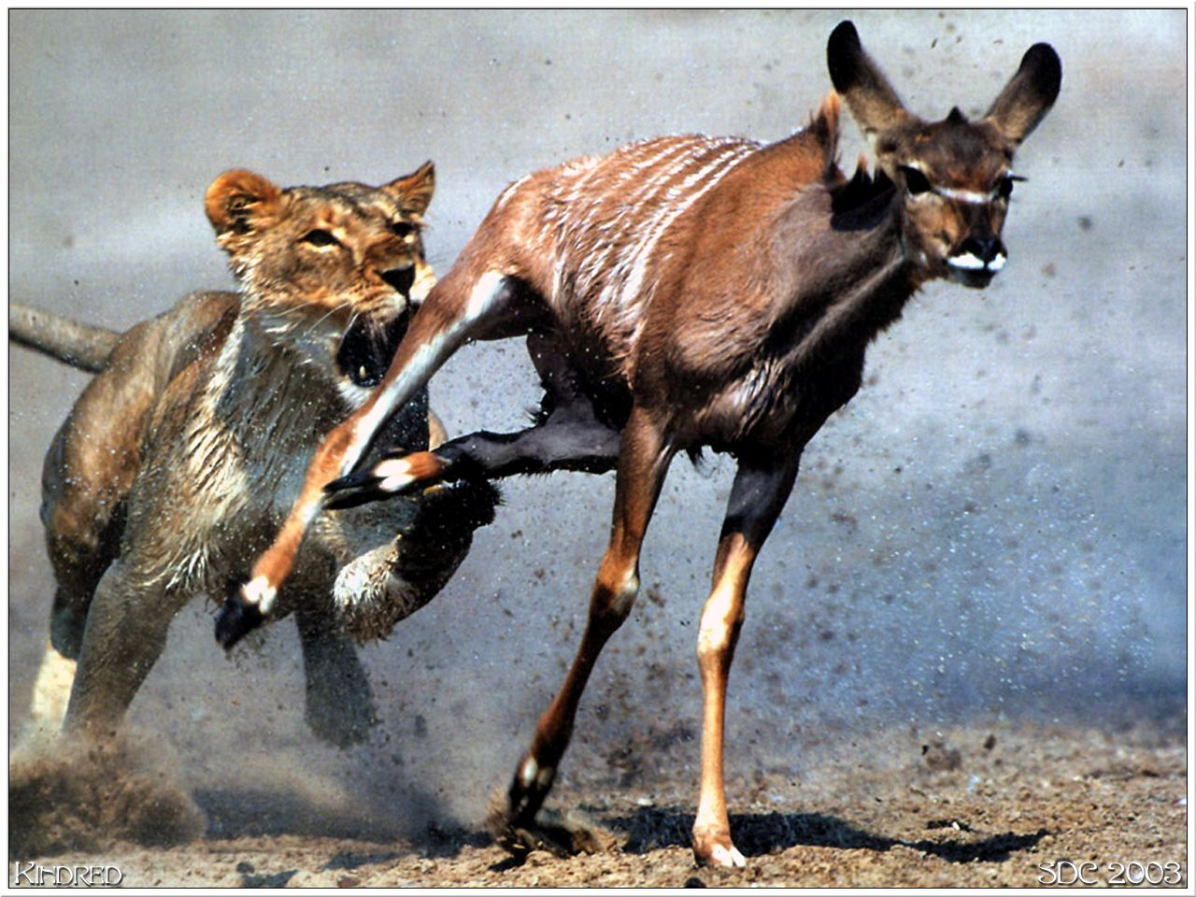
*** NATURAL SELECTION ***
Charles Darwin developed this theory of natural selection which explains how a population of species could be modified to suit the current environment and produce new species. The result of this process is called _____________ by natural selection.
Darwin’s theory of evolution lead to his world changing book called “_______________________”!
EVOLUTION
THE ORGIN OF SPECIES

Slide 13
COMPETITION FOR FOOD
ACTIVITY

