Slide 1
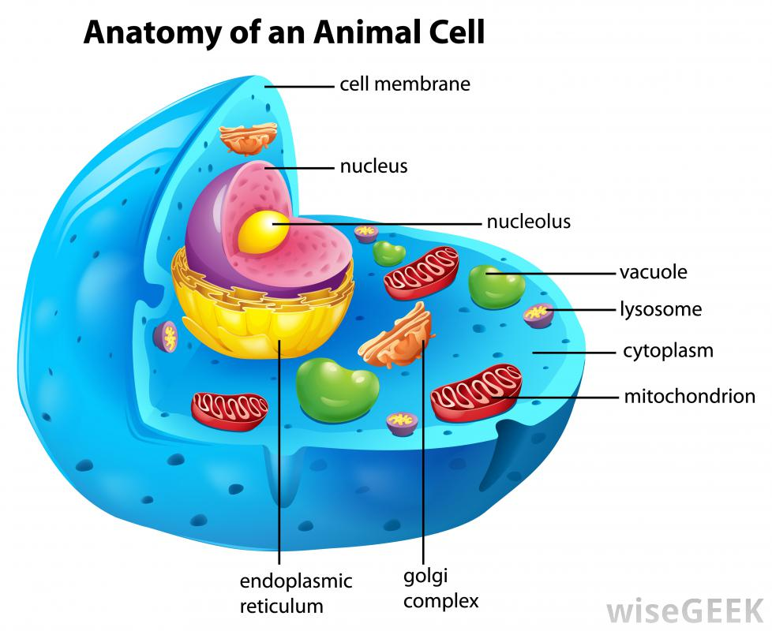
ANIMAL CELL

Slide 2
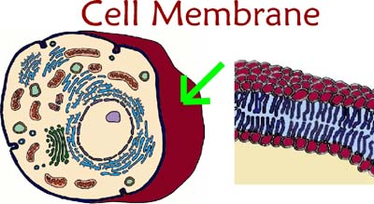
Cell Membrane
Encloses the cell.
Controls what gets in and what gets out of the cell
Acts like a gatekeeper

Slide 3
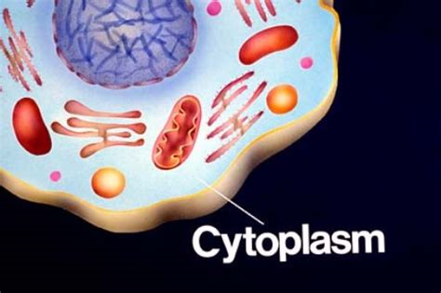
Cytoplasm
A gel-like fluid that takes up most of the space inside a cell
A gel-like fluid that contains all the organelles
https://tse4.mm.bing.net/th?id=OIP.eDijURXy2B6bYvzuJKbSawHaE7&pid=Api

Slide 4
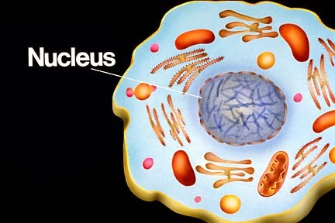
Nucleus
Usually located near the center of cell
Genetic material is found here
Directs the cells activity
Like the Brain of the cell
http://s3.amazonaws.com/rapgenius/1372009846_nucleus.jpg

Slide 5
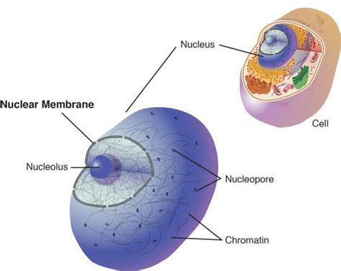
Nuclear Membrane
Surrounds and protects the nucleus
https://tse2.mm.bing.net/th?id=OIP.gpUZJeXKFY8SPwdrOrC_fQHaF5&pid=Api

Slide 6
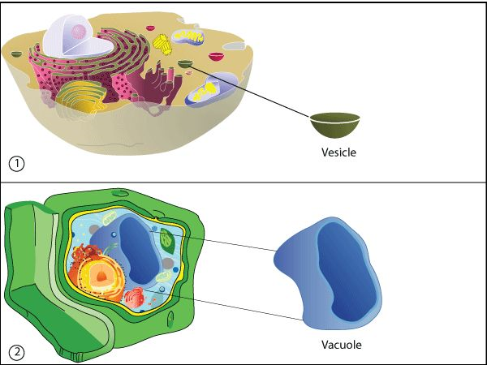
Vacuoles
Fluid filled structures temporarily store different substances needed by the cell
Storage Tank
Animal Cell Vacuoles are Small
Plant Cell Vacuole is Large (only 1)
https://s-media-cache-ak0.pinimg.com/736x/44/b9/08/44b9087594ca3bc1dd00ce441399d24d.jpg

Slide 7
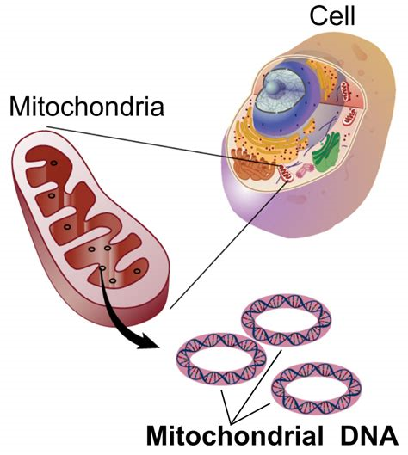
Mitochondria
Powerhouse of the cell
Makes energy for the cell
Uses oxygen to transform the energy in food to form the energy the cell can use to carry out its activities.
https://tse1.mm.bing.net/th?id=OIP.qk40_E0ApGFjGij8NXKywgHaIR&pid=Api

Slide 8
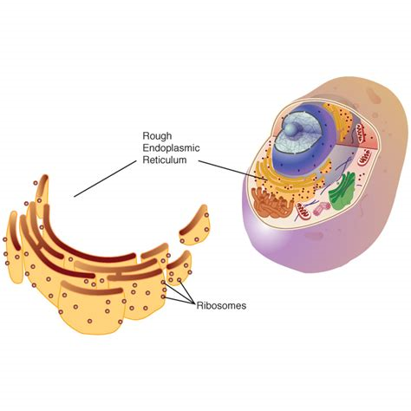
Endoplasmic Reticulum (ER)
Serves an internal delivery system for the cell
https://tse4.mm.bing.net/th?id=OIP.n4hRmRgh7rXcLWtTidTskQHaHa&pid=Api

Slide 9
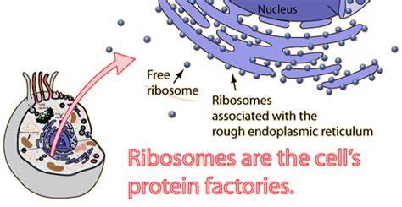
Ribosomes
Produce proteins for the cell
https://tse1.mm.bing.net/th?id=OIP.o-GBVb0OgKB-v0TXu_3xwgHaD1&pid=Api

Slide 10
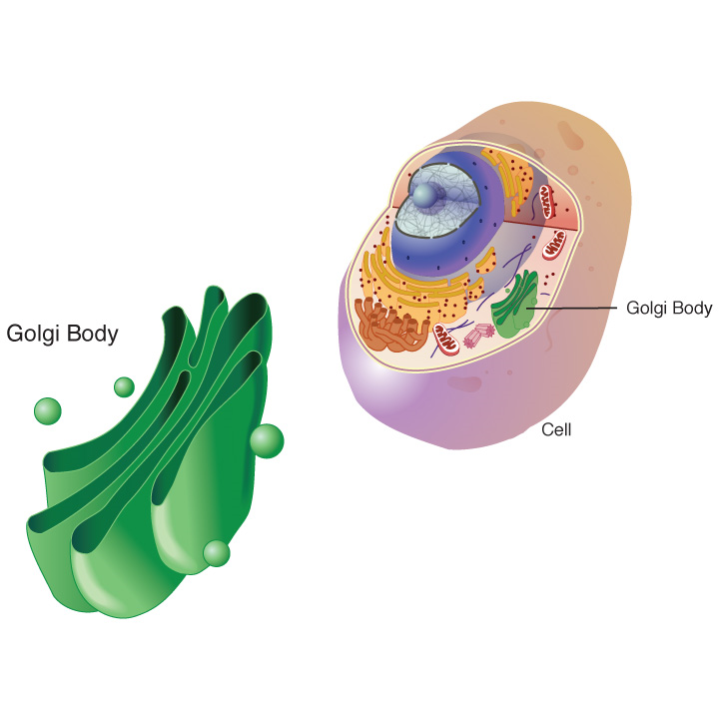
Golgi Bodies
Package products from the ER
Distributes them around the cell
Like the Mail Man of the Cell
http://unlockinglifescode.org/sites/default/files/golgi_body_lg.jpg

Slide 11
Chloroplast
Food making structures of plant cell
Makes chlorophyll, green color in plants
Where Photosynthesis takes place
http://image.slidesharecdn.com/honorsphotosynthesis-120402070717-phpapp02/95/honors-biology-photosynthesis-4-728.jpg?cb=1333350602

Slide 12
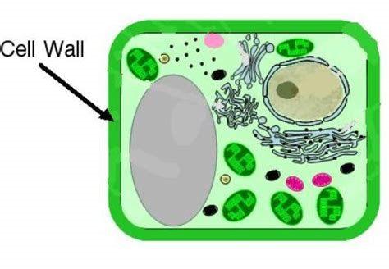
Cell Wall
* Outer barrier provides extra support for the plant cell
* Gives the plant cell its shape
https://tse4.mm.bing.net/th?id=OIP.5XDD9aKO6JC-euYFto410QHaFI&pid=Api

Slide 13
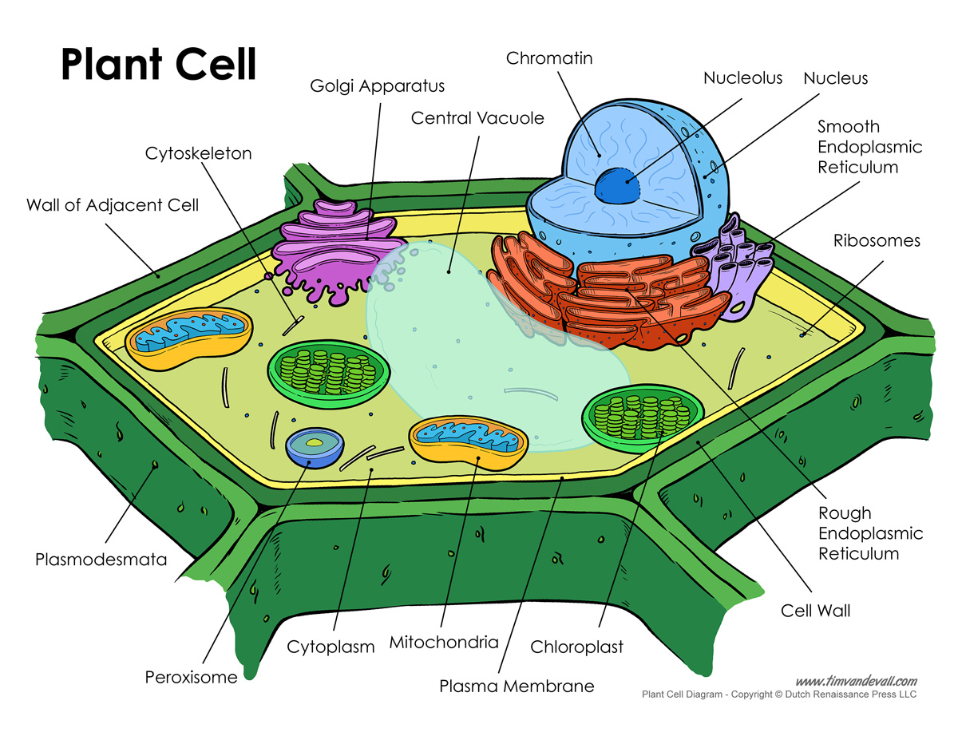
Plant Cell
http://www.timvandevall.com/wp-content/uploads/plant-cell-diagram.jpg

