Slide 1
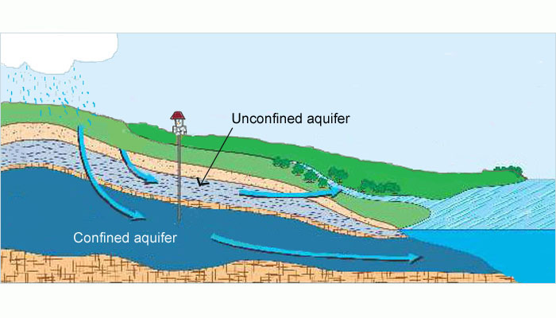
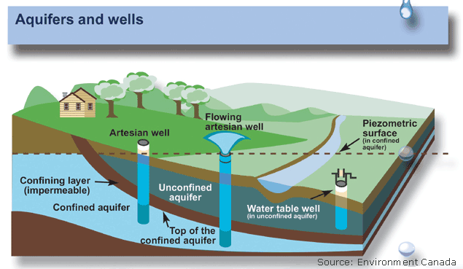
Build an Aquifer Lab

Slide 2
Safety First
Goggles on
Careful with sharp objects
Clean up work area before leave
No Horse Play
Follow directions the first time

Slide 3
Materials Needed
2 water bottles, take labels off
1 pair scissors
1 coffee filter
1/8 the cup pea gravel
1/8 th cup gravel
1/8 th cup sand
Clay
Clean water
Food coloring
Coffee grounds
Pen/pencil
journal

Slide 4
Objective
We will infer why it is not safe to drink water directly from Lake Waco and determine how the pollution we might find in the lake could affect our drinking water. We will do this through investigating how an aquifer works.

Slide 5
Product
We will generate an aquifer model to test how an aquifer helps to clean our water sources. We will determine our understanding of this process through a lab summary.
I will write a summary about the process that our water must go through to be safe to drink.
I will write/share a poster to educate the public about what pollution can do to our drinking water.

Slide 6
Procedure
1. Read entire lab as a group
2. Collect needed materials
3. Watch as Teacher demo’s example
4. Cut both water bottles in half as teacher modeled
5. Put one coffee filter in the bottom of the bottle, the end that you drink out of
6. Put 1/8th cup sand in bottom of 1 bottle
7. Put a ¼ inch layer of clay in bottom of second bottle

Slide 7
8. put 1/8th cup pea gravel in both bottles
9. put 1/8th cup large gravel in both bottles
10. make hypothesis to this question
“If it rained would the bottle with sand or the bottle with clay be more preamble? Why?”
Record Hypothesis in journal
11. Pour ½ cup water over bottle with sand in bottom, make sure bottle is held over top of beaker to catch water
12. Record observation
13. Pour ½ cup of water over bottle with clay in bottom, make sure bottle is held over top of beaker to catch water
13. Record observation
14. Bases on observation from experiment write conclusion to hypothesis. Explain why.

Slide 8
2nd Test
Write Hypothesis in Journal
“When clean rain water filters through the aquifer what will it look like? Explain.”
“How would this water look if the first layer of soil was polluted? Explain”

Slide 9
1. Pour ½ cup of clean water over bottle with sand in bottom.
2. Record observation
3. Ask teacher to put food coloring over top layer of sediment (food coloring represents pollution that was run off in our water shed)
4. Record what you think will happen when it “rains” next
5. Pour ½ cup clean “rain” water over bottle with sand in bottom
6. Record what happened
7. Bases off of hypothesis and experiment write a conclusion to this test. Explain why.

Slide 10
Conclusion Questions
1. What is a permeable layer in an aquifer?
2. What is an impermeable layer in an aquifer?
3. How are the two layers different?
4. Does the size of the sediment make a difference? Why? Explain
5. How does pollution affect our aquifers?

Slide 11
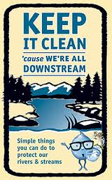
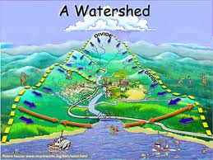
Educate the Public
Make a poster to educate the public on one way they can help keep our watershed clean.
Creativity and Neatness Counts.

