Slide 1
Biodiversity
By C Kohn, Waterford WI

Slide 2
Objectives
Define and describe “biodiversity”
Explain how biodiversity is used as a measure of the health of an ecosystem
Connect how increased biodiversity can lead to a more stable ecosystem

Slide 3
Background
All life on earth has one thing in common: DNA
  Every characteristic of every living species is a result of that species’ DNA
  All the diversity of living species is due to changes in that species’ DNA
The higher the genetic diversity, the healthier the ecosystem
  Each living species plays a role and serves a purpose in an ecosystem.
  The more species that exist, the more secure an ecosystem will be (in general)

Slide 4
3 levels of diversity
There are really three levels of diversity that we are concerned about:
  1. Genetic Diversity: variations among individuals of a species (e.g. among human beings, there are many different traits such as eye color, hair color, height, etc.)
  2. Species Diversity: all of the species that exist in a specific area (e.g. Wisconsin has more species than some areas but less than others)
  3. Ecosystem Diversity: the measure of the variety of ecosystems on the planet including forests, prairie, coral reefs, tundra, etc.

Slide 5
Biodiversity, Defined
Biodiversity: the measure of the genetic variability of species and ecosystems.
3 key components:
  Genetic Variability
  Species
  Ecosystems
Biodiversity = #Species/ #Individuals
  E.g. a corn field has very low biodiversity
  10,000 individual corn stalks but one species = 1/10000, or a biodiversity score of 0.0001
  Max = 1.0

Slide 6
Why Does Biodiversity Matter?
Biodiversity matters because it is a measure of the health of an ecosystem.
To understand why this is the case, we have to understand the basics of how an ecosystem works.
For an ecosystem to function, it must be able to serve different roles and provide various services.

Slide 7
Examples of Ecosystem Services
Energy flow –
  Capture and utilization of sunlight at all trophic levels (trophic levels: producers, primary consumer, secondary consumer, decomposer)
Nutrient cycling –
  Conversion of inorganic carbon (CO2) to organic carbon (sugars, cellulose, living tissue)
  Conversion of inorganic nitrogen (N2) into organic nitrogen (amino acids, peptides, proteins)
Filtration & Removal of waste and pollutants
  Purification of water
  Air purification
Reproduction and Genetic Diversity
  Pollination
  Species vigor (“weeding out the sick and lame”) created by predation and competition

Slide 8
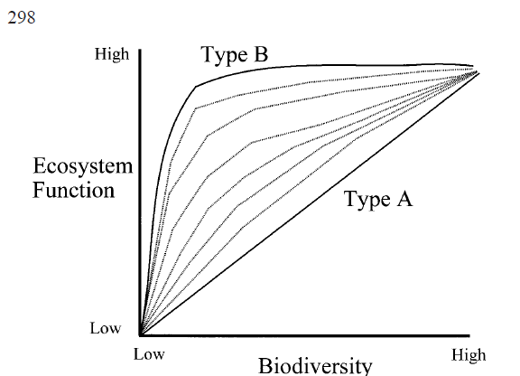
Hypothetical relationship between biodiversity and ecosystem function
TPS: Create a caption for this graph
Source: Schwartz, et. al. 1999. Linking biodiversity to ecosystem function: implications for conservation ecology. UC-Davis
http://bio.research.ucsc.edu/people/thompson/PublPDFs/Schwartzetal00.pdf

Slide 9
Ecosystem Function
It can be hard to imagine an ecosystem functioning at higher rates.
It might be easier to compare a normal ecosystem to a degraded natural area
Whiteboards: divide your board in half; then compare a well-functioning ecosystem to a degraded or polluted natural area. What makes them different?

Slide 10
Loss of Biodiversity = Loss of Life
As biodiversity decreases, so do ecosystem services (energy flow, nutrient cycling, filtration, resource renewal, reproduction, etc.)
As ecosystem functions decrease, each individual and each species is put at greater risk for loss due to the fact that the other species that they depend upon will decrease in numbers.

Slide 11
Community Analogy
Pretend for a moment that species are like members of the community.
Instead of different species, we have ‘police’, ‘firefighters’, ‘teachers’, ‘business owners’, etc.
TPS:
What would the community be like if we increasingly lost individuals within each of these categories.
What would it be like if we started to lose whole categories?
What conditions might lead to this situation?

Slide 12
Community to Ecology
Just as slight changes in the economy, safety, or governance of a community can create snowballing effects in that community’s structure, so to can small changes lead to drastic outcomes in an ecosystem.
Slight changes in the pH of a lake, an increase in the number of invasive species in a forest, or the loss of keystone species in a prairie can cause rippling effects that induce losses at every level in that particular ecosystem.

Slide 13
Loss of Biodiversity
Whiteboard Challenge: What can cause the loss of biodiversity? Make the longest list you can of possible of potential causes of biodiversity.
After each item, briefly explain how it causes a loss of biodiversity.

Slide 14
Our Job
The role of a natural resources management is to maximize biodiversity and minimize species loss.
Whether it is game management, environmental protection, or ecological sampling, the job is the same – minimize the loss of diversity.
Next week: how do we lose biodiversity?

