Slide 1


August 29, 2014 Warm Up
Please sharpen pencil before you sit down.
Please collect file folder before you sit down.
Take seat Silently and sit down
Take out composition notebook
Take out any signed paperwork that needs to be turned in (safety contract, newsletter, syllabus, mobile device)

Slide 2
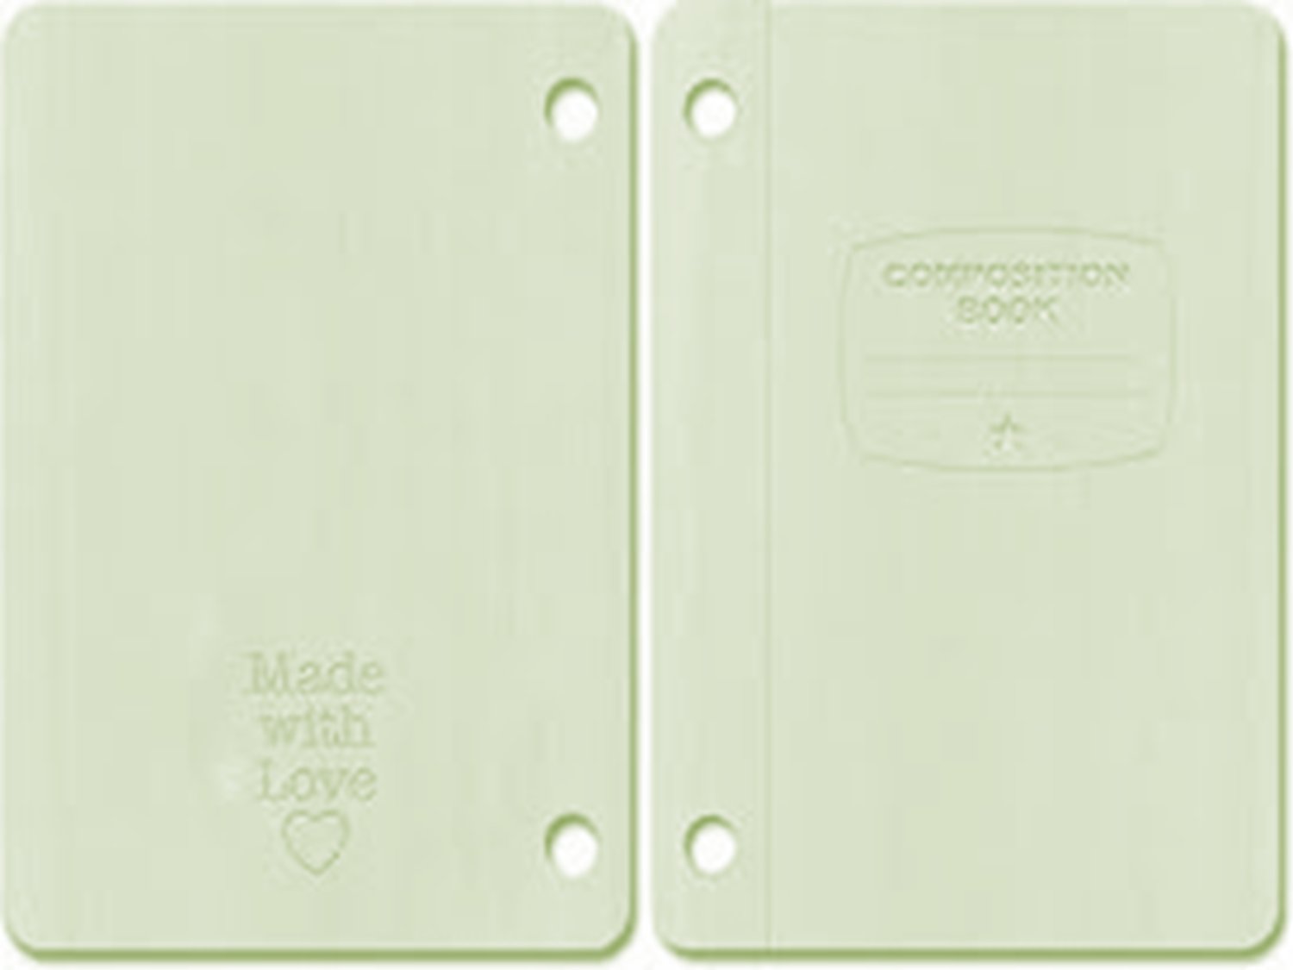
What is an Interactive Journal?
Class Discussion:
Teacher will explain with additional File…

Slide 3
Order to put items into Journal
Front Cover: Glue White Sheet of Paper on (teacher will model)
Inside Front Cover: Glue “My Science Journal” sheet
Number pages in top outside corner of paper (teacher will model)
Page 2/3: Left, Right side handouts
Page 4/5: Table of Contents (teacher will model)
Page 6: Fryer Model Diagram (teacher will model)
Page 8/9: Prefix – Root Word – Suffix sheets
Page 10: Leave Blank

Slide 4
Page 11/12/13/14: Unit 1 Physical Properties of Matter page (teacher will model)
Going Backwards in Book (Teacher will model)
Back inside cover: Leave blank so can see conversion charts
Back page: Periodic Table of Elements
Next 2 pages: Laboratory Report Format (left side) Laboratory Report Score Sheet (right side)
Next Page: Rubric for Grading
Next Page: Scientific Method
Next Page: Lab Tools / Laboratory Safety Symbols
Next Page: Conversion Tables / SI Base Units
Next Page: Measurement Definitions / Conversion table with the thermometer at the bottom of the page

Slide 5
Teacher will Walk you through how to put this together.
Once everything is glued in and labeled, go back and design cover (science related)
Remember to be creative but appropriate

