Slide 1
August 30,2019
Collect DOL Quiz from Blue Basket
Sharpen Pencil
Sit in seat silently
Complete the DOL quiz

Slide 2
TEKS 6.11
(A) describe the physical properties, locations, and movements of the Sun, planets, moons, meteors, asteroids, and comets;
(B) understand that gravity is the force that governs the motion of our solar system; and
(C) describe the history and future of space exploration, including the types of equipment and transportation needed for space travel.

Slide 3
L.O.
Regular:
Student will compare/contrast different objects found in space through completing a vocabulary activity.
Honors:
Student will create a celestial object book to compare/contrast different objects found in space.

Slide 4
D.O.L.
Student will complete 5/5 questions over objects in space such as planets, asteroids, comets, meteors, and/or the sun with 80% accuracy or higher.

Slide 5
Honors
Continue to work on Celestial Objects Book
Resources:
Textbook, starts of page 356
Print out resources (Coach Pease has on lab table 3)
www.coachpease.com
Links
Celestial Objects / Space

Slide 6
Regular
Students will create a diagram of the solar system to compare/contrast different objects in space.
1. Diagram must contain:
Sun All 8 Planets Comets
Asteroid Belt Meteors
2. Label all items in the diagram
3. All planets must contain information below written inside of the planet
Name Distance from the Sun
Mass Atmosphere (gasses)
Composition (material made out of)

Slide 7
Resources to Assist
Name
Textbook, starts on page 356
Pre-Ran Powerpoint notes
Vocabulary Foldable
www.cochpease.com
“1st 6 Weeks” Link and/or “Links” link
Mass:
Distance from Sun:
Atmosphere (Gasses):
Composition
(materials made out of):

Slide 8
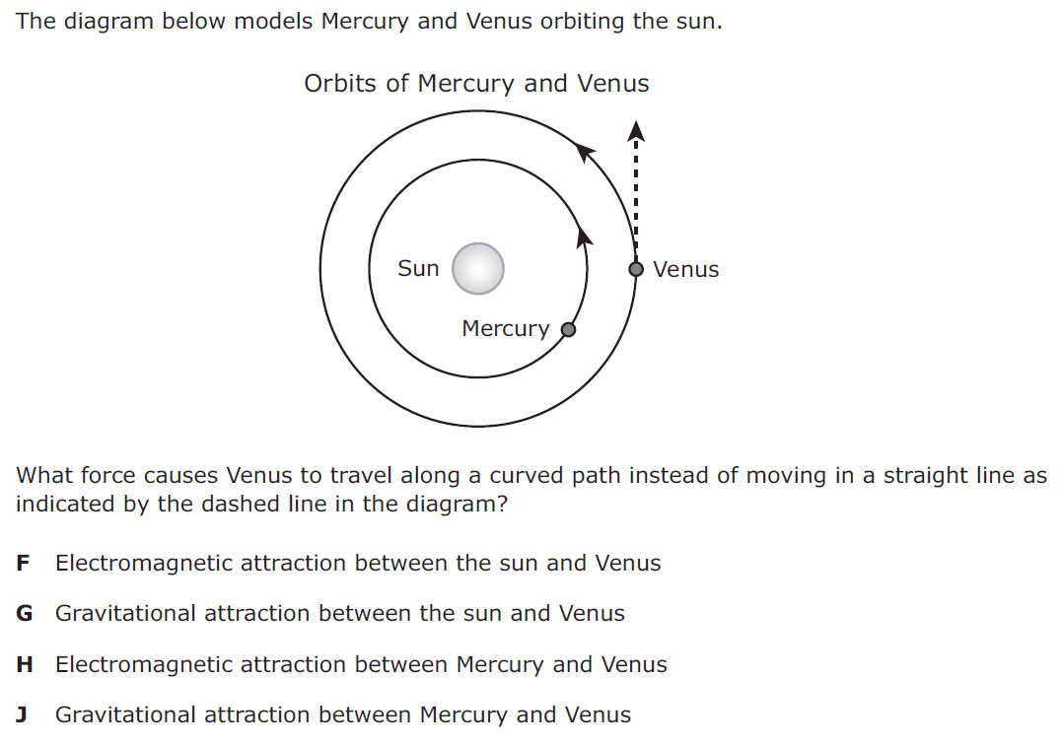
DOL Quiz Name: _______________ Per.___
1.

Slide 9
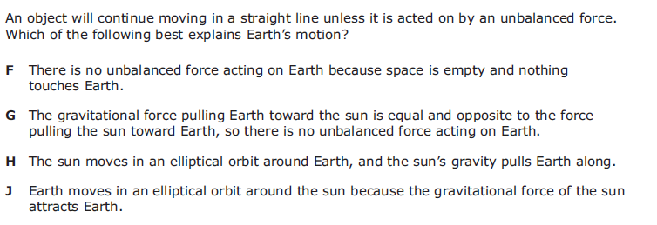
2.
3.
The majority of asteroids are found in a belt located between what two planets?
a. Earth and Mars
b. Mars and Venus
c. Mars and Jupiter
d. Jupiter and Saturn

Slide 10
4. The four inner planets are rocky and small. Which description best fits the next four outer planets?
A. They are also rocky and small.
B. They are very large and made of ice.
C. They are small and made of ice.
D. They are very large and made of gases.
5. What are comets mostly made of?
A: Ammonia C: Ice
B: Hydrogen D: Iron

