Slide 1
Aug. 30, 2017
Please Collect PDN
Sharpen Pencil
Sit silently in same seat as yesterday
Begin / Complete PDN on own

Slide 2
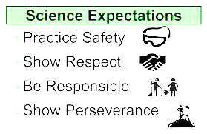
LO: We will understand procedures and expectations in the classroom, lab and school.

Slide 3
DOL: I will explain what my the purpose of science journal in 2 or more complete sentences.

Slide 4
Agenda
1. PDN
2. Collect signed paper work
3. Explain Journal Expectations
4. Build Science Journals
5. DOL

Slide 5
Inter-active Journal Power Point Examples
http://www.coachpease.com/resources/science%20interactive%20notebooks%20presentation.pdf
http://www.coachpease.com/resources/Interactive%20notebook.pdf

