Slide 1

April 9, 2018
Collect PDN from basket
Turn off or silence Cell Phone NOW!!!
Sharpen Pencil
Sit in assigned seat
Complete PDN on own

Slide 2
Agenda
7th Grade
PDN
Review 5th 6 Wk Test
Water Shed Foldable
DOL
6th Grade
PDN
Review 5th 6 WK Test
Nervous System Foldable
DOL

Slide 3
LO’s
7th Grade
We will identify the structures and functions of a watershed.
6th Grade
We will identify the structures and functions of the nervous system.

Slide 4
DOL’S
7th Grade
I will complete an exit slip to explain what a water shed is.
6th Grade
I will complete an exit slip to explain the main function of the nervous system.

Slide 5
TEK’S
7th Grade
7.8C (C) model the effects of human activity on groundwater and surface water in a watershed
6th Grade
7.12B (B) identify the main functions of the systems of the human organism, including the circulatory, respiratory, skeletal, muscular, digestive, excretory, reproductive, integumentary, nervous, and endocrine systems

Slide 6
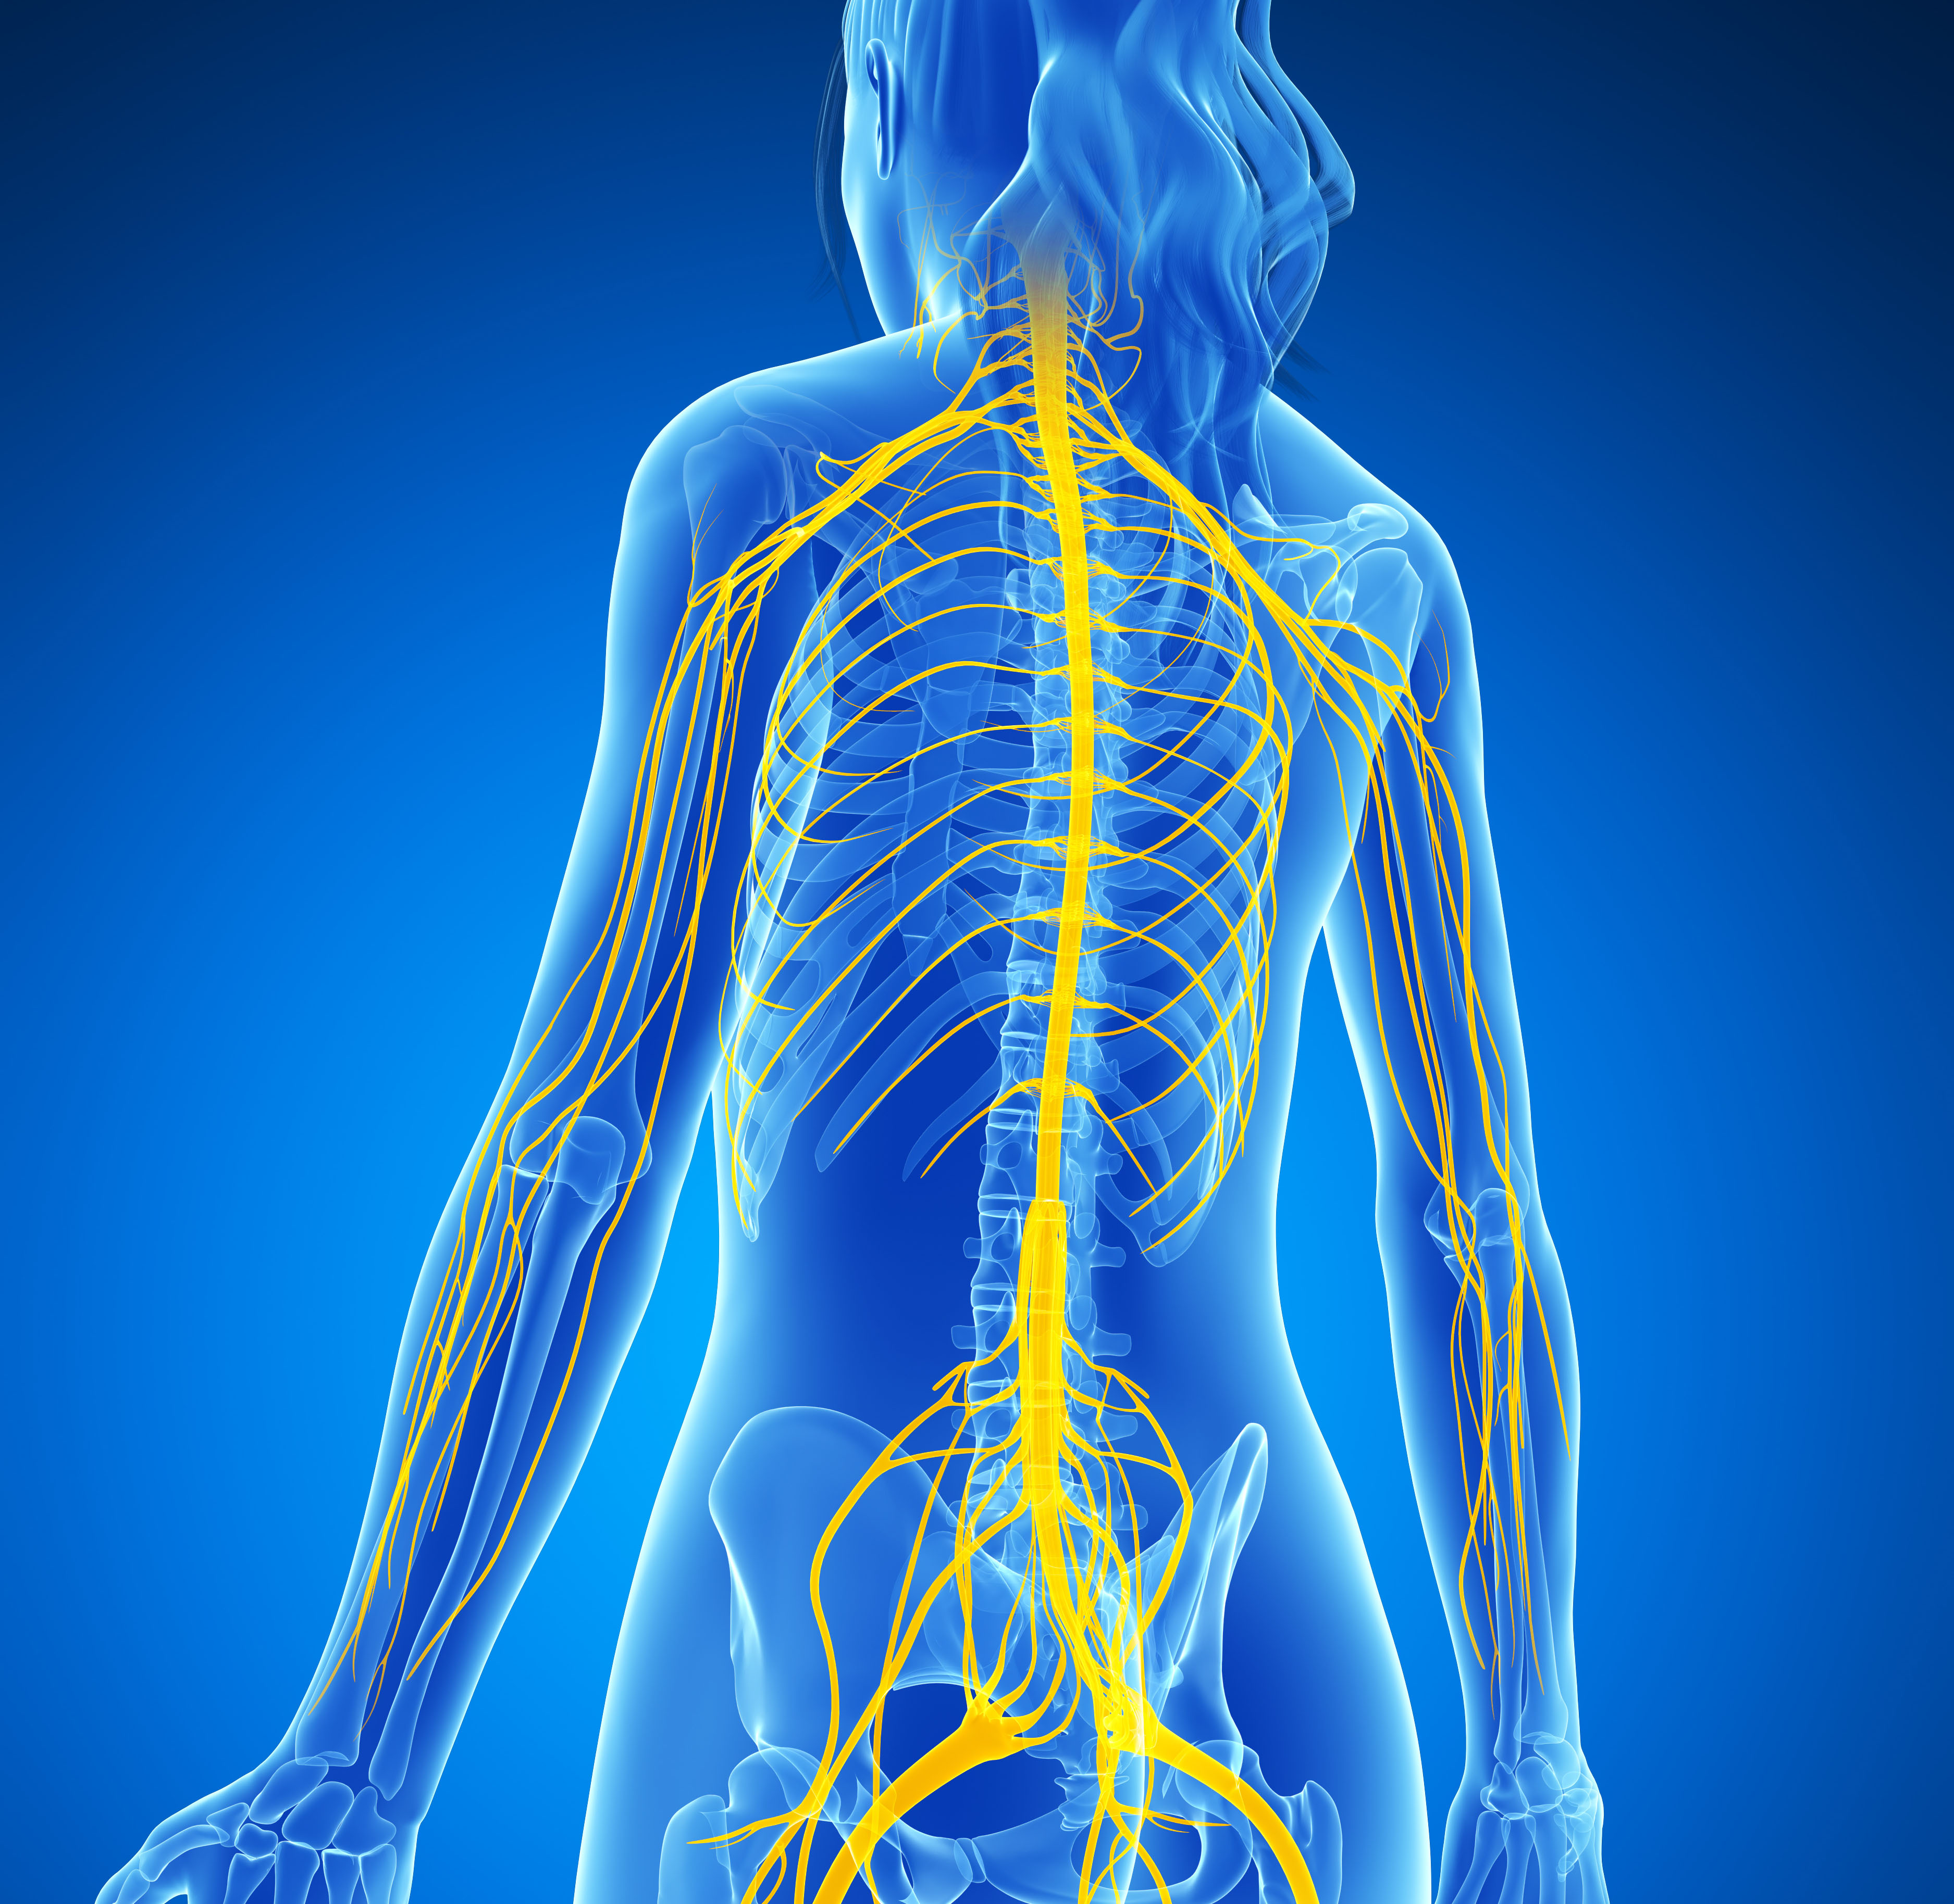
6th Pre-AP Science
Review 5th 6 Weeks Test
Take out your Nervous System Foldable (in journal
Complete Journal as follow along with nervous system power point

Slide 7
7th Grade Science
1. Review 5th 6 Week Test
2. Collect Water Shed Foldable
3. Students follow along with power point to complete foldable over watershed

