Slide 1
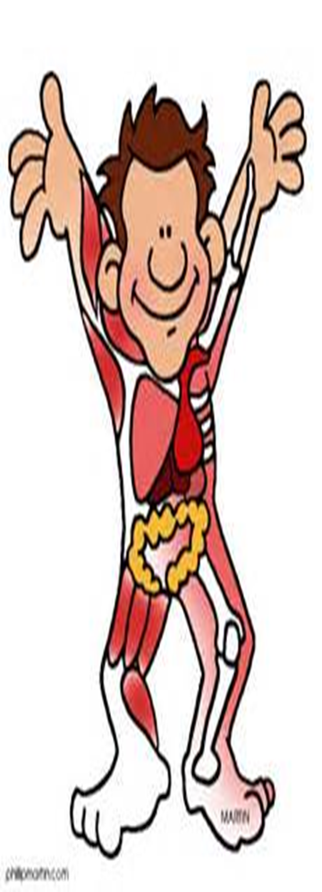
April 8, 2016 Please Do Now
Sharpen Pencil
Collect Chrome Book, Clicker, Pen/Pencil that works
Collect DOL: The Endocrine System from turn in basket
Continue to Work on This Weeks Playlist

Slide 2
Agenda
DOL Correct with Clickers
Finish Items in Playlist
Practice Vocabulary over human body by playing virtual games
Games found on Website under “Games”

Slide 3
Clickers / Correct Endocrine System DOL
Once graded glue into journals to assist with studying

Slide 4
Complete Items on Playlist
1. Nervous System Foldable
2. Endocrine System Foldable
3. Nervous System Diagram Poster
4. 5th 6 Weeks Review
Resources found on website, textbook, handouts, journals
www.coachpease.com
Login to “5th 6 weeks”, “Links”, “Games”

Slide 5
DOL / Exit Slip
Students will tell 3 things they will do to help prepare for 5th 6 Weeks District Test on a post it note.

