Slide 1
April 7, 2017
Sharpen Pencil
PDN, 7th Grd Textbook for 7th Grade
6th Grd: Collect Chrome Book (1 per group) login to Buncee and work on Project
3. Sit in assigned Seat
4. Complete PDN / Catastrophic Event Project

Slide 2
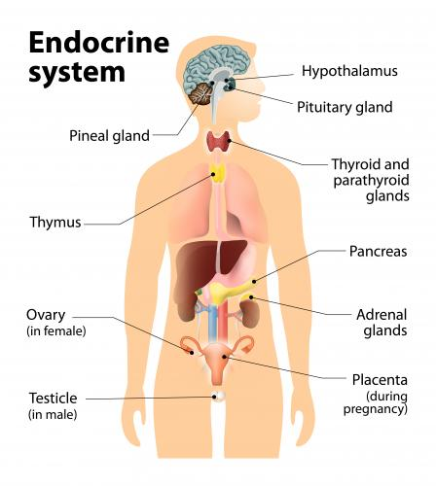
7th Grade Agenda
PDN Endocrine System
Video Clip from kidshealth.org Endocrine System
Endocrine System Foldable
DOL Endocrine System Exit Slip

Slide 4
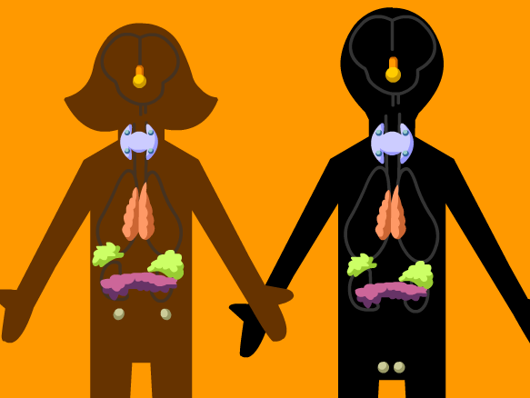
7th Grade LO
LO: We will compare/contrast the different structures and functions of the endocrine system through completion of a foldable.
TEK: 7.12B

Slide 5
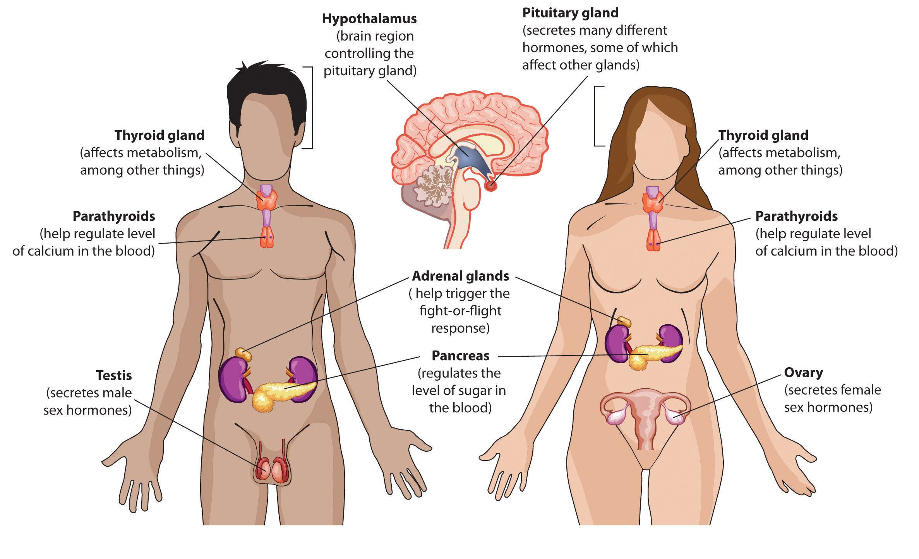
7th Grade DOL
DOL: I will complete an exit slip to explain how my endocrine system helps my body maintain homeostasis.

Slide 6
Disclaimer Slide
Due to working on same topic as earlier in the week, some slides are not listed here. The missing slides are hanging up in classroom from previous days daily agendas.

Slide 7
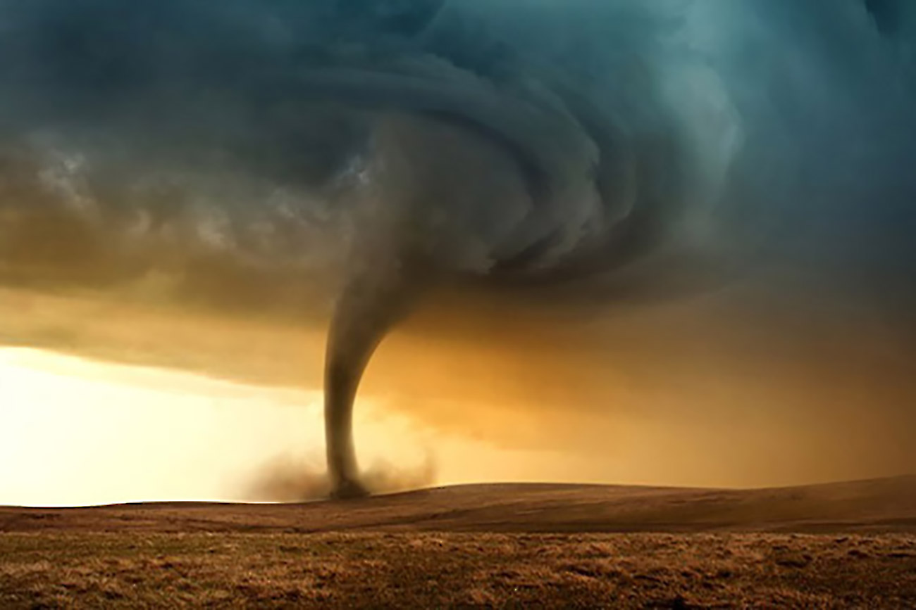
6th Grade Agenda
DOL Catastrophic Events
Teacher Explain Project
Catastrophic Event Project
DOL Quiz

Slide 8
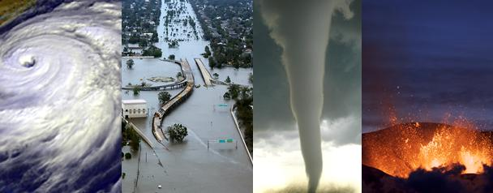
6th Grade LO
We will investigate one type of catastrophic event in depth to assist in creating a public service announcement via buncee.com that will educate others about what to do in case they have to experience such an event.

