Slide 1
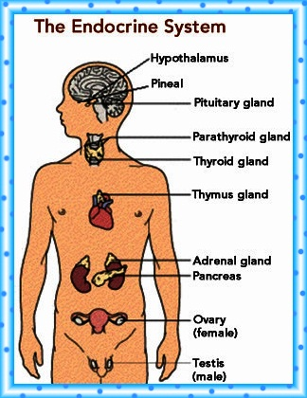
April 6, 2016 / Please Do Now
Sharpen Pencil
Collect Please Do Now from blue basket, chrome book (NO NOT LOGIN), pen / pencil that works
Take out Planner, Write in Homework: Study/Complete Endocrine System Foldable
Use the textbook to complete the please do now

Slide 2
Agenda
Please Do Now
Pass out Clickers
Essential Question
Endocrine System Foldable
DOL / Exit Slip

Slide 3
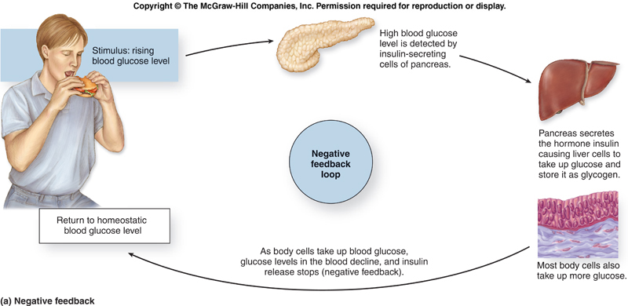
Essential Question:
What happens to Coach Pease if her sugar levels get to low? Is her body at homeostasis when this occurs? What symptoms does she exhibit to help you know if she is not at homeostasis? What other body system will help her blood sugar levels to reach homeostasis besides her digestive system? Explain.

Slide 4
Endocrine System Foldable
Teacher will pass out and explain/model how to complete the foldable
Students will watch a video clip over the endocrine system as teacher passes out foldable
https://www.youtube.com/watch?v=HXPCQBD_WGI
Students use information collected form video to assist with completing the foldable

Slide 5
Power Point to Assist with Foldable on Endocrine System
Login to www.coachpease.com
Click on 5th 6 weeks
Scroll to “The Endocrine / Nervous System” power point
Use the information gathered form the power point to complete the foldable
May also use Textbook pg. 482-485

Slide 6
DOL / Exit Slip
Students answer questions over the nervous system on own without a textbook or use of their foldable

