Slide 1
April 5, 2017
Sharpen Pencil
PDN, 7th Grd Textbook for 7th Grade / Handout for 6th Grade
Sit in assigned Seat
Complete DOL

Slide 2
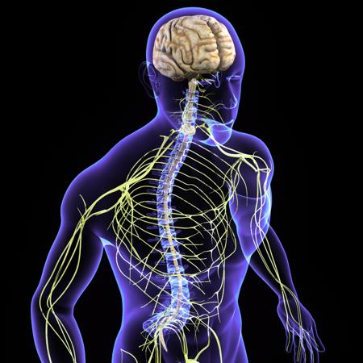
7th Grade Agenda
PDN Nervous System
Noise Test
Video Clip from kidshealth.org Nervous System
Nervous System Foldable
DOL Nervous System

Slide 4
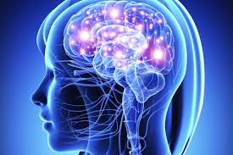

Slide 5
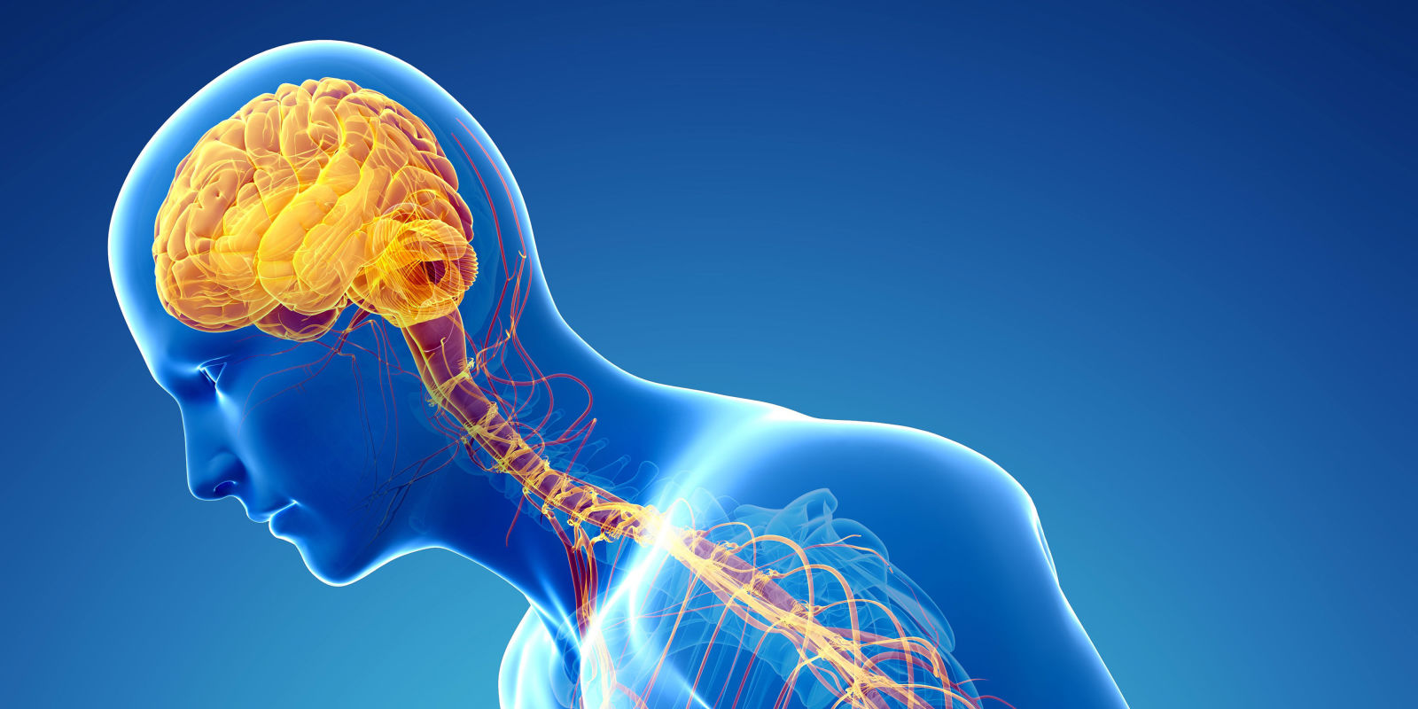

Slide 6
Disclaimer Slide
Due to working on same topic as earlier in the week, some slides are not listed here. The missing slides are hanging up in classroom from previous days daily agendas.

Slide 7
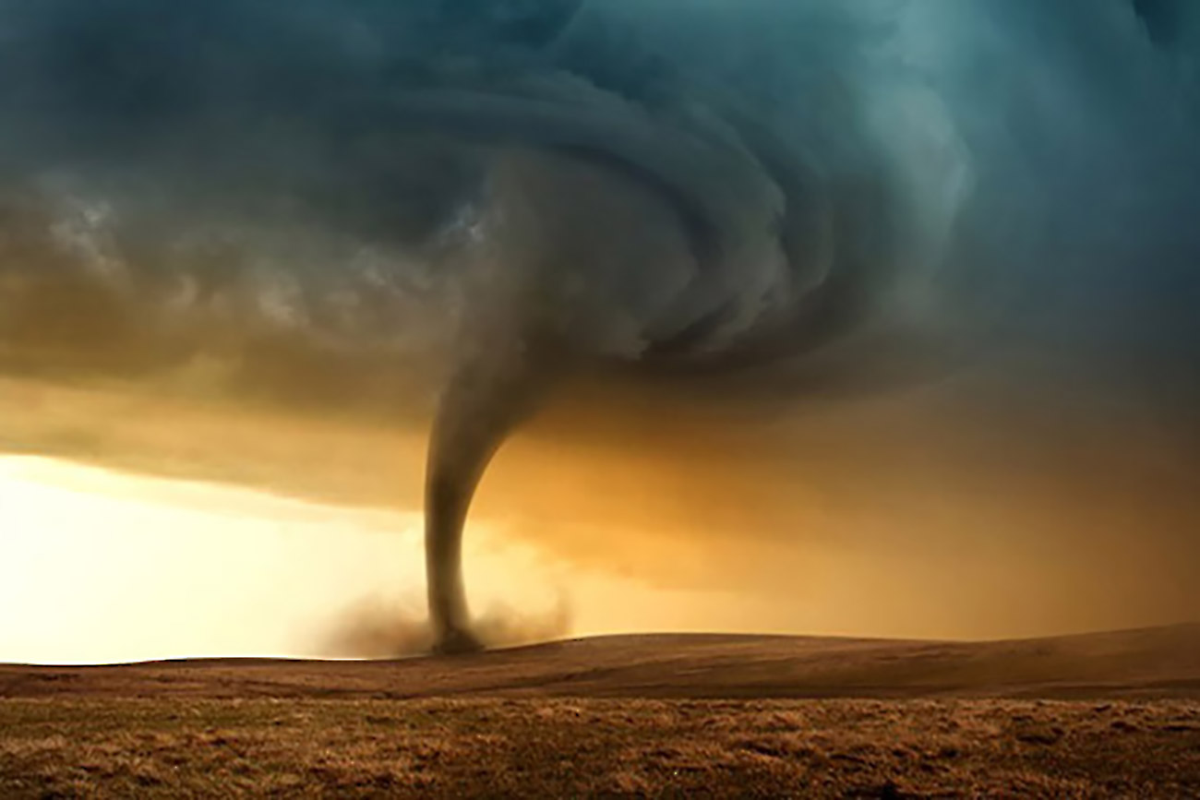
6th Grade Agenda
PDN
Teacher Explain Project
Catastrophic Event Project
DOL Quiz

Slide 8
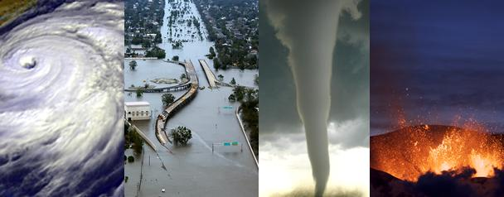
6th Grade LO
We will investigate one type of catastrophic event in depth to assist in creating a public service announcement via buncee.com that will educate others about what to do in case they have to experience such an event.

