Slide 1
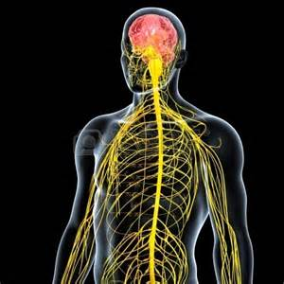
April 5, 2016 / Please Do Now
Sharpen Pencil
Collect Please Do Now from blue basket, chrome book (NO NOT LOGIN), pen / pencil that works
Take out Planner, Write in Homework: Study/Complete Nervous System Foldable
Use the textbook to complete the please do now

Slide 2
Agenda
Please Do Now
Pass out/Explain Clickers
Vocabulary Match Up
Nervous System Foldable
Nervous System Diagram
DOL / Exit Slip

Slide 3
Vocabulary Match Up
Students work in small groups to match the structure (vocabulary term) to it’s function (definition/job it performs).
Groups will race against each other to see who can complete it first with most correct matches.

Slide 4
Nervous System Foldable
Teacher will pass out and explain/model how to complete the foldable
Students will watch a video clip over the nervous system as teacher passes out foldable
https://www.youtube.com/watch?v=ivk_irrH1WY
Students use information collected form video to assist with completing the foldable

Slide 5
Power Point to Assist with Foldable on Nervous System
Login to www.coachpease.com
Click on 5th 6 weeks
Scroll to “The Nervous System” power point
http://www.coachpease.com/resources/The%20Nervous%20System.ppt
Use the information gathered form the power point to complete the foldable
May also use Textbook pg. 475-481

Slide 6
Nervous System Diagram
Student will collect 1 “boy” diagram and 1 neuron diagram from playlist 2 basket
Color both diagrams
Cut out both diagrams and glue onto large sheet of construction paper (see teacher example)
Label each part of the nervous system and the neuron
Write the function for each structure below the label (see teacher example if not sure)
Be sure to put your name / class period on diagram poster before you turn it in.
Take your time, NEATNESS counts.

Slide 7
DOL / Exit Slip
Students answer questions over the nervous system on own without a textbook or use of their foldable

