Slide 1
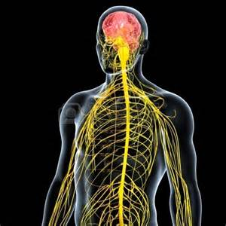
April 4, 2016 / Please Do Now
Sharpen Pencil
Collect Please Do Now from blue basket, chrome book (NO NOT LOGIN), pen / pencil that works
Take out Planner, Write in Homework: Study/Complete Nervous System Foldable
Use the textbook to complete the please do now

Slide 2
Agenda
Please Do Now
Pass out/Explain Clickers
Essential Question
Nervous System Foldable
DOL / Exit Slip

Slide 3
Essential Question:
We learned that out skeletal muscles react voluntarily to move our skeleton, but what allows these muscles to know when to cause movement in the body? What body system is responsible for sending the message to our skeletal muscles to contract or relax? Explain.

Slide 4
Nervous System Foldable
Teacher will pass out and explain/model how to complete the foldable
Students will watch a video clip over the nervous system as teacher passes out foldable
https://www.youtube.com/watch?v=ivk_irrH1WY
Students use information collected form video to assist with completing the foldable

Slide 5
Power Point to Assist with Foldable on Nervous System
Login to www.coachpease.com
Click on 5th 6 weeks
Scroll to “The Nervous System” power point
http://www.coachpease.com/resources/The%20Nervous%20System.ppt
Use the information gathered form the power point to complete the foldable
May also use Textbook pg. 475-481

Slide 6
DOL / Exit Slip
Students answer questions over the nervous system on own without a textbook or use of their foldable

