Slide 1
April 28, 2017
Sharpen Pencil
Collect PDN / DOL, 7th Grade Textbook
Sit in assigned Seat
Complete PDN / DOL

Slide 2
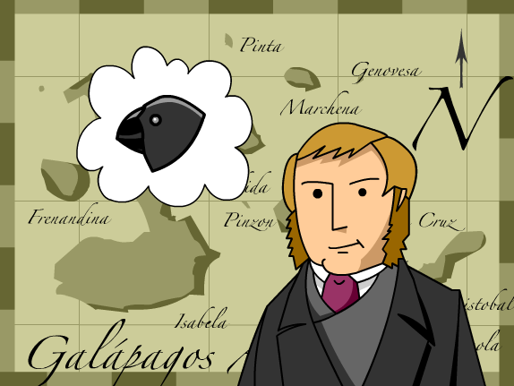
7th Grade Agenda
1. PDN
2. Moth Quick Lab
3. Natural Selection / Darwin Foldable
4. DOL

Slide 3
7th Grade TEKS
7.11(C) identify some changes in genetic traits that have occurred over several generations through natural selection and selective breeding such as the Galapagos Medium Ground Finch (Geospiza fortis) or domestic animals

Slide 4
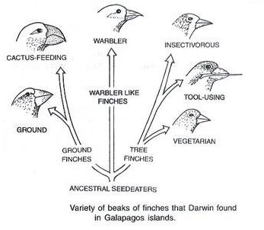
7th Grade Lo
We will investigate who Darwin was and his discovery of natural selection through completion of a foldable.
7.11(C) identify some changes in genetic traits that have occurred over several generations through natural selection and selective breeding such as the Galapagos Medium Ground Finch (Geospiza fortis) or domestic animals

Slide 5
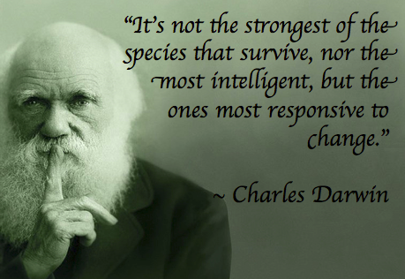
7th Grade DOL
I will complete written STAAR type assessment questions over natural selection and Darwin via a DOL quiz.

Slide 6
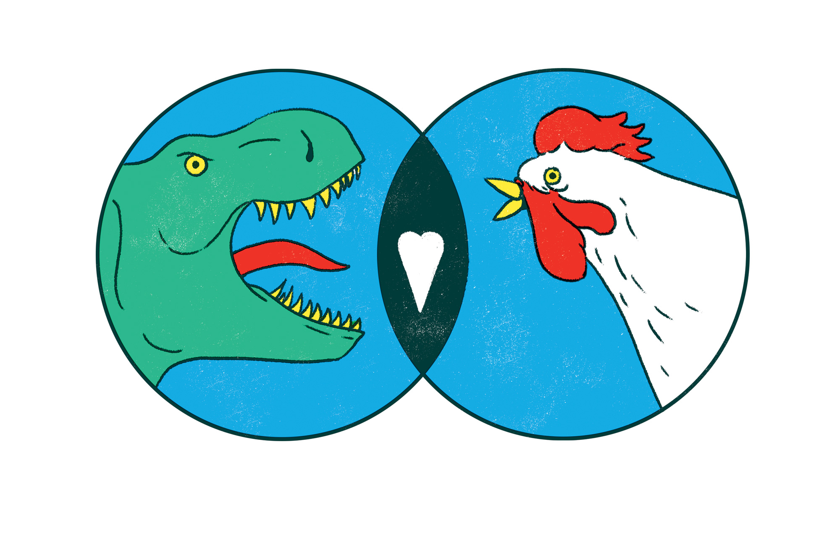
7th Grade Question:
What does a chicken and a dinosaur have in common? Explain.
Pair Share
Video to Explain: https://www.youtube.com/watch?v=0-7iXyYS0uw
https://www.youtube.com/watch?v=XAzGC89n0S4
Who played a major role in helping us to understanding how this could be? What was the specie of animals is he most famous for to help explain this relationship, how animals change/adapt over time?
https://www.youtube.com/watch?v=XAzGC89n0S4

Slide 7
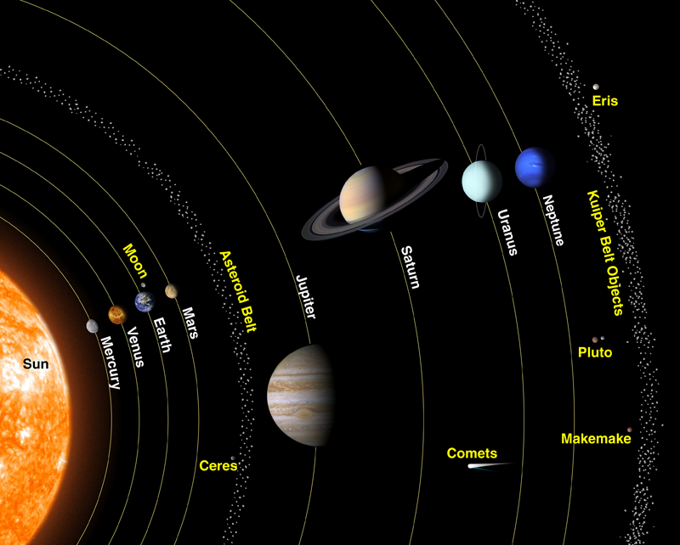
6th Grade Agenda
1. PDN
2.Why is their only life on Earth??? Space Video
3. Characteristics of Objects in Space Foldable https://dallasisd.schoology.com
4.. DOL

Slide 8
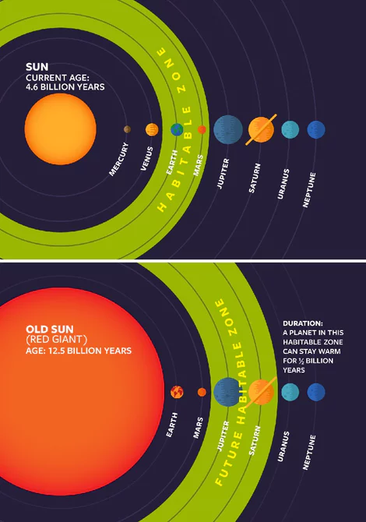
6th Grade TEKS
7.9(A) analyze the characteristics of objects in our solar system that allow life to exist such as the proximity of the Sun, presence of water, and composition of the atmosphere

Slide 9
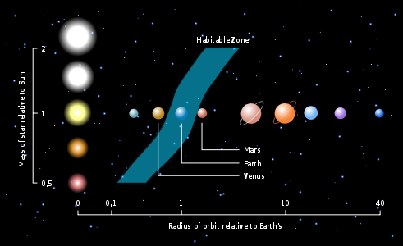
6th Grade LO
LO: We will investigate what characteristics it takes for life in space through completion of a foldable.
7.9(A) analyze the characteristics of objects in our solar system that allow life to exist such as the proximity of the Sun, presence of water, and composition of the atmosphere; and

Slide 10
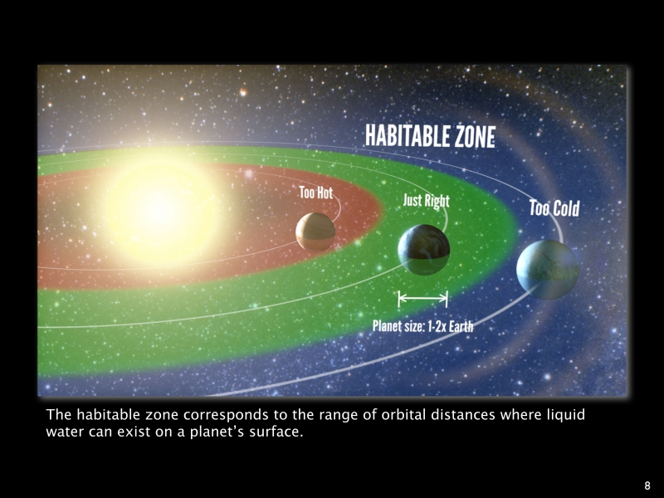
6th Grade DOL
I will complete written STAAR type questions over characteristics of life in space via a DOL quiz.

Slide 11
6th Grade Characteristics of Life in Space
As of today, Earth is the only know planet for actual life. Why Earth? What is so special about Earth in regards to everything else in our universe?
Pair share with our table neighbor / record answers in journal
Re-group as a class and discuss
Watch Video Clip below to Assist.
https://exoplanets.nasa.gov/resources/1062

