Slide 1
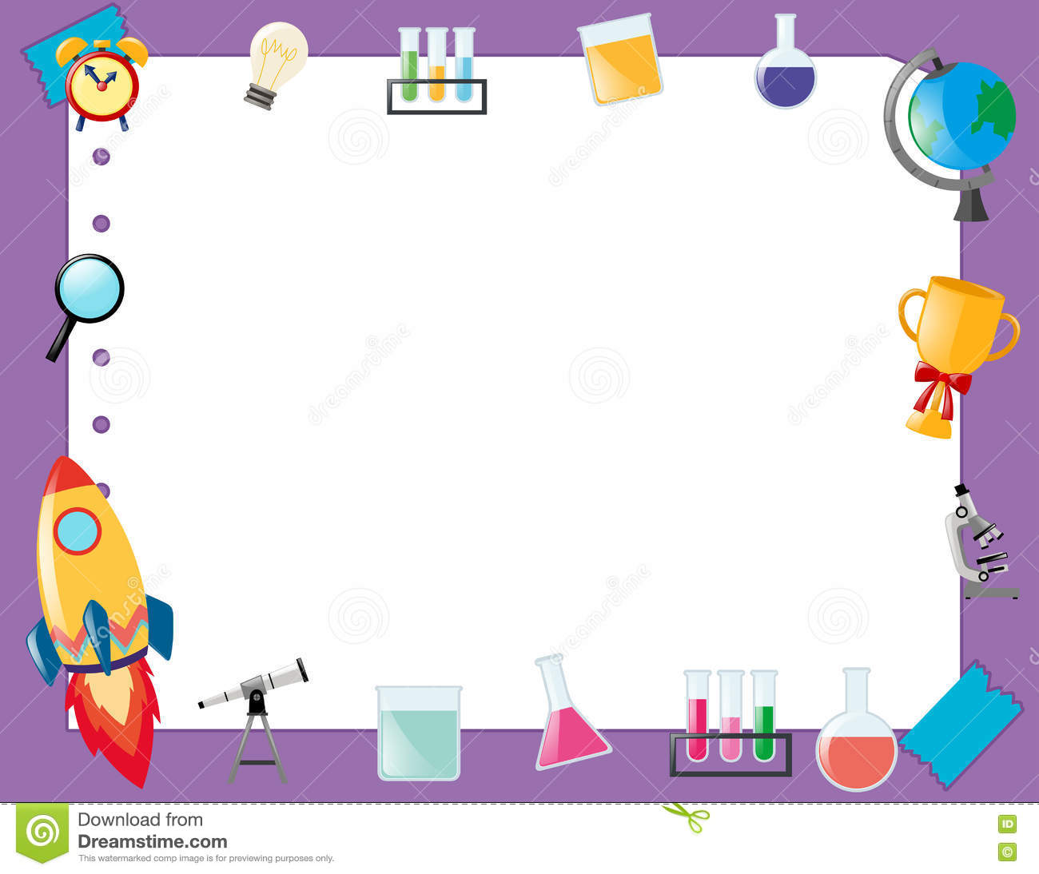
April 26, 2018
Collect PDN/DOL from basket
Turn off or silence Cell Phone NOW!!!
Sharpen Pencil
Sit in assigned seat
Complete PDN/DOL on own

Slide 2
Agenda
7th Grade
PDN
2. Finish Survival in Space Powerpoint
3. DOL
6th Grade
PDN
Finish Sexual/Asexual Reproduction foldable
DOL

Slide 3
LO’s
7th Grade
We will identify how astronauts survive in space.
6th Grade
We will compare/contrast sexual vs’ asexual reprocution.

Slide 4
DOL’S
7th Grade
I will complete 5/5 written assessment questions over people in space.
6th Grade
I will complete 5/5 questions over sexual/asexual reproduction.

Slide 5
TEK’S
7th Grade
7.9 (B) identify the accommodations, considering the characteristics of our solar system, that enabled manned space exploration
6th Grade
7.14 (B) compare the results of uniform or diverse offspring from sexual reproduction or asexual reproduction

Slide 6
7th Grade
Take out Journal
Turn to Next Empty Page
Write 4-25-18 at the top and “Survival in Space”
Teacher will pass out note outline page to be used along with power point.
Power Point Link: http://www.coachpease.com/resources/Survival%20in%20Space.pptx

Slide 7
6th Pre-AP Science
DOL
Collect Dol, Correct/Review as a class
Teacher will pass out foldable
Students will use textbook, power point notes to complete foldable over vocabulary.

Slide 8
6th Grade
Power Point Link:
http://www.coachpease.com/resources/asexual_vs._sexual_reproduction.ppt

