Slide 1
April 26, 2016 Please Do Now
Sharpen Pencil
Collect Please Do Now from blue basket, chrome book, clicker, pen/pencil that works
Take out Heredity/Genetics Foldable from Friday, make sure name is on it and turn it in.
Take out TEXTBOOK, Open the book to pg. Use this information to complete the Please Do Now (Remember that Clicker Grades go directly into gradebook, so Don’t Guess!)

Slide 2
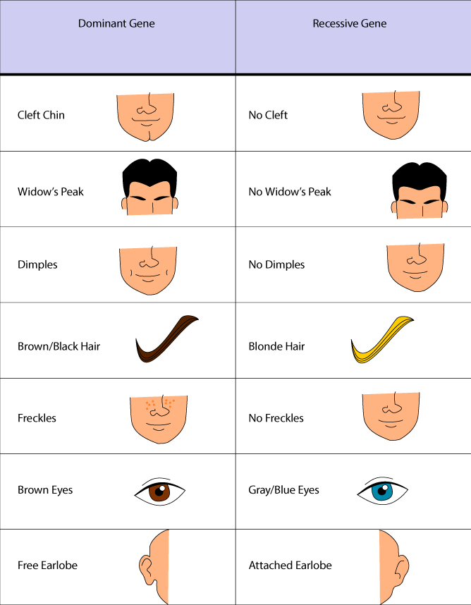
Agenda
Correct DOL from Yesterday
Please Do Now
Monster Babies Activity

Slide 3
Monday’s DOL/Exit Slip: Genetic Dominance
Directions: Complete the chart below by predicting the outcome of two fish below. (pg. 223)
Blue Fish
Yellow Fish
X
Answer Choice:
All Blue
½ Blue
All Yellow
½ Yellow
Green
(Blue Color is Dominant to Yellow)
Complete Dominance | Incomplete Dominance | Codominance
1. | 2. | 3.

Slide 4
Please Do Now: Punnett Square
Directions: Students will pick correct answer choice to answer the question/statement. Student will circle / click in correct answer. PG.230-237
# | Question / Statement To Answer | Answer Choice A | Answer Choice B
1 | What is a graphic used to predict the possible genotypes of offspring in a given cross? | Punnett Square | Graphic Organizer
2 | A Punnett square tells the ________ , the mathematical chance of a specific outcome in relation to the total number of possible outcomes. | Ratio | Probability
3 | Probability is show as a _________, an expression that compares two quantities. | Ratio | Probability
4 | Probability can be expressed as a ratio or as a __________. | Fraction | Percentage %
5 | What traces the occurrence of a trait through generations of a family? | Heritage | Pedigree
Name: _______________

Slide 5
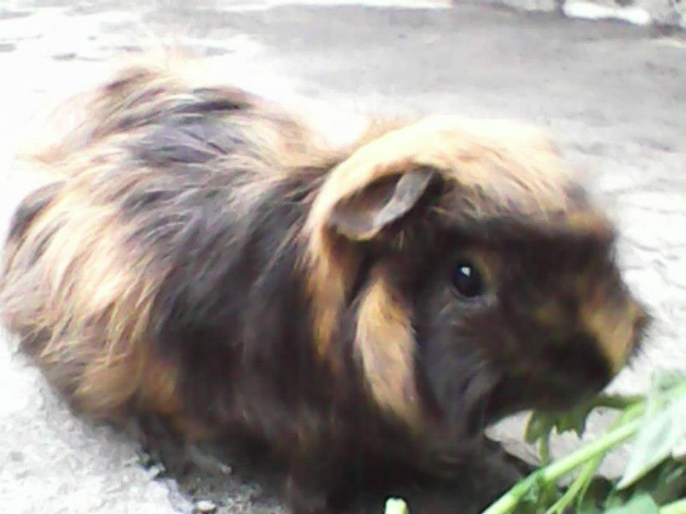
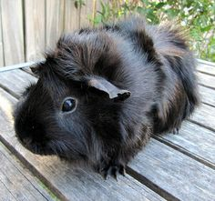
Essential Question
If we were to breed Sweetie to an homozygous dominant black male what do you think the phenotype of the young would be? What could you use to predict this outcome? How would you do it? Explain.
Bb

Slide 6
Video to assist with Essential Question
https://www.youtube.com/watch?v=prkHKjfUmMs
Students take notes as watch the video
Regroup and re-discuss question as a class

Slide 7
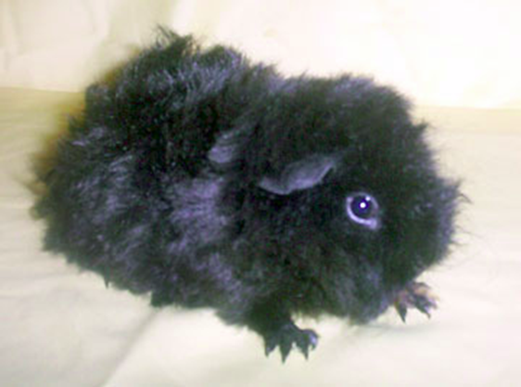
Sweetie's Sister who is Heterozygous Dominant (Bb) bred with a Homozygous Dominant Male (BB). What will the off springs genotype and phenotype be?
Phenotype
B
b
100
Black
B
B
B
B
b
0
White
Genotype
BB
50
B
B
B
B
b
Bb
50
??
??

Slide 8
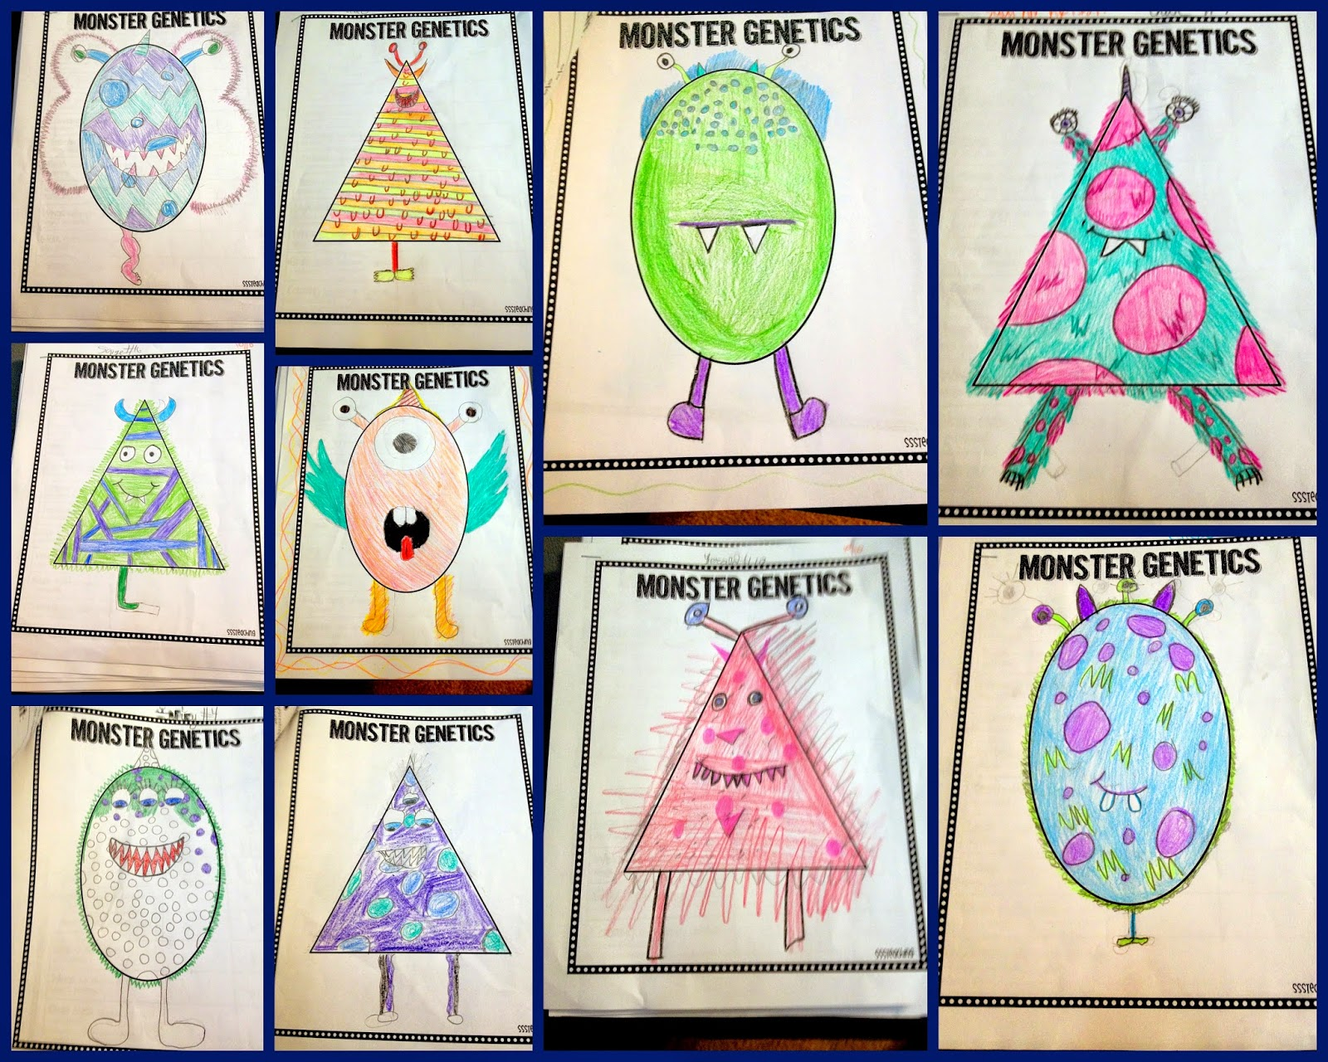
Monster Babies Activity
Teacher will pass out packet and explain directions to entire class as a whole

Slide 9
DOL/Exit Slip: Punnett Squares
Directions: Complete the Punnett Square Below (pg. 231 in textbook)
Genotype: __________________________________
Phenotype: __________________________________
 | R | r
R
r
Genotype:
______________________
Phenotype:
______________________
Genotype: ______________
Phenotype: ______________
Genotype: ______________
Phenotype: ______________
Genotype: ______________
Phenotype: ______________
Genotype: ______________
Phenotype: ______________

