Slide 1
April 25, 2016 Please Do Now
Sharpen Pencil
Collect Please Do Now from blue basket, chrome book, clicker, pen/pencil that works
Take out Heredity/Genetics Foldable from Friday, make sure name is on it and ready to be turned in
Take out TEXTBOOK, Open the book to pg. Use this information to complete the Please Do Now (Remember that Clicker Grades go directly into gradebook, so Don’t Guess!)

Slide 2
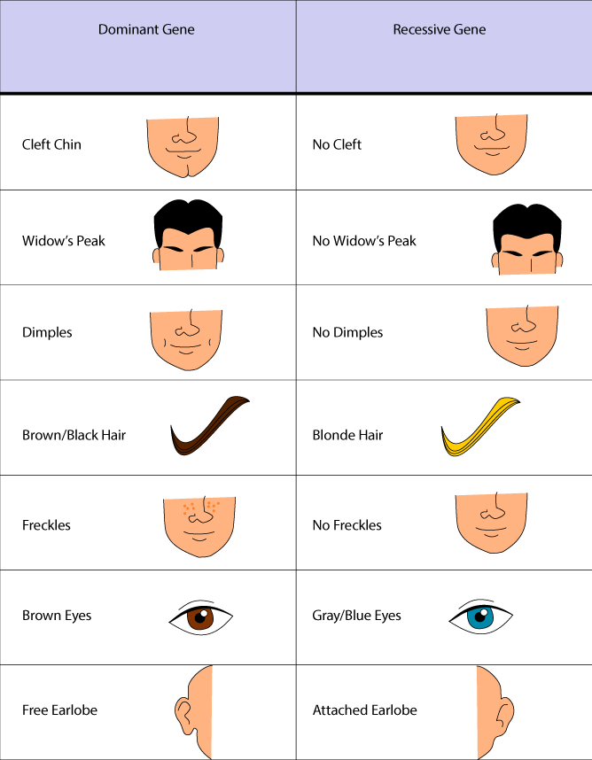
Agenda
Please Do Now
Review/Turn in Foldable
Monster Babies Activity

Slide 3
Please Do Now: Genetic Dominance
Directions: Students will pick correct answer choice to answer the question/statement. Student will circle / click in correct answer.
Monday
# | Question / Statement To Answer | Answer Choice A | Answer Choice B
1 | If an individual is heterozygous dominant it will always show the _________ trait. | Dominant | Recessive
2 | When one trait is completely dominant over another, we say it has _______ dominance. | Complete | Incomplete
3 | When each allele in a heterozygous individual influence it’s phenotype, we say it has __________ dominance. | Complete | Incomplete
4 | When both alleles in a heterozygous individual are contributing to the phenotype we day it shows _____________. | Codominance | Individual Dominance
5 | If a blue fish and a yellow fish breed and have all green babies, the babies would show__________. | Codominance | Individual Dominance
Name: _______________

Slide 4
Review/Grade Heredity / Genetics Foldable
Students will follow along with teacher to grade and correct their own foldable

Slide 6
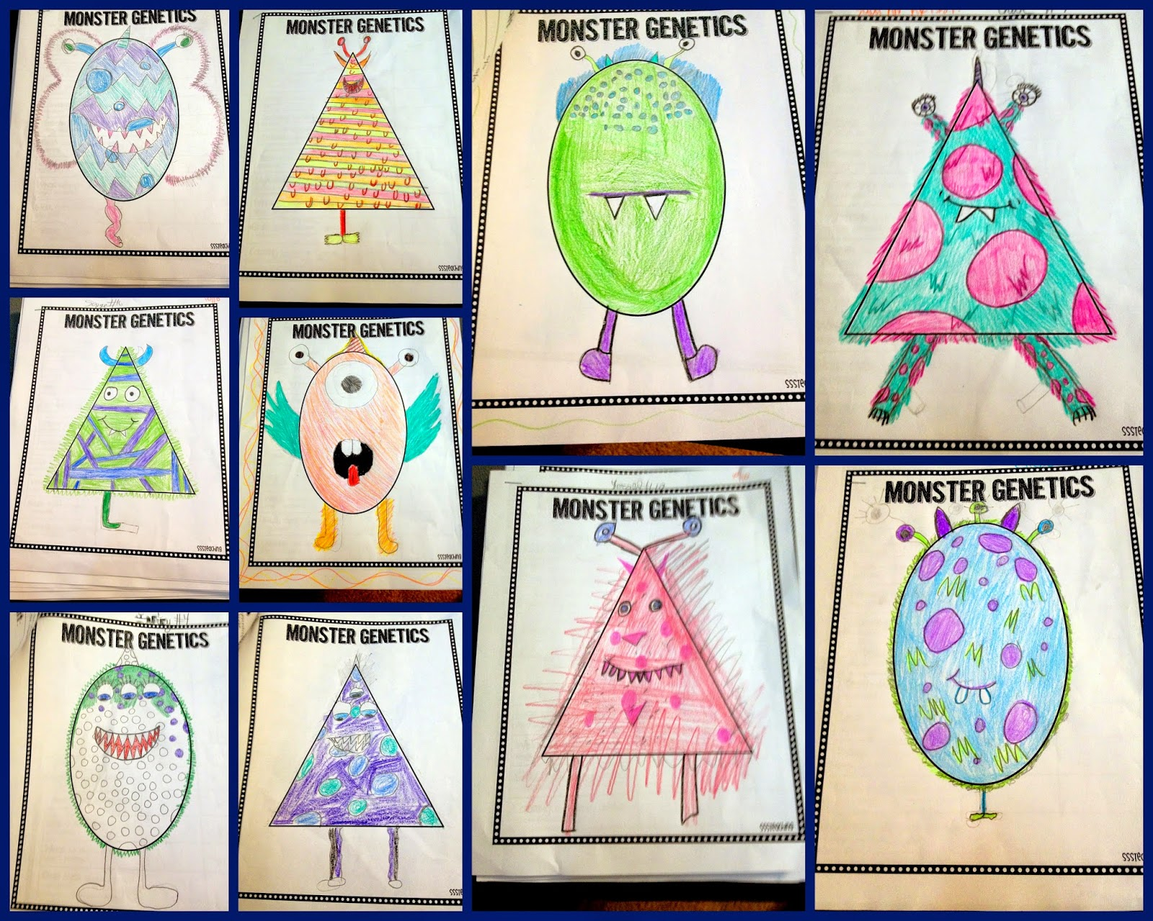
Monster Babies Activity
Teacher will pass out packet and explain directions to entire class as a whole

Slide 7
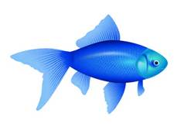
DOL/Exit Slip: Genetic Dominance
Directions: Complete the chart below by predicting the outcome of two fish below. (pg. 223)
Blue Fish
Yellow Fish
X
Answer Choice:
All Blue
½ Blue
All Yellow
½ Yellow
Green
(Blue Color is Dominant to Yellow)
Complete Dominance | Incomplete Dominance | Codominance
1. | 2. | 3.

