Slide 1
April 24, 2013
Sharpen Pencil
Collect PDN / DOL
Sit in assigned seat
Complete PDN / DOL

Slide 2
7th Grade Agenda
1. PDN Heredity
2. Heredity Video
3. Heredity Foldable
4. Heredity Task Cards
5. DOL

Slide 3
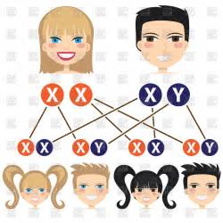
7th Grade TEK
7.14C recognize that inherited traits of individuals are goverened in the genetic material found in the genes within chromosomes in the nucleus

Slide 4
7th Grade Lo
We will investigate how heredity is effected by genes and chromosomes through completion of an inter-active foldable.

Slide 5
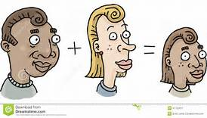
7th Grade DOL
I will complete written staar type assessment questions over heredity, and inherited genetics via a dol quiz.

Slide 6
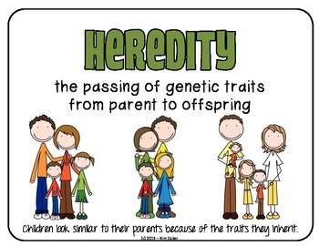
7th Grade Heredity Video Clip
https://youtu.be/Mehz7tCxjSE

Slide 7
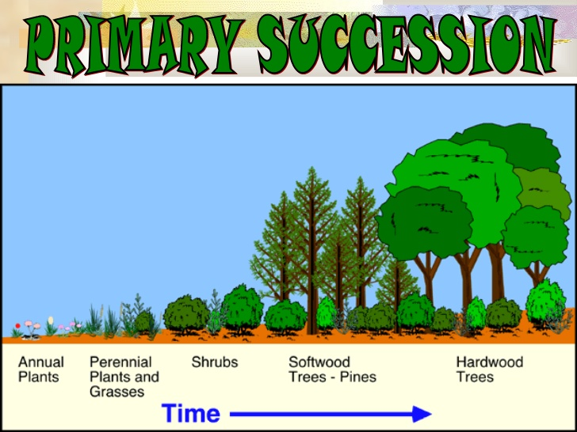
6th Grade Agenda
1. PDN Succession
2. Card Sort over Succession
3. Descriptive Sucession Poster
4. DOL

Slide 8
6th Grade TEK
7.10C observe, record, and describe the role of ecological succession such as a microhabitat of a garden with weeds.

Slide 9
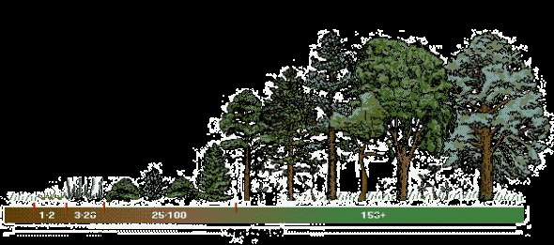
6th Grade LO
We will investigate how ecological succession can change the landscape of an area by completing a card sort activity.
TEK: 7.10C observe, record, and describe the role of ecological succession such as a microhabitat of a garden with weeds.

Slide 10
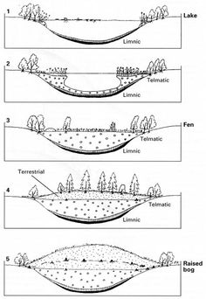
6th Grade DOL
I will complete written assessment questions over ecological succession via a dol quiz.

