Slide 1
April 21, 2016 Please Do Now
Sharpen Pencil
Collect Please Do Now from blue basket, clicker, chrome book, pen/pencil that works
Take out Textbook and complete please do now on own

Slide 2
Agenda
Please Do Now
DOL
Video Clip
Complete Mendelism Genetics Note Outline
Exit Slip.

Slide 3
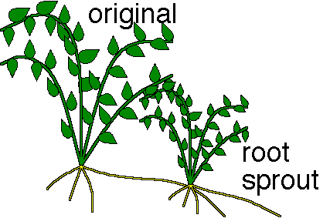
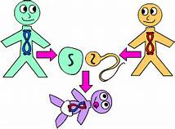
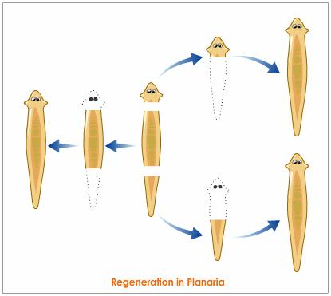
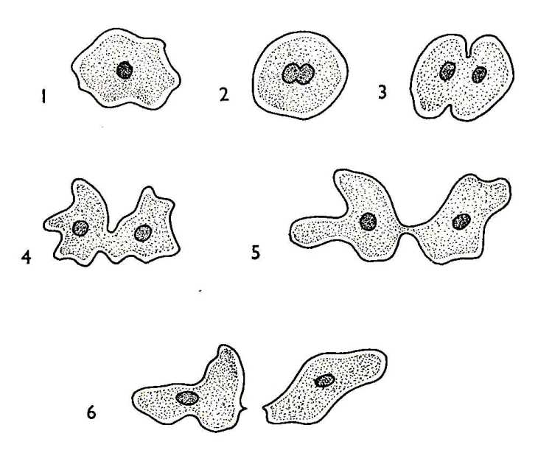
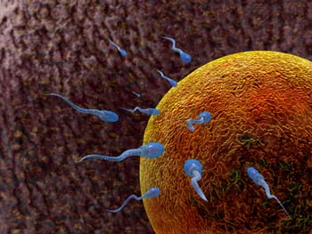
Name the type of reproduction (asexual or sexual) seen in each of the pictures below. Click A for Sexual Reproduction and B for Asexual Reproduction Word Bank: A) Sexual Reproduction B) Asexual Reproduction
Name: __________________________________________________________ Class Period: ___
DOL/Exit Slip: Asexual/Sexual Reproduction
#1
#2
#3
Wednesday
#5
#4

Slide 4
Name: __________________________________________________________ Class Period: ___
Please Do Now: Heredity
Directions: Read pgs. 216-217 aloud as a group. Use information collected to complete questions below
# | Question / Statement to Answer | Answer Choice A | Answer Choice B
1 | The passing of genetic material from parents to offspring is called _____________. | Heredity | Genetics
2 | Who is know for doing the first major experiments that investigated heredity? | Albert Einstein | Gregor Mendel
3 | These characteristics that Mendel studied had two different forms. These different forms, such as green or yellow pea color are called______. | Traits | Features
4 | Gregor found that a __________ plant will always produce offspring with a certain trait when allowed to self pollinate. | True-Breeding | Traits
5 | Mendel studied different features that formed in a population. These features are called_____________. | Characteristics | Traits
Thursday

Slide 5
Essential Question:
Have you ever heard that you have your mother’s eyes, or your father’s nose? Why do you think this is? What do you think causes this? Explain.

Slide 6
Gregor Mendel / Genetics
https://www.youtube.com/watch?v=MhNWI7KVJh4

Slide 7
Complete This Weeks Play List
4. Heredity / Mendel Genetics Note Outline
5. Heredity / Mendel Genetics Foldable
Resources to Assist: Journal Notes, power points, textbooks, www.coachpease.com, www.marshscience6.blogspot.com

Slide 8
Name: __________________________________________________________ Class Period: ___
Dol/Exit Slip: Heredity
Directions: Read pgs. 216-217 aloud as a group. Use information collected to complete questions below
# | Question / Statement to Answer | Answer Choice A | Answer Choice B
1 | Gregor Mendel is know for the study of _____________. | Diseases | Genetics
2 | Mendel’s 1st generation produced all green peas. Green pea color is the ________ , stronger trait. | Dominant | Recessive
3 | Mendel called the weaker yellow pea color the ____________ trait because it seemed to fade away. | Dominant | Recessive
4 | Gregor found that a __________ plant will always produce offspring with a certain trait when allowed to self pollinate. | True-breeding | Traits
5 | These characteristics that Mendel studied had two different forms. These different forms, such as green or yellow pea color are called______. | Self-Pollinate | Traits
Thursday

