Slide 1
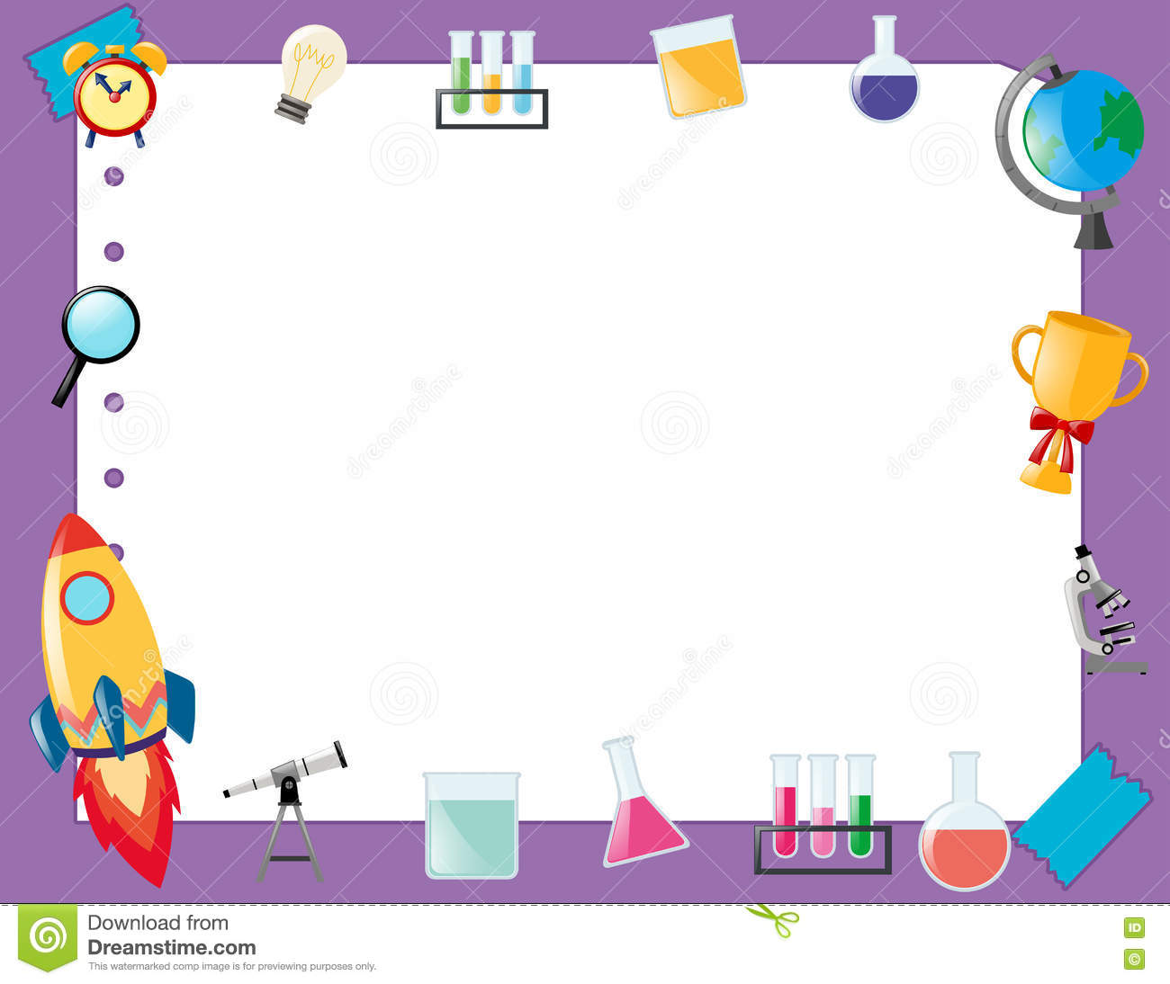
April 19, 2018
Collect PDN from basket
Turn off or silence Cell Phone NOW!!!
Sharpen Pencil
Sit in assigned seat
Complete PDN on own

Slide 2
Agenda
7th Grade
PDN
2. Solar System Kahoot
3. DOL
6th Grade
PDN
Finish Digestive System Foldable
DOL

Slide 3
LO’s
7th Grade
We will identify different objects found in our solar system.
6th Grade
We will identify the structures/functions of the digestive system

Slide 4
DOL’S
7th Grade
I will complete 5/5 written assessment questions over the solar system.
6th Grade
I will complete 5/5 questions over the digestive system.

Slide 5
TEK’S
7th Grade
7.9 (B) identify the accommodations, considering the characteristics of our solar system, that enabled manned space exploration
6th Grade
7.12(B) identify the main functions of the systems of the human organism, including the circulatory, respiratory, skeletal, muscular, digestive, excretory, reproductive, integumentary, nervous, and endocrine systems

Slide 6
7th Grade
Take out Journal
Turn to Next Empty Page
Write 4-20-18 at the top and “The Solar System”
Teacher will assign groups and pass out chrome books
https://play.kahoot.it/#/?quizId=548d7cab-50f1-436d-a695-efc6fc55600b
Students log in to www.Kahoot.it
Students will type in code ______________________
Team Name: First Name of each player on team
As play the game, will write out the question and correct answer to assist with studying.

Slide 7
6th Pre-AP Science
PDN
Collect Chrome Book, 1 per table
Log in to www.coachpease.com
Click on 6th 6 Weeks
Go to 6th Grd Column
Click on Digestive System Power Point
Use the power point notes to complete foldable

Slide 8
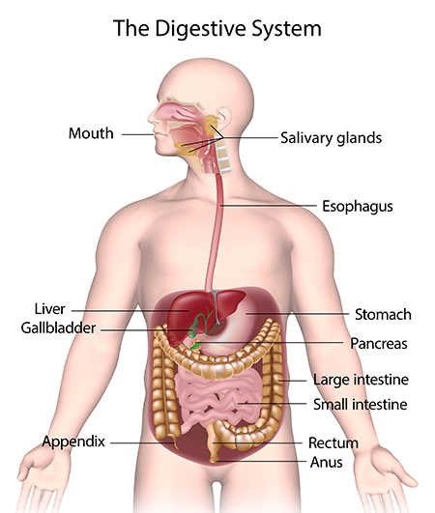
6th Grade

