Slide 1

April 20, 2017
Sharpen Pencil
Collect PDN / DOL, 7th Grade Textbook
Sit in assigned Seat
Complete PDN / DOL

Slide 2
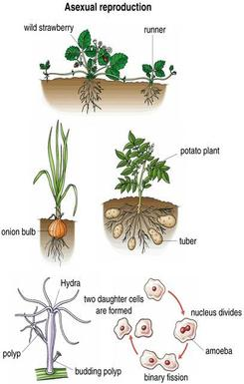
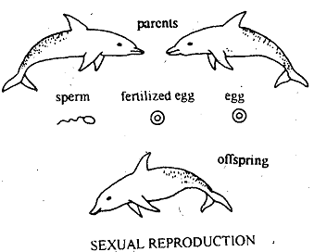
7th Grade Agenda
1. PDN
2. Sexual / Asexual Reproduction Foldable
3. Sexual / Asexual Reproduction Task Cards
DOL Quiz

Slide 3
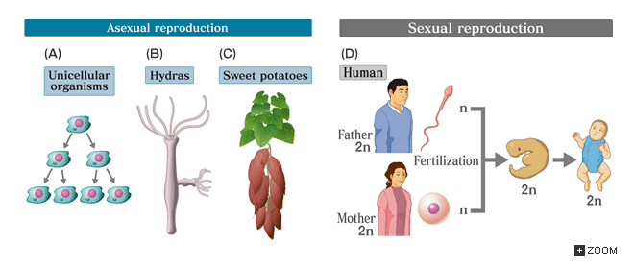
7th Grade TEKS
7.14B compare the results of uniform or diverse offspring from sexual reproduction or asexual reproduction

Slide 4
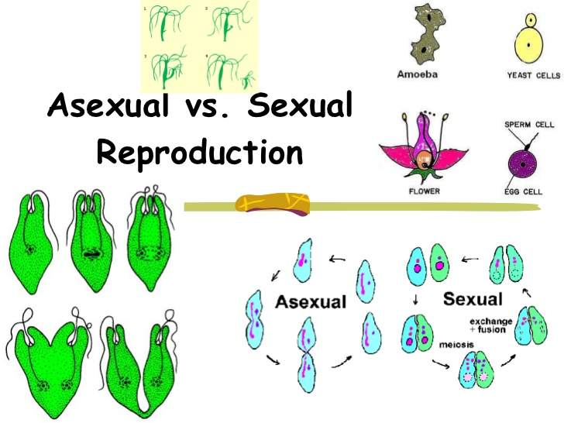
7th Grade Lo
We will compare/contrast the function of sexual and asexual reproduction through completion of an inter-active foldable.
  7.14B compare the results of uniform or diverse offspring from sexual reproduction or asexual reproduction

Slide 5
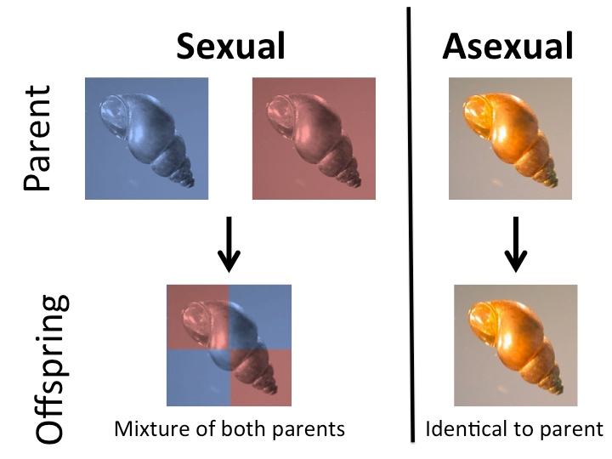
7th Grade DOL
I will complete written STAAR type assessment questions over sexual / asexual reproduction via a DOL quiz.

Slide 6
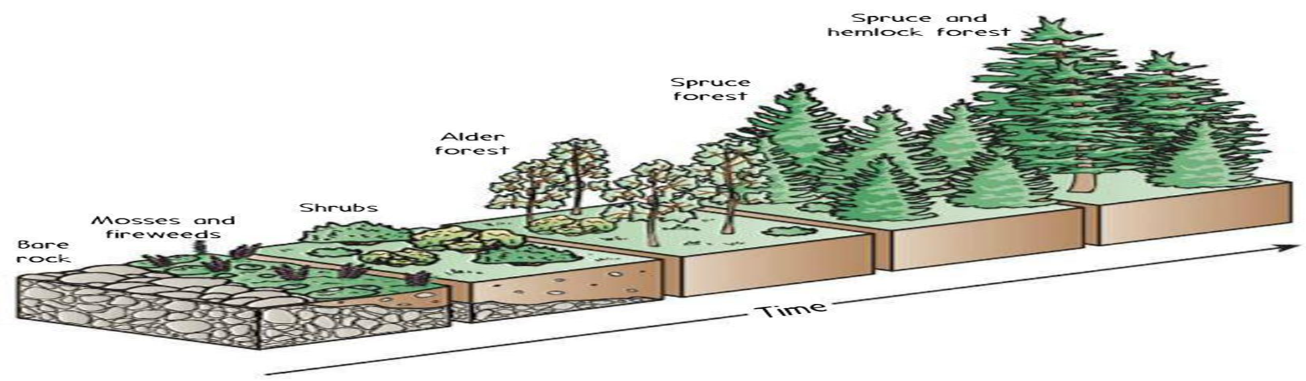
6th Grade Agenda
1. PDN
2. Ecological Succession Video
3. Ecological Succession Foldable
5. DOL

Slide 7

6th Grade TEKS
TEK: 7.10C Observe, record, and escribe the role of ecological succession such as a microhabitat of a garden with weeds.

Slide 8
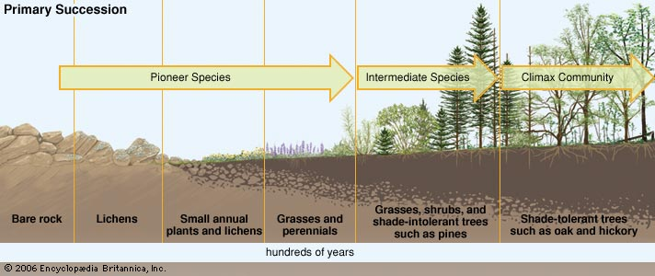
6th Grade LO
LO: We will investigate what ecological succession is through completion of a foldable.
TEK: 7.10C Observe, record, and escribe the role of ecological succession such as a microhabitat of a garden with weeds.

Slide 9
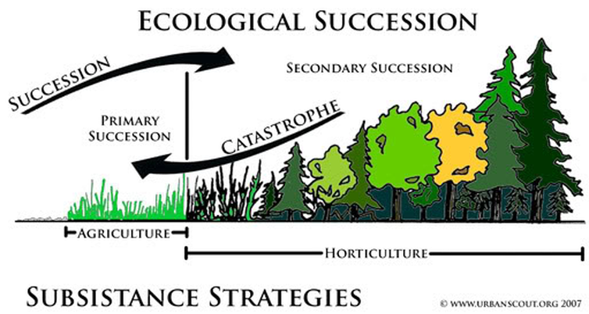
6th Grade DOL
I will complete written STAAR type questions over ecological succession via a DOL quiz.

Slide 10
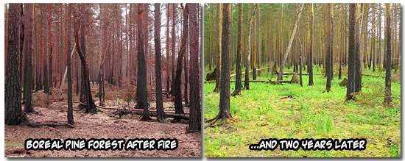
6th Grade Succession Photo

Slide 11
6th Grade Ecological Succession Video
https://www.youtube.com/watch?v=VTQU-rXIGGY

