Slide 1
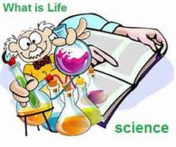
April 19, 2017
Sharpen Pencil
Collect PDN, 7th Grade Textbook
Sit in assigned Seat
Open Textbook, READ to answer PDN

Slide 2
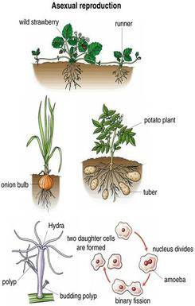
7th Grade Agenda
1. PDN
2. Finish Sexual / Asexual Reproduction Foldable
3. DOL Quiz

Slide 3
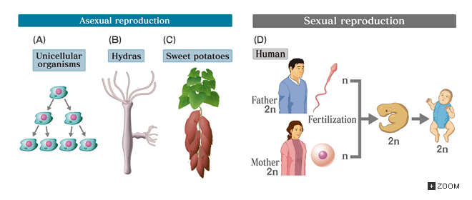
7th Grade TEKS
7.14B compare the results of uniform or diverse offspring from sexual reproduction or asexual reproduction

Slide 4
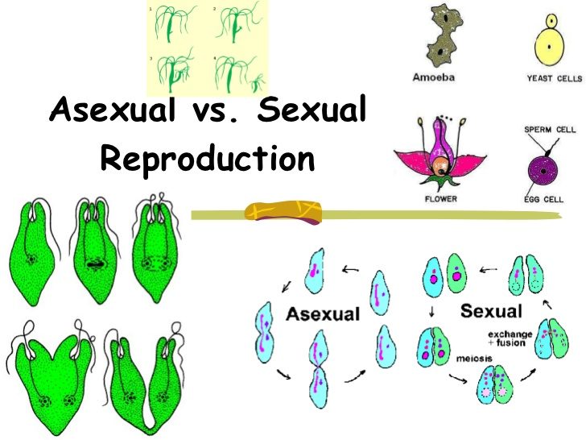
7th Grade Lo
We will compare/contrast the function of sexual and asexual reproduction through completion of an inter-active foldable.
7.14B compare the results of uniform or diverse offspring from sexual reproduction or asexual reproduction

Slide 5
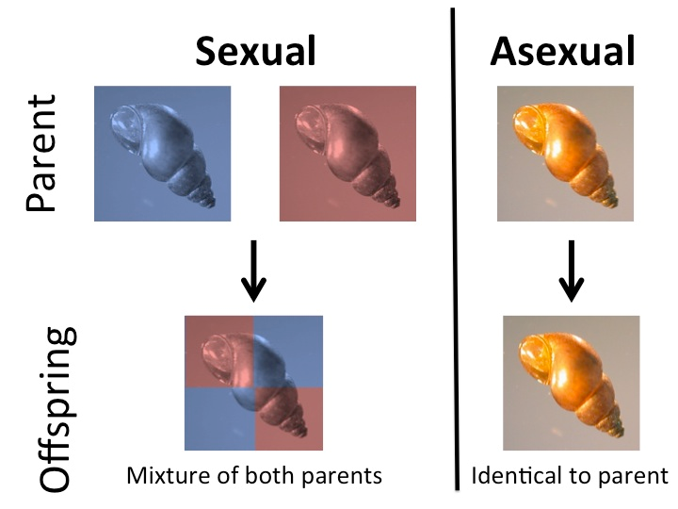
7th Grade DOL
I will complete written STAAR type assessment questions over sexual / asexual reproduction via a DOL quiz.

Slide 6
6th Grade Agenda
1. PDN
2. Finish Biodiversity Foldable
3. DOL

Slide 7
6th Grade TEKS
7.10B Describe how biodiversity contributes to the sustainability of an ecosystem.

Slide 8
6th Grade LO
We will investigate what biodiversity is through completion of an inter-active foldable.
7.10B Describe how biodiversity contributes to the sustainability of an ecosystem.

Slide 9
6th Grade DOL
I will complete written STAAR type questions over biodiversity via a DOL quiz.

