Slide 1
April 18, 2018
Collect PDN/DOL from basket
Turn off or silence Cell Phone NOW!!!
Sharpen Pencil
Sit in assigned seat
Complete PDN/DOL on own

Slide 2
Agenda
7th Grade
PDN
2. 3. Habitable Zone Poster
3. DOL
6th Grade
PDN
Finish Homeostasis Virtual lab
Internal Stimuli Quiz
DOL

Slide 3
LO’s
7th Grade
We will create a diagram to show what / where the zone of habitability is in space.
6th Grade
We will determine how internal stimuli effect homeostasis.
(If Finish Early)
We will identify the structures/functions of the digestive system

Slide 4
DOL’S
7th Grade
I will complete 5/5 written assessment questions over zone of habitability.
6th Grade
I will complete 8/8 questions over homeostasis/internal stimulus.

Slide 5
TEK’S
6th Grade
7.13B describe and relate responses in organisms that may result from internal stimuli such as wilting in plants and fever or vomiting in animals that allow them to maintain balance
7.12(B) identify the main functions of the systems of the human organism, including the circulatory, respiratory, skeletal, muscular, digestive, excretory, reproductive, integumentary, nervous, and endocrine systems
7th Grade
7.9 Earth and space. The student knows components of our solar system. The student is expected to:
(A) analyze the characteristics of objects in our solar system that allow life to exist such as the proximity of the Sun, presence of water, and composition of the atmosphere

Slide 6
7th Grade Zone of Habitability Poster
Collect blank paper
Take out habitable zone notes/foldable
Collect Textbook, Colors
Create a poster to illustrate/describe the zone of habitability
Must include:
Title
Map to show location in solar system
Label each planet / star
Label the zone of habitability
Describe what the zone is
Describe why some planets are/are not in it, why Earth is

Slide 7
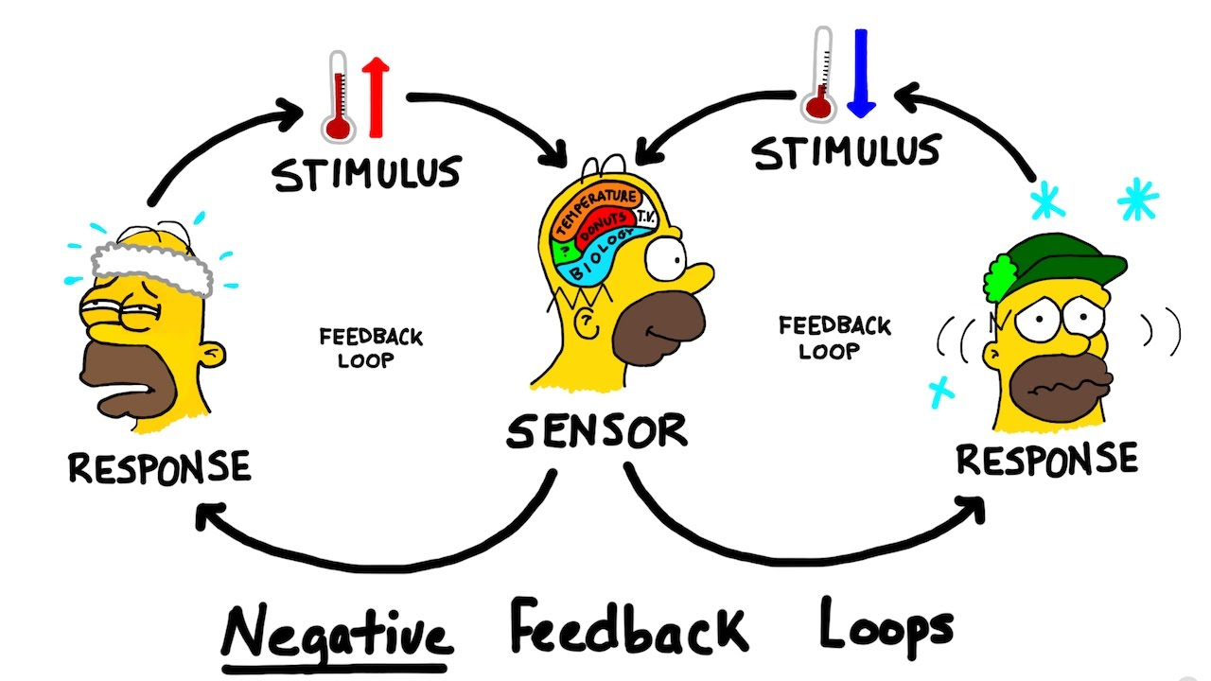
6th Pre-AP Science
PDN
Homeostasis Complete note outline as follow along with virtual lab

Slide 8
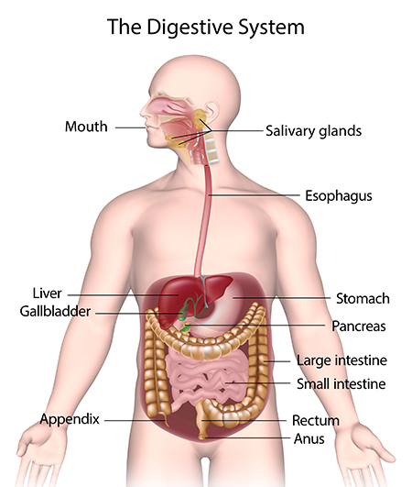
6th Grade Digestive System
Kids Health Video / Complete questions on quiz for video
Teacher Hands Out Foldable
Students use textbook, kidshealth.org and power points to complete on own

