Slide 1
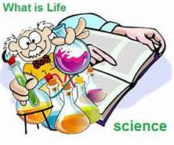
April 18, 2017
Sharpen Pencil
Collect PDN, 7th Grade Textbook
Sit in assigned Seat
Open Textbook, READ to answer PDN

Slide 2
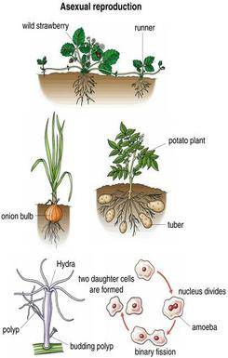
7th Grade Agenda
1. PDN
2. Sexual / Asexual Reproduction Video
3. Sexual / Asexual Reproduction Foldable
4. DOL Quiz

Slide 3
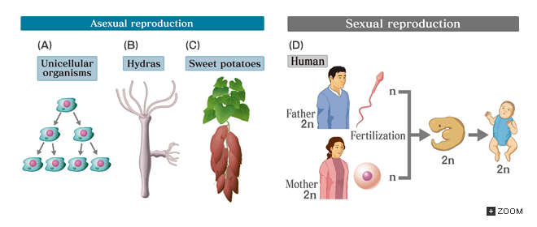
7th Grade TEKS
7.14B compare the results of uniform or diverse offspring from sexual reproduction or asexual reproduction

Slide 4
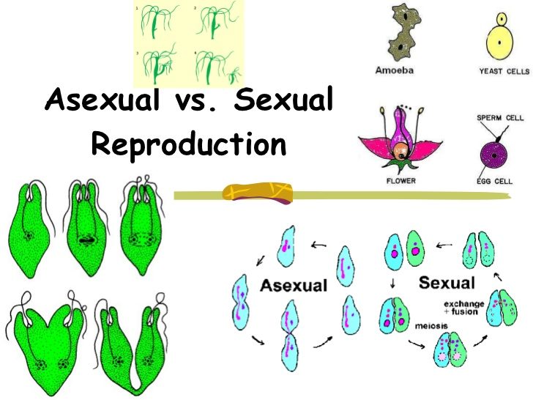
7th Grade Lo
We will compare/contrast the function of sexual and asexual reproduction through completion of an inter-active foldable.
7.14B compare the results of uniform or diverse offspring from sexual reproduction or asexual reproduction

Slide 5
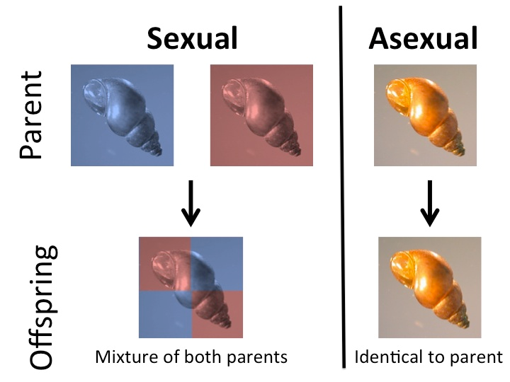
7th Grade DOL
I will complete written STAAR type assessment questions over sexual / asexual reproduction via a DOL quiz.

Slide 6
7th Grade Sexual / Asexual Reproduction Essential Question
Last fall Coach Pease planted Morning Glory seeds and added water to the soil. As time went on they grew and we were able to watch them grow, flower and then die. When taking down the dead plant we were able to collect the seeds left behind on the plant. We planted these new seeds and now we have new growth. What happened between when we planted the first set of seeds last fall then the new seedlings we now have growing? Do you think they will identical to the parent plant or have slight genetic differences? Explain.
http://study.com/academy/lesson/asexual-versus-sexual-reproduction.html

Slide 7
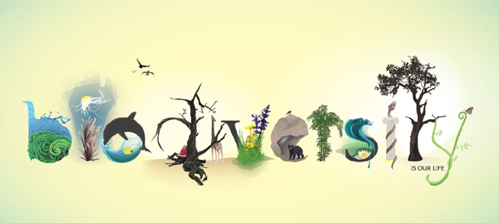
6th Grade Agenda
1. PDN
2. Land Plot Observation
3. Biodiversity Video
4. Biodiversity Foldable
5. DOL

Slide 8
6th Grade TEKS
7.10B Describe how biodiversity contributes to the sustainability of an ecosystem.

Slide 9
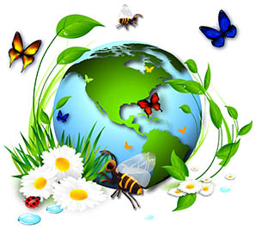
6th Grade LO
We will investigate what biodiversity is through completion of an inter-active foldable.
7.10B Describe how biodiversity contributes to the sustainability of an ecosystem.

Slide 10
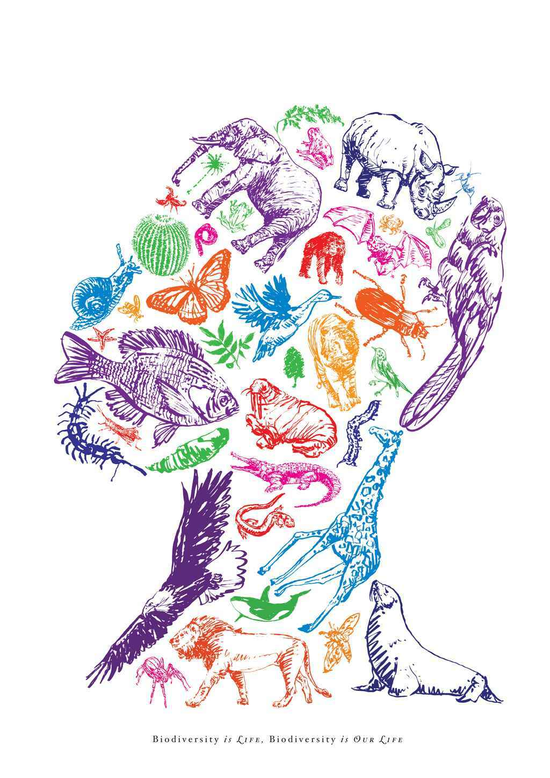
6th Grade DOL
I will complete written STAAR type questions over biodiversity via a DOL quiz.

Slide 11
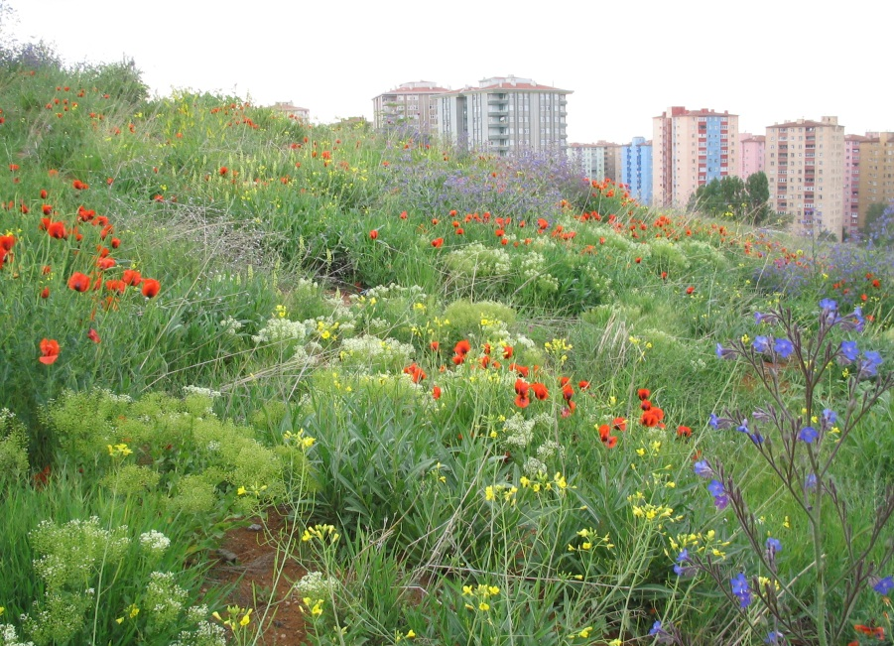
6th Grade Land Plot Photo

Slide 12
6th Grade Biodiversity Video
http://study.com/academy/lesson/what-is-biodiversity-definition-and-relation-to-ecosystem-stability.html

