Slide 1
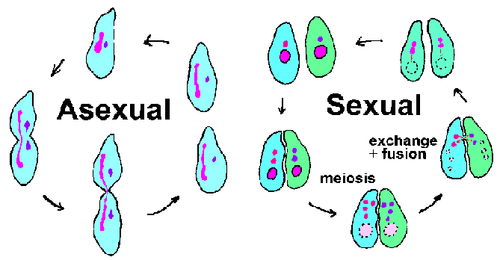
April 18, 2016 Please Do Now
Sharpen Pencil
Collect Please Do Now, clicker, chrome book, pen/pencil that works
Open Textbook and complete Please Do Now (remember by using clicker you grade is automatically put into grade book, so don’t guess)

Slide 2
Please Do Now
Grade DOL from Friday
Essential Question
Video
Asexual / Sexual Reproduction Note Outline

Slide 3
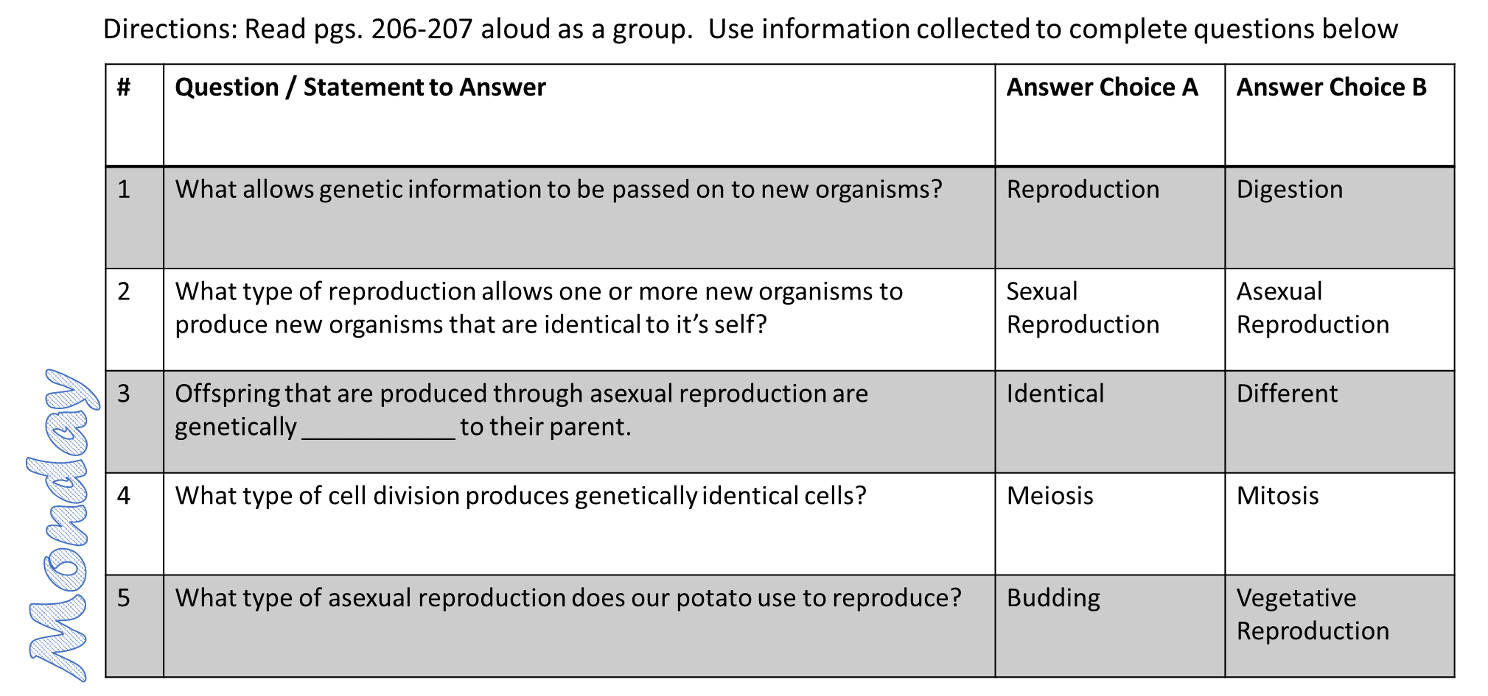

Slide 4
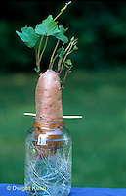
Essential Question:
We were able to create a new potato plant by putting it in water, but we only used one parent to accomplish it. How is this possible? How is this the same or different from how humans are produced? Explain

Slide 5
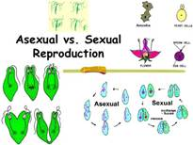
Asexual / Sexual Reproduction Video
https://www.youtube.com/watch?v=jk2RJm5RBEk

Slide 6
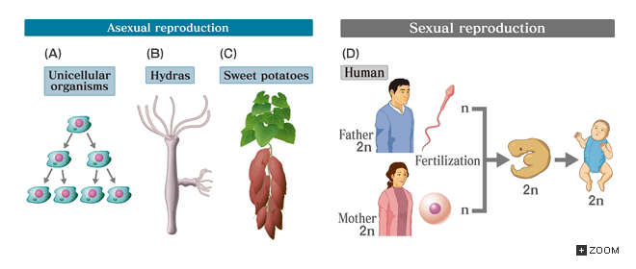
This Week’s Playlist
1. Asexual / Sexual Reproduction Note Outline
2. Asexual / Sexual Reproduction Poster
3. Heredity / Genetics Note Outline
4. Genetics Vocabulary Foldable
5. “Monster Babies”

Slide 7
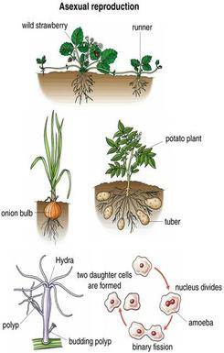
Asexual / Sexual Reproduction Note Outline
Teacher will pass out note outline
Students will login to chrome book
www.coachpease.com
6th 6 Weeks
Asexual sexual reproduction power point
http://sitebuilder.yola.com/restricted_view/site_design/8a4986cb37bc2ecf0137bd9fc638135d/resources/asexual_vs._sexual_reproduction.ppt

Slide 8
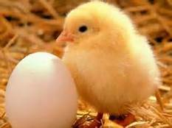
Exit Slip
Finish / Complete today’s Please Do Now
Will do the DOL on Tuesday
Study your notes from today!

