Slide 1
April 17, 2018
Collect PDN from basket
Turn off or silence Cell Phone NOW!!!
Sharpen Pencil
Sit in assigned seat
Complete PDN on own

Slide 2
Agenda
7th Grade
PDN
2. Finish Sustaining life in Space
3. Habitable Zone Poster
3. DOL
6th Grade
PDN
Homeostasis Virtual lab
DOL

Slide 3
LO’s
7th Grade
We will determine what is needed to sustain life in space.
6th Grade
We will determine how internal stimuli effect homeostasis.

Slide 4
DOL’S
7th Grade
I will complete 5/5 written assessment questions over sustaining life in space.
6th Grade
I will complete 5/5 questions over the homeostasis.

Slide 5
TEK’S
7th Grade
7.9 Earth and space. The student knows components of our solar system. The student is expected to:
(A) analyze the characteristics of objects in our solar system that allow life to exist such as the proximity of the Sun, presence of water, and composition of the atmosphere
6th Grade
7.13B describe and relate responses in organisms that may result from internal stimuli such as wilting in plants and fever or vomiting in animals that allow them to maintain balance

Slide 6
7th Grade Science
1. Collect Sustaining life note outling
2. Login to www.coachpease.com
3. Click on 6th 6 Weeks
4. Scroll to right side of screen, 7th grade column
5. Click on Habaitable Zone Power Point
6. Use information from the power point to complete handout for a grade

Slide 7
7th Grade Water Awareness Poster
Collect blank paper
Take out habitable zone notes/foldable
Collect Textbook, Colors
Create a poster to illustrate/describe the zone of habitbility
Must include:
Title
Map to show location in solar system
Label each planet / star
Label the zone of habitbility
Describe what the zone is
Describe why some planets are not in it, why Earth is

Slide 8
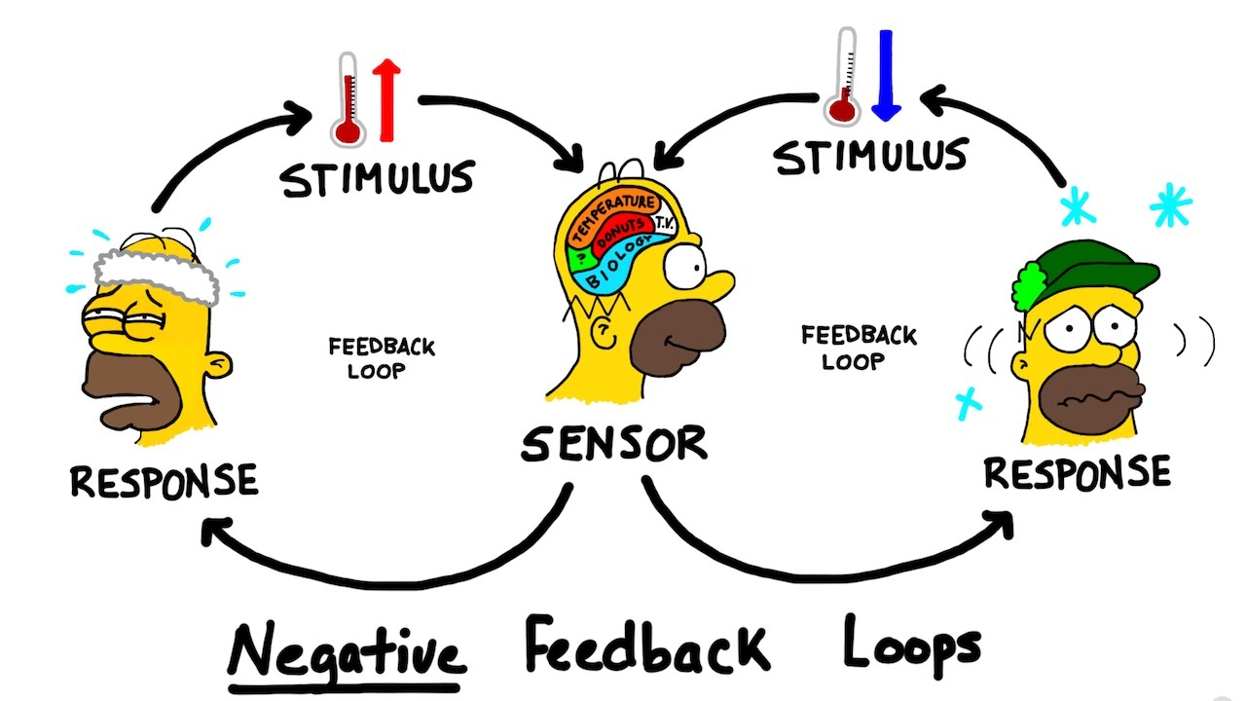
6th Pre-AP Science
PDN
Homeostasis Complete note outline as follow along with virtual lab

