Slide 1
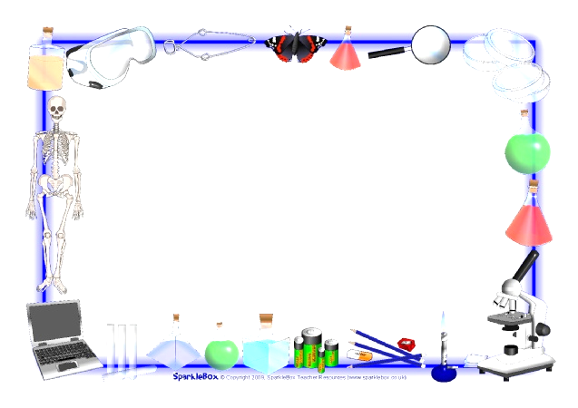
April 16, 2018
Collect PDN from basket
Turn OFF / PUT ON SILENCE your cell phone
Sharpen Pencil
Complete PDN on own

Slide 2
Agenda
7th Grade
PDN
Group K/W/L chart
Life in Space Power Point
DOL
6th Grade
PDN
Finish Endocrine System Foldable
DOL

Slide 3
LO
7th Grade
We will identify different factors that effect life in space.
6th Grade
We will identify the structures / functions of the endocrine system.

Slide 4
DOL
7th Grade
I will complete 5/5 written questions over sustaining life in space.
6th Grade
I will complete 5/5 questions over the endocrine system.

Slide 5
TEKS
6th Grade
7.12B(B) identify the main functions of the systems of the human organism, including the circulatory, respiratory, skeletal, muscular, digestive, excretory, reproductive, integumentary, nervous, and endocrine system(B) identify the main functions of the systems of the human organism, including the circulatory, respiratory, skeletal, muscular, digestive, excretory, reproductive, integumentary, nervous, and endocrine system(B) identify the main functions of the systems of the human organism, including the circulatory, respiratory, skeletal, muscular, digestive, excretory, reproductive, integumentary, nervous, and endocrine system
7th Grade
7.9A analyze the characteristics of objects in our solar system that allow life to exist such as the proximity of the Sun, presence of water, and composition of the atmosphere

Slide 6
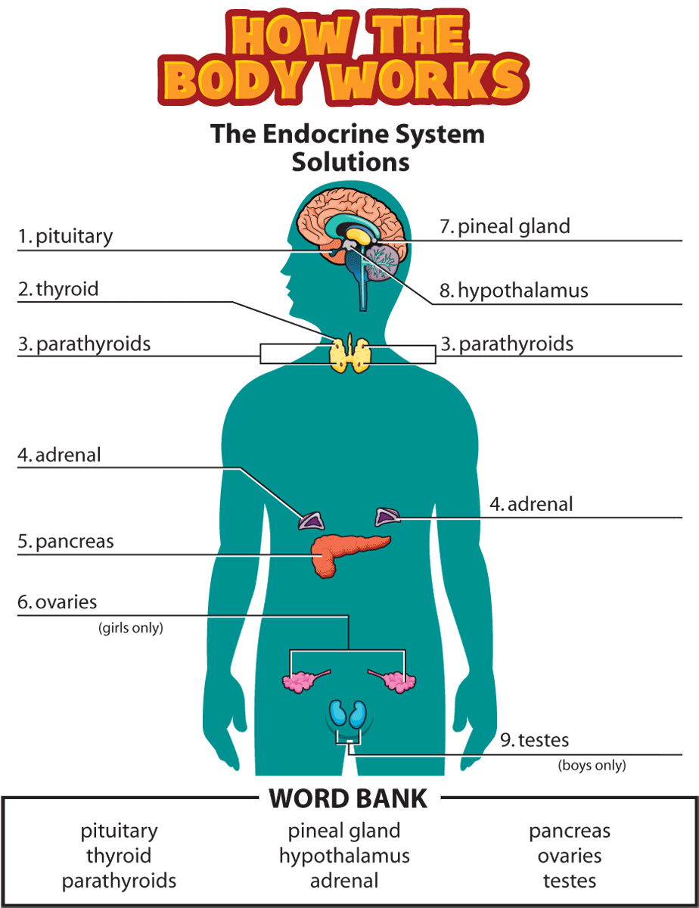
6th Grade
Complete PDN
Take out Endocrine System foldable (We started this on Friday.)
Follow along with power point to complete foldable
DOL / Quiz over endocrine and nervous system

Slide 7
7th Grade
Complete PDN
Class K/W/L Chart as a group
Video clip over Sustaining life In Space
4. Note Outline page over Space
5. DOL / Quiz over space

Slide 8
Answer this question in your own words on the back of your PDN:
“If you were to take a trip to any other planet in our solar system, not Earth would you be able to survive? Why or why not? Explain.”

Slide 9
1. Pair Share Answer to question with table partner , be sure to write down information on back of PDN
2. Re-Group / Discuss
3. Watch video clip to assist with answering question, take notes
Goldilocks Zone : National Geographic
https://www.youtube.com/watch?v=u2OlT9bECqg
4. Re-group and discuss new information
Goldilocks Zone : National Geographic
https://www.youtube.com/watch?v=u2OlT9bECqg
Goldilocks Zone Video:
https://www.youtube.com/watch?v=aeEiYkmkCdw
Earth: Why it has life on it.
https://www.youtube.com/watch?v=IDhapt7nw4A

Slide 10
Follow along with power point to complete note outline over Earth’s ability to sustain life
Teacher will hand out note outline over power point.
Complete outline as follow along with power point.

