Slide 1
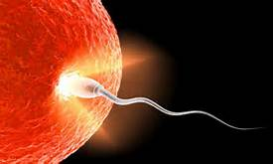
April 14, 2016 Please Do Now
Sharpen Pencil
Collect Please Do Now from blue basket, chrome book, clicker, pen/pencil that works
Use the textbook to complete the Please Do Now on your own.

Slide 2
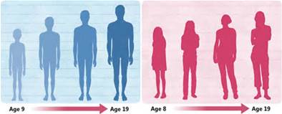
Agenda
Please Do Now
Essential Question
Video Clip
Reproductive System power point outline notes
DOL

Slide 3
Essential Question: TEK 7.12B
We all know that boys and girls are different in how their bodies are formed. Why is this? What is the purpose for these differences in the way that mammal bodies are formed? Do these differences occur in one particular body system? Which one?

Slide 4
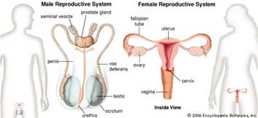
Kidshealth.com / Reproductive System
Take notes as watch clip to assist with answering essential question.
https://www.youtube.com/watch?v=ZpKlt1sHr4Q

Slide 5
Human Reproductive System Note Outline
Teacher will pass out note outline sheet
Students login to www.coachpese.com
Click on 5th 6 Weeks
Click on Human Reproductive System PowerPoint
Follow along with power point to complete note outline

Slide 6
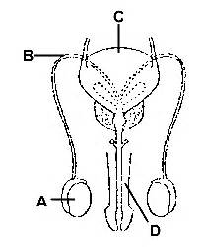
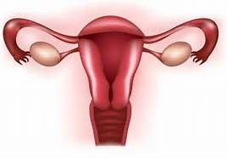
Dol / Exit Slip
Word Bank:
Sperm
Testes
Penis
Vas Deferens
Epididymis
Sex | Sex Cell / Gamete | Organ that Produces Gamete
Male | 1. | 2.
Sex | Sex Cell / Gamete | Organ that Produces Gamete
Female | 3. | 4.
Word Bank:
Egg
Uterus
Ovary
Vagina
Fallopian tube
10.
9.
5.
11.
6.
12.
8.

