Slide 1
April 13, 2018
Collect PDN from basket
Turn off or silence Cell Phone NOW!!!
Sharpen Pencil
Sit in assigned seat
Complete PDN on own

Slide 2
Agenda
7th Grade
PDN
2. Human Use of Water Web Quest
3. Water Awareness Poster
3. DOL
6th Grade
PDN
Endocrine System Video / Foldable
DOL

Slide 3
LO’s
7th Grade
We will identify different ways human actions can affect our watershed.
6th Grade
We will identify the structures and functions of the endocrine system.

Slide 4
DOL’S
7th Grade
I will complete 5/5 written assessment questions over watersheds.
6th Grade
I will complete 5/5 questions over the nervous and endocrine system.

Slide 5
TEK’S
7th Grade
7.8C (C) model the effects of human activity on groundwater and surface water in a watershed
6th Grade
7.12B (B) identify the main functions of the systems of the human organism, including the circulatory, respiratory, skeletal, muscular, digestive, excretory, reproductive, integumentary, nervous, and endocrine systems

Slide 6
7th Grade Science
1. Collect Water Web Quest, chrome book (1 per table)
2. Login to www.coachpease.com
3. Click on 6th 6 Weeks
4. Scroll to right side of screen, 7th grade column
5. Click on Water Web Quest Link
6. Use information from the web quest to complete handout for a grade

Slide 7
7th Grade Water Awareness Poster
Collect blank paper
Take out watershed / conservation notes/foldable
Collect Textbook, Colors
Create a poster to make the public aware of ways to protect our watershed.
Must include:
Title
Watershed function
What it is
How it effects for our water supply
3 Ways we can help to protect it

Slide 8
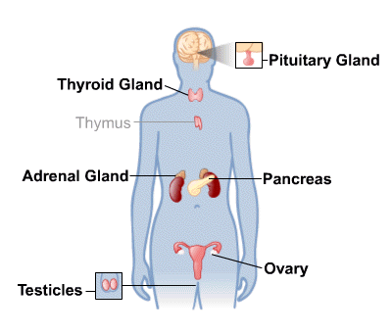
6th Pre-AP Science
PDN
Endocrine System Foldable Complete foldable as follow along with endocrine system power point and video

